Slide 1
Dressability Altering and adapting clothing for people of all ages with learning and/or physical disabilities, to reflect their personal style whilst maintaining independence and dignity
https://www.dressability.org.uk
01793 512878

Slide 2
Dressabilty
We provide specialist adaptation services, addressing the clothing needs of people with disabilities.
Innovative solutions to clothing challenges
Tailored clothing advice and information for clients of all age ranges
Adaptations provided on a heavily subsidised, low cost basis - or free at the point of delivery, dependent on need
Outreach service for clients who lack access to transport
Friendly and fully-accessible premises in West Swindon

Slide 3
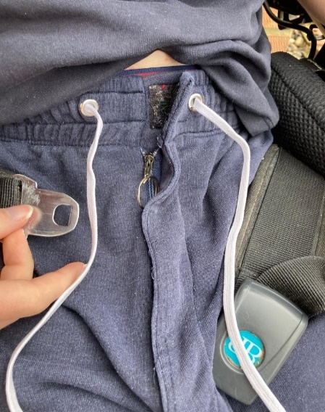
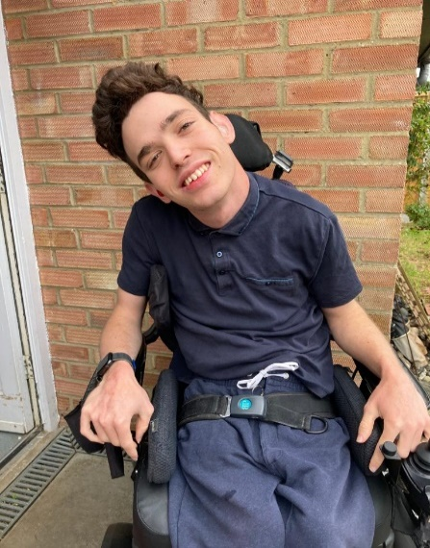
Theo was born in the year 2000 with Quadriplegic Cerebral Palsy and partial deafness. Theo began using Dressability’s service when he was at secondary school, as he needed to be able to dress himself independently.
Being able to use the toilet independently was a priority for Theo, recognising this Dressability were able to trial several different materials and fastenings before settling on an option that really worked for him.
Being away at university, these adaptations proved invaluable to Theo and many different trousers and shorts have been adapted along the way. Feedback from Theo has informed new ideas and ensured we’ve always found the best solutions. For instance, adding a ring pull to a zip or discrete ribbon making it easier to operate the zip, and replacing fiddly buttons with Velcro. Small adjustments make sitting in a chair for long periods more comfortable, Dressability have achieved this by removing the back pockets of trousers, a simple idea that makes a big difference to comfort levels.
We continue to support Theo, who says; ‘Dressability are so brilliant, because they know exactly how to adapt clothing without losing the look that we all buy new clothes for.

Slide 4
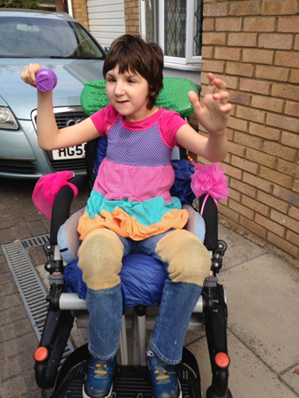
Rachel was born in 2004 with high muscle tone Cerebral Palsy and has a global learning delay. Rachel is unable to talk or operate a normal or electric wheelchair - meaning her only means of independent mobility is crawling on her knees - which she loves to do - never missing opportunity to venture out into the garden. However, Rachel's jeans were unable to withstand the impact of her crawling for very long meaning regular replacement was required - and she was experiencing problems with very sore knees. Rachel's mum approached Dressability for advice, who suggested adding padding and hard wearing knee patches to her jeans. Specialist materials were identified to provide an ideal solution. Rachel's mum's summing up of the adaptations made by the Charity as "small things that make a massive difference" encapsulates Dressability's simple aim - "to make people's lives better by making their clothes work for them".

Slide 5
Dressability Opening Times: Monday to Friday 10:00 am — 3:00 pm Clients are welcome to visit our friendly and fully accessible premises for a consultation or to pick up and drop off items of clothing - although to avoid disappointment, it is advisable to make an appointment. Alternatively, for clients who lack transport provision, we offer an outreach service covering a 25 mile radius from Swindon - to include parts of Wiltshire, Gloucestershire, Oxfordshire and Berkshire.
Dressability Address: Bradbury House, Westmead Drive, Swindon SN5 7ER We are on the upper floor of the MS Swindon Therapy Centre. We have disabled access if required

