Slide 1
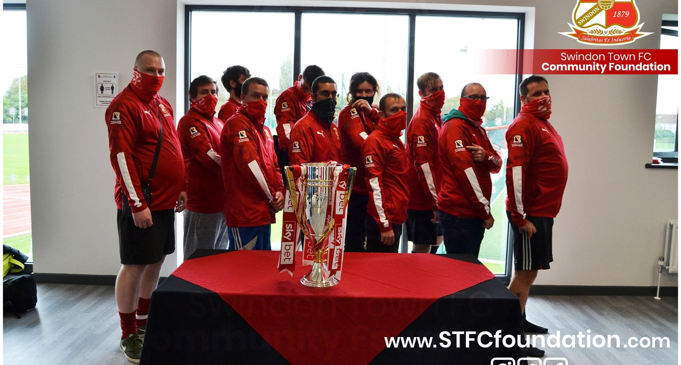
STFC Community foundation
Preparing for adulthood transitions roadshow

Slide 2
Who are we and what do we do?
We’re one of 72 charitable organisations funded by the efl, that deliver sporting and social opportunities to the local communities.
At the foundation we offer services for all ages from 18 months +
Our goal is to have a positive impact on as many people within the local community as we can, whether that be through football, sport or other services.

Slide 3
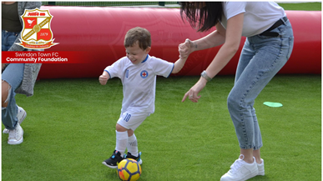
What do we offer to support your clients?
Pan-disability sessions
Special Olympics football
Super robins mental health team
Football fans in training

Slide 4
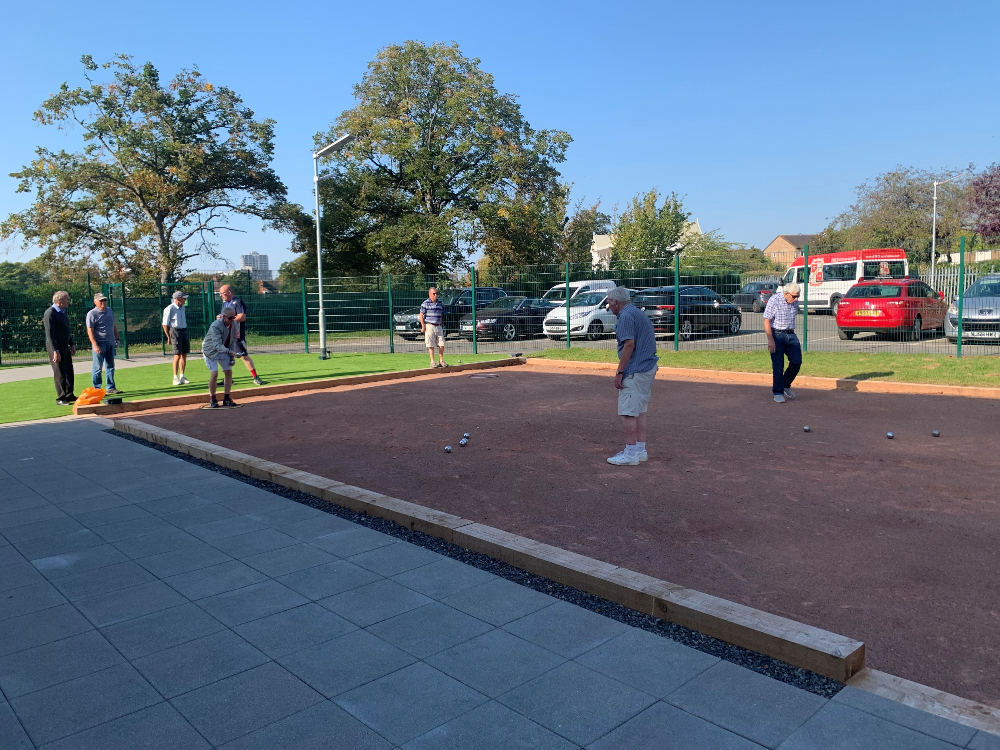
Pan-disability
Weekly football sessions for 6-16 year olds.
Designed to be fun and engaging while also teaching a range of new skills.
Held at the deanery school, wichelstowe every Wednesday evening 5-6pm.
Sessions cost £2 per week – paid by direct debit
Sessions can be accessed by e-mailing james sims on james.s@stfcfoundation.com

Slide 5
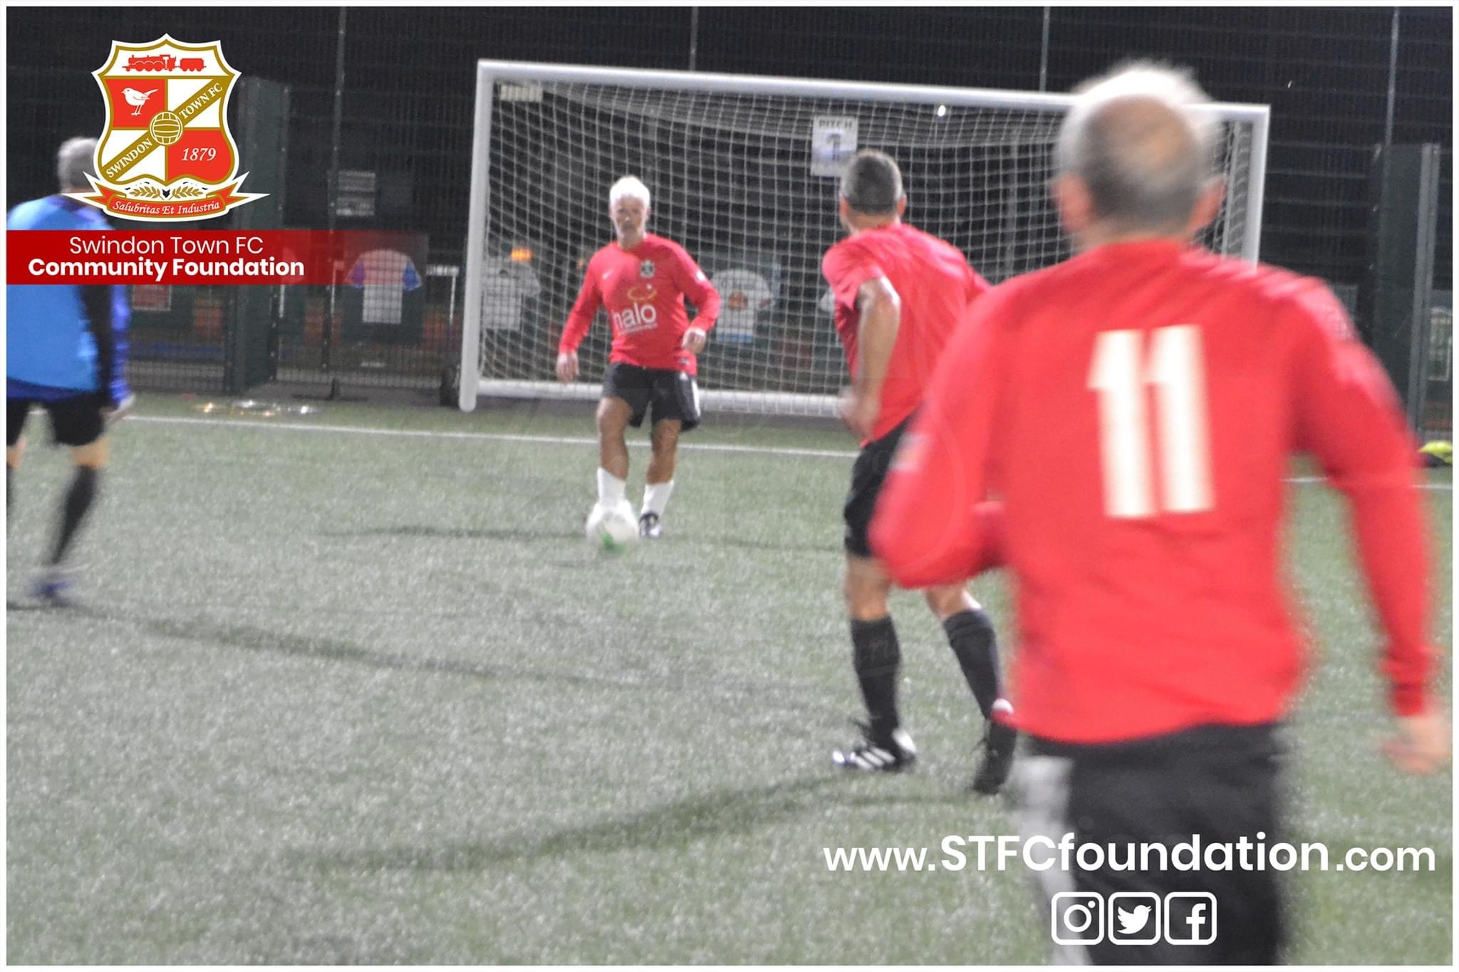
Adults disability team – stfc special olympics
Delivered for adults aged 16+ with additional needs. Formerly delivered by sbc.
Part of the wiltshire fa ability counts football league
Weekly sessions held at foundation park every Monday
Sessions cost £2 per week and are paid by direct debit via our online registration website
For more information please e-mail brad carter on brad@stfcfoundation.com

Slide 6
MENTAL HEALTH TEAM – SUPER ROBINS
Designed to help support the ongoing recovery of peoples mental health through football.
Sessions delivered in partnership with mind and the nhs avon and wiltshire partnership.
Sessions cost £2 per week which is paid via direct debit.
To access these sessions please contact james sims on james.s@stfcfoundation.com

Slide 7
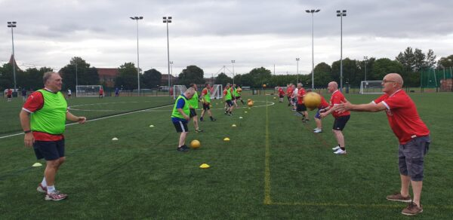
Football fans in training
Supported by public health England and Swindon borough council.
Weight management programme to help people lose weight, live a healthier lifestyle and change their lives for the better.
Very recently we have launched a pilot course for 18-35 year olds, which also supports an individuals social life.
For more information on this free of charge course, please e-mail aaron@stfcfoundation.com

Slide 8
any questions?

