Slide 1

In House Provider Services
Swindon Family Breaks
Building Independent Futures
Shared Lives
OK4U

Slide 2

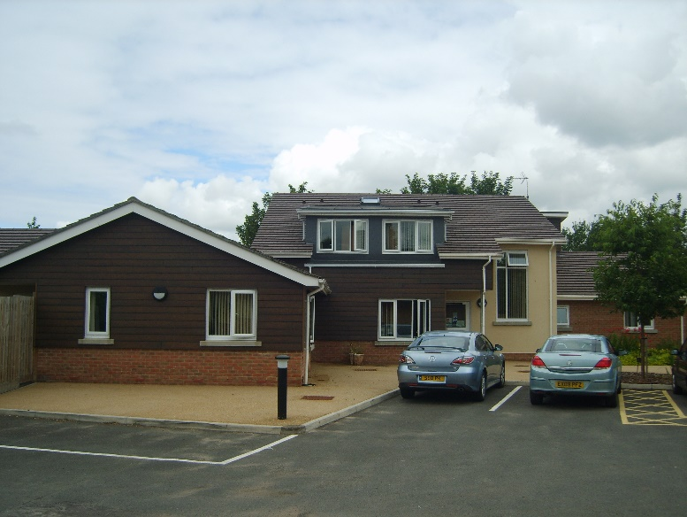
Swindon Family Breaks
Meeting people at Firethorn is good
Swindon Family Breaks is a respite service for people with learning disabilities over the age of 18 years.
2 houses with 7 bedrooms with ensuite shower rooms
An adapted bathroom is available for those with mobility problems
A TV with a DVD player in all bedrooms
All meals (including snacks) will be provided
Bespoke respite bungalow available
The staff are very kind and thoughtful

Slide 3
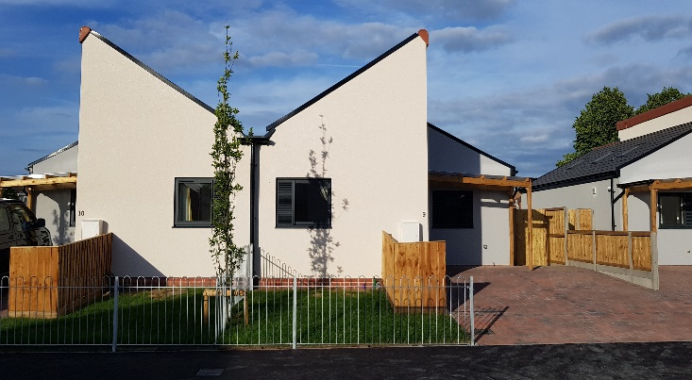
Building Independent Futures
Supporting people to live independently in their communities
Supporting people with their tenancies
Helping people to find employment, leisure and social activities
They are supportive when I need them. I love living in Firethorn Close
I feel safe, I have never felt so safe for many years
The activities I do are amazing and make me feel great
I am learning to be more independent

Slide 4
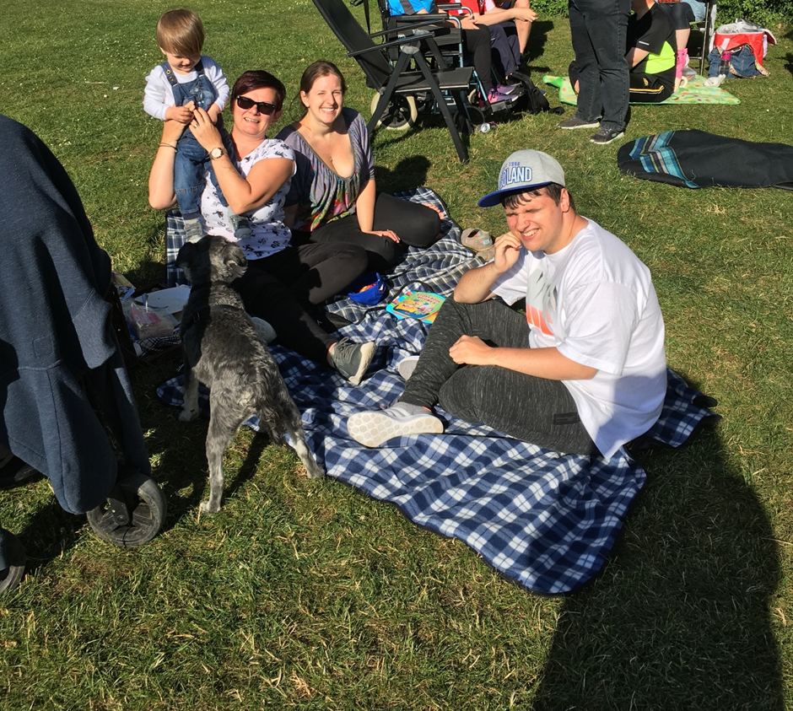
Shared Lives
They treat me like a member of their family. I like them
Adults who need support are matched with a compatible Shared Lives Carer who agrees to share their home, their family and community life.
I am more independent
I like living in my placement, I feel happy and secure
In Swindon we have two different types of service:
Live-in placements
Floating Support
They give me good advice and I feel supported to do the things that I want to do

Slide 5
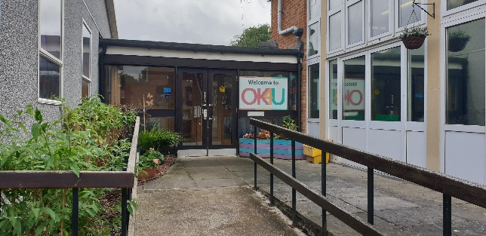

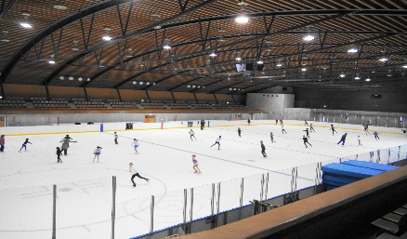



Day Day Service
I like to see my friends
Supporting people to improve their health and wellbeing
Supporting people to make their own choices and decisions
Encouraging and supporting people to develop and maintain connections with family, friends and the local community
I like joining the cooking and music groups
Encouraging people to do as much as possible for themselves in order to improve their independence and quality of life
Assist people to develop new life skills for the future
Helping people to access work, education and leisure activities
Singing, signing and chatting – Great!

Slide 6
Contact Details
In House Provider Service Manager:
Angie Smith – asmith6@swindon.gov.uk

