Slide 1
Charity No : 1116680
Co No: 5421272
The Wyvern Theatre Swindon
Visit Reach at: www.reachinclusivearts.org.uk
Contact: reachinclusive3@btconnect.com or phone 01793 520318

Slide 2
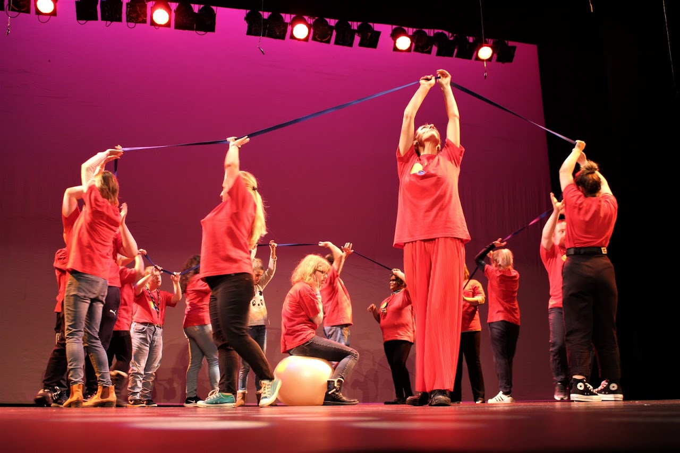
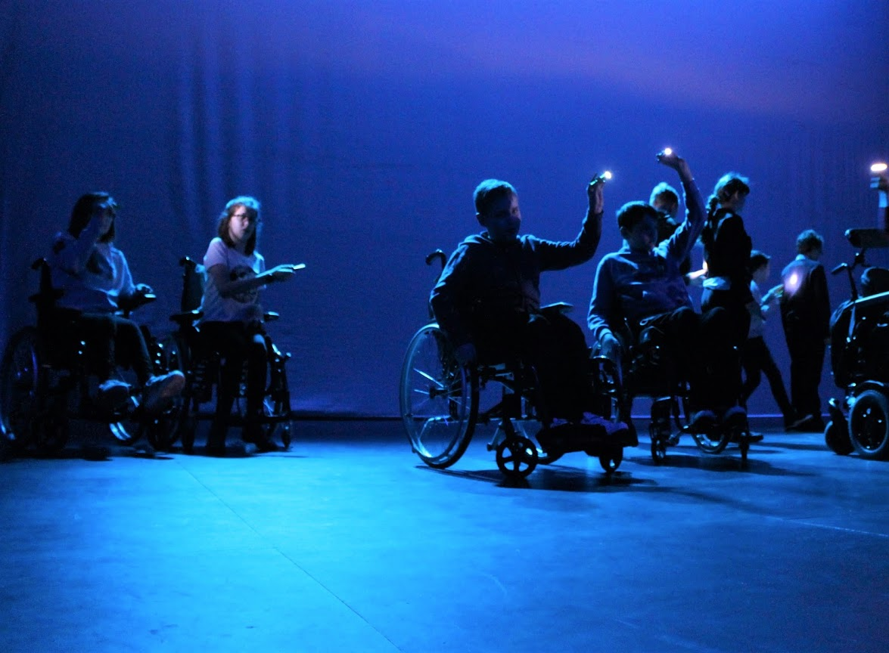
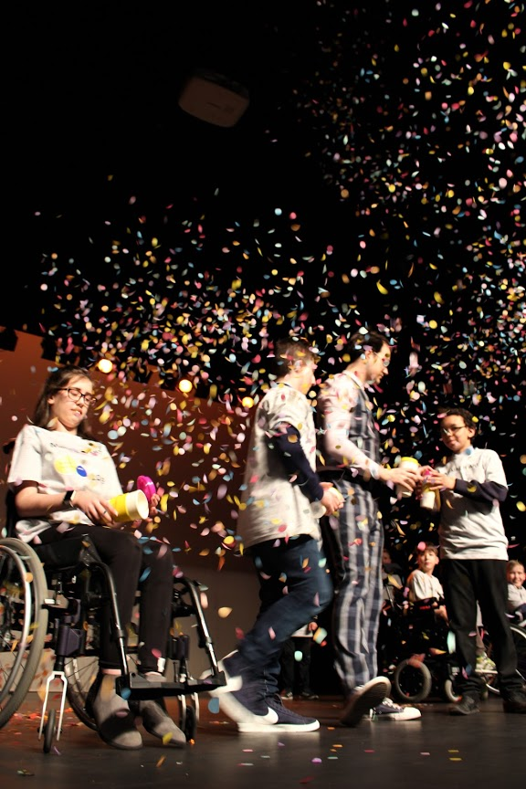
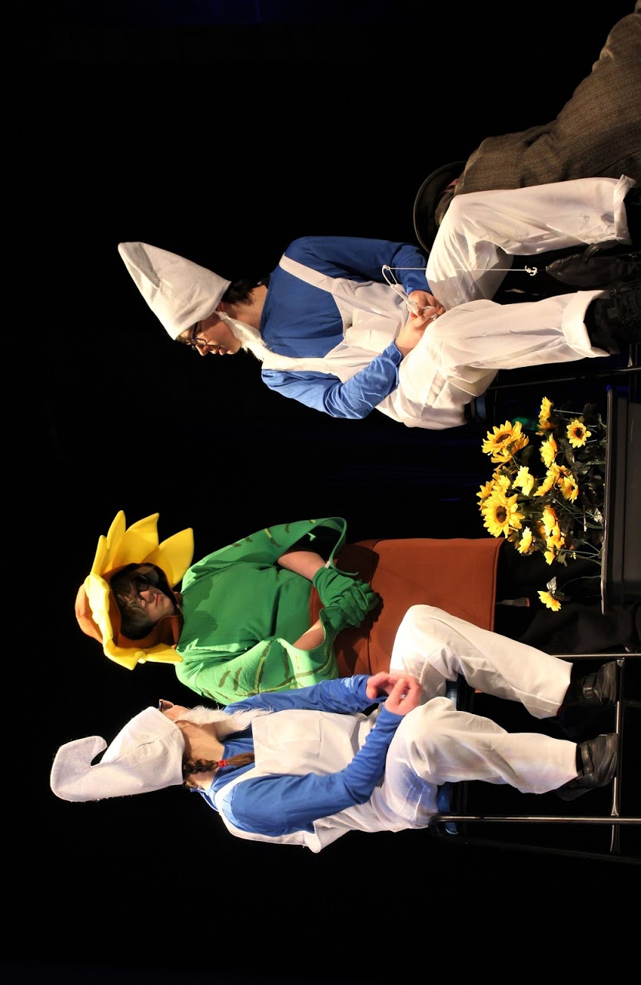
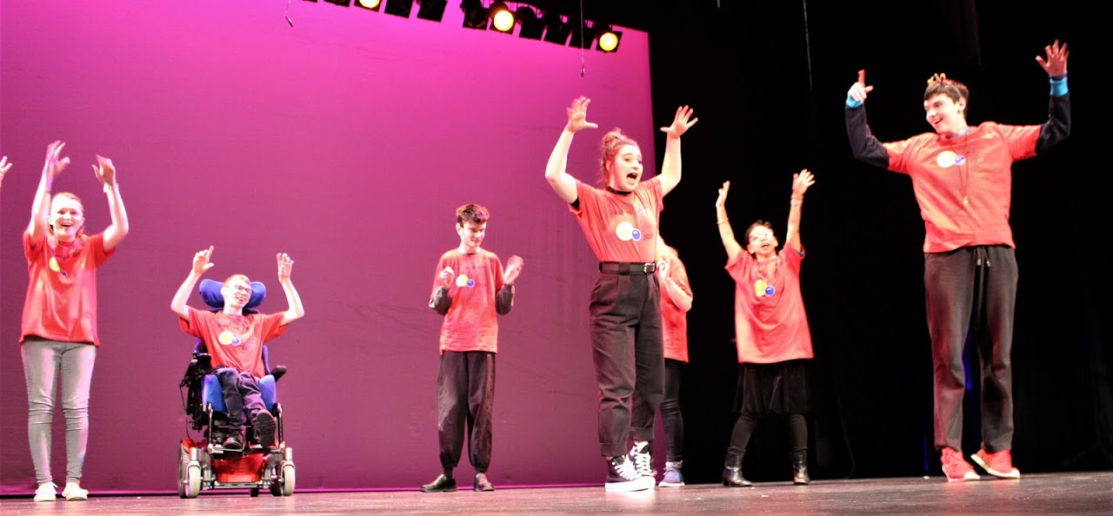
Reach Inclusive Arts works with young people on an outreach basis in a project that helps young people prepare for life after full-time education.

Slide 3
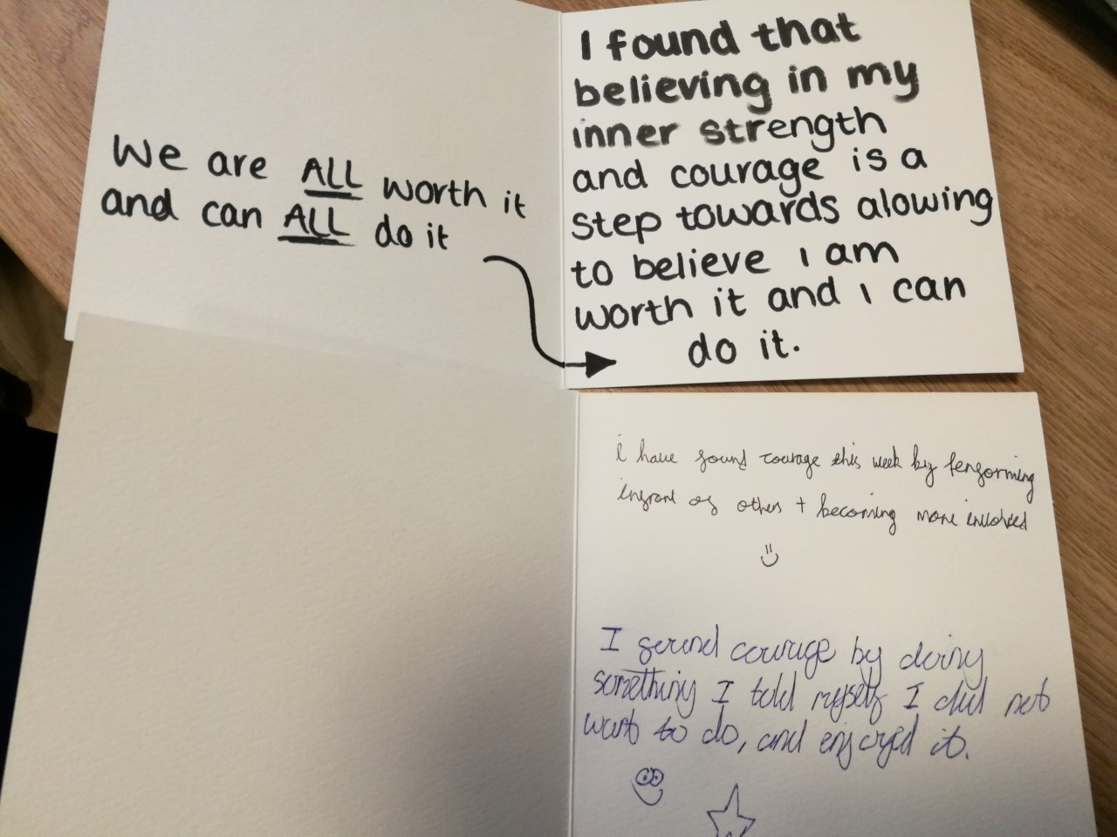
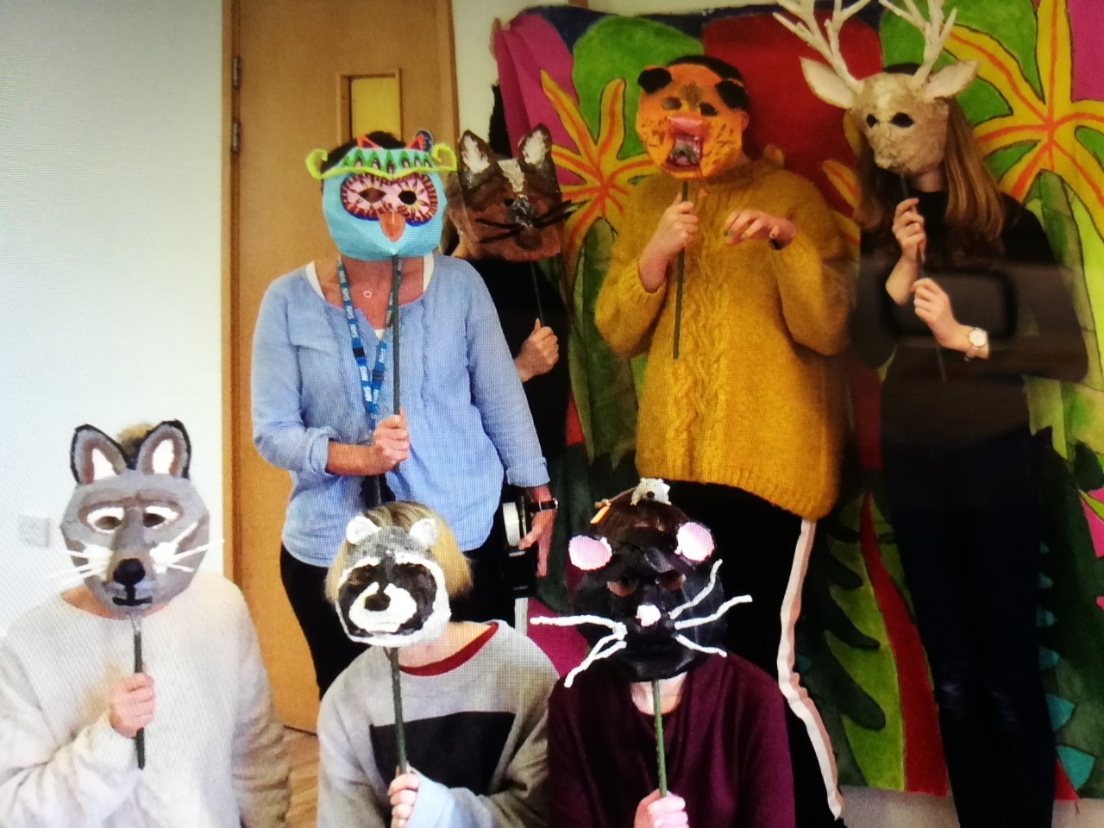
Participant comments
Reach Inclusive Arts working with young people from Marlborough House in Street Arts performance.

Slide 4
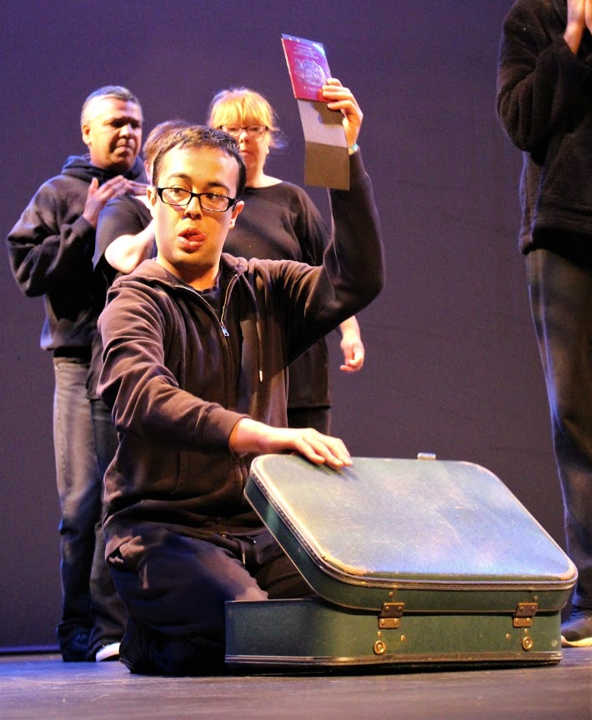
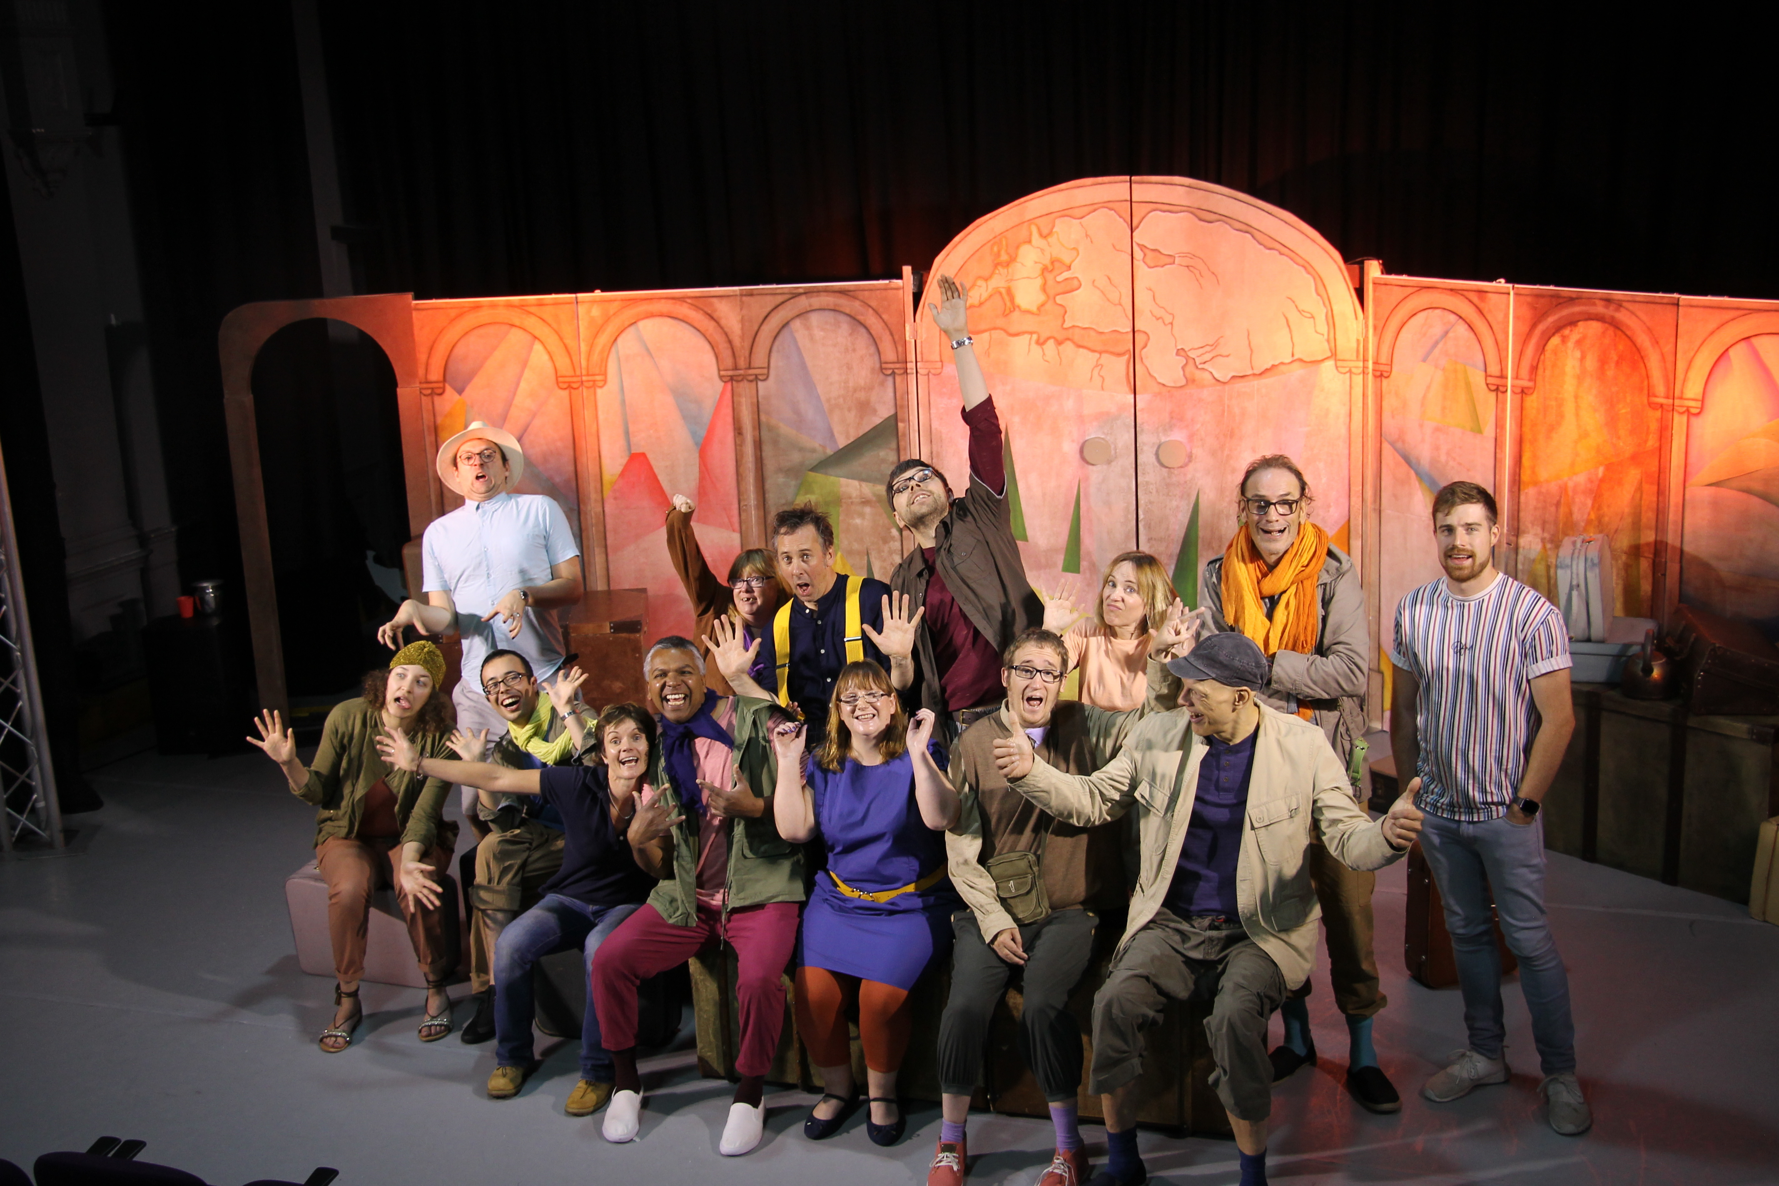
Reach Inclusive Arts provides exciting opportunities for young people to enjoy shows produced by people with disabilities.
Reach Inclusive Arts support disabled adults in Partners Theatre Company who meet every week and tour shows around the region.

Slide 5
Charity No : 1116680
Co No: 5421272
The Wyvern Theatre Swindon
Visit Reach at: www.reachinclusivearts.org.uk
Contact: reachinclusive3@btconnect.com or phone 01793 520318

