Slide 1
Preparation for Adulthood – making the Annual Review count
Caroline Bell (Statutory SEND Services Senior Manager)
Marny Jessop – Team Lead for Preparation for Adulthood
Becca Fiden – Commonweal School

Slide 2
What is an Annual Review
EHC plans should be used to actively monitor children and young people’s progress towards achieving the outcomes specified in the EHC plan and must consider whether these outcomes remain appropriate.
Review should aim to:
review the content of all parts of the EHC Plan
consider the continuing appropriateness of the EHC plan in the light of the child or young person’s progress
Actively involve children, young people and their families
Notes:
Reviewing an EHC Plan – the Legal References
Section 44 of the Children and Families Act 2014
Regulations 2, 18, 19, 20 of the SEND regulations 2014
The SEND Code of Practice 0-25 2014

Slide 3
The purpose of the annual review meeting is to consider whether:
A child or young person has made progress towards the outcomes and interim targets in the EHCP and to celebrate any successes in achieving these, or amend them.
An EHCP is the best way to support the child or young person as they move forward and is still required
Any changes to personal details and significant changes to information in Section A
The effectiveness of support (what will help the child or young person to achieve their outcomes) and any suggested changes. If the needs of the young person have changed (this must be evidence-based)
Any additional considerations associated with transition to the next stage of education, employment or training

Slide 4
The ‘musts’ for reviewing an EHC plan
The first review must be held within 12 months of the date when the EHC plan was issued, and then within 12 months of any previous review.
Must actively monitor the child or young person’s progress towards achieving the outcomes specified in the EHC plan.
Must consider whether outcomes and supporting targets remain appropriate.
Must be undertaken in partnership with the child and their parent or the young person, and must take account of their views, wishes and feelings, including the right to request a personal budget.
Professionals across education, health and care must co-operate with LAs during reviews.

Slide 5
The ‘musts’ for reviewing an EHC plan (cont.)
When reviewing an EHC plan for a young person aged 18+, the LA must have regard to whether the educational/training outcomes specified in the EHC plan have been achieved.
LAs must ensure that the EHC plan review at Year 9, and every review thereafter, includes a focus on preparing for adulthood.
For young people moving from secondary school to a Post-16 institution or apprenticeship, the review and any amendments to the EHC plan (including specifying the Post-16 provision and naming the institution) must be completed by 31 March in the calendar year of the transfer.
For young people moving between Post 16 institutions, the review process should normally be completed by 31 March where a young person is expected to transfer to a new institution in the new academic year.
Notes:
Remind schools that when reviewing the EHCP for Phase Transfer to Post 16 and particularly to go to mainstream college to remember to review Section F as the college offer and provision is different from a schools provision and more of an adult environment

Slide 6

Young People Preparing to make their own decisions:
The Special Educational Needs and Disability (SEND) Code of Practice 2015 states local authorities and others should normally engage directly with the young person when they turn 16, rather than their parents. However, the young person’s family and parents should continue to be involved in discussions about the young person’s future.

Slide 7


Slide 9
From Year 9…….
All reviews from Y9 onwards must include a focus on Preparation for Adulthood
Recording the wishes, views and feelings of children and young people is an important part of the review. LAs and others have a duty to support and involve the young person and his or her parent and pay regard to their views, wishes and feelings.
The review meeting should have a particular focus on options and choices for the next phase of education.
When the young person is nearing the end of formal education and the EHC plan is likely to be ceased within the next 12 months, there should be a focus on good exit planning.
Notes:
From Year 9 onwards, the local authority has a duty to ensure that the annual review meeting “consider[s] what provision is required to assist the child or young person in preparation for adulthood and independent living” (Regulation 20(6) and Regulation 21(6) of the SEN and Disability Regulations 2014).
The EHC plan must fit the individual young person and not the other way around.
Young people should be appropriately supported to participate and make decisions.

Slide 10
Continued
Transition planning must be built in to the revised EHC plan. Although outcomes will need to be revised remember that only the contents of sections B and F of an EHC plan can be appealed and it will be crucial that the transition planning is specified and quantified in section F of the revised plan;
The outcomes sought for a young person must be “ambitious” and “stretching” and “prepare young people for adulthood”. This is very important when thinking about education or training for young people aged 19-25 where provision tends to be more bespoke (and harder to get).
Notes:
Support young people to have a voice from as early as possible-planning depends entirely on the young person’s aspirations and abilities and what is needed to support them to “achieve their ambition”:
Person-centred planning-Parents and carers need to think about how best to enable their young people to make decisions when the time comes;
Think about advocacy, communication passports, decision making agreements, technology, peer support
Information about housing and support options from at least year 9
Workforce to understand the Equality Act and the Mental Capacity Act as well as what is positive and possible
Curriculum to support young people to find out about housing options – choosing where to live and who to live with
Young people and families to meet adults to provide inspiration and role models
Welfare benefits advice
Ensure the local housing strategy includes people with significant disabilities
Support independence from the earliest years
Support young people to have time away with other young people

Slide 11
Pathway into Employment and Training
to find suitable post-16 pathways that lead to outcomes for employment or higher education; training opportunities;
to find a job and help to understand the benefits of work
to prepare for independent living, including exploring decisions young people want to make for themselves
Notes:
Young people aged 16-19 that continue education (who have an EHC plan, those aged over 19 and up to age 25) should have a clear study plan that enables them to achieve the best possible outcomes in adult life.
Schools and colleges should ensure courses enable progression to a qualification or work placement that is meaningful to the student without repeating learning
already completed.
Vocational work placements should ensure activities prepare the young person for healthy, independent living that supports building relationships and engagement in
the community.

Slide 12
Things to think about…..
Have I got any experience? How will I find a job?
What am I good at? At home/ at school?
Will I need any support or adjustments in the workplace?
Do I have my own bank account?
How will I get to a job?

Slide 13
Independence and Housing Pathway
where to live in the future and the support they will need;
local housing options and support to find accommodation;
housing benefits and money matters;
eligibility for social care.
Notes:
Schools and family members should support young people to acquire independent living skills such as travel training, basic cookery skills, personal care and money management. Moving away from home is a huge step and should be thought through carefully.

Slide 14
Things to think about….
How will I pay my rent/ bills?
Who do I want to live with?
What jobs can I learn now to become more independent?
Will I need help to run my own home?

Slide 15
Developing friendships, relationships and community inclusion
travel support to enable independence;
to participate and maintain relationships in the community
– including support on activities in the community.

Slide 16
Things to think about….
What is the best way to support me to have friends and be part of my community
Who is important to me?
How will I keep in touch with friends when I leave school?
What do I do now? How will this change when I’m an adult?
Are there new things I would like to try?

Slide 17
Planning for Good Health
to maintain good health and wellbeing in adulthood;
to plan continuing health services from children’s to adult’s services
helping young people understand which health professional may work with them as adults; ensuring those professional understand the young person’s needs, including the production of a Health Action Plan and prompts for annual health checks for young people with learning disabilities;

Slide 18
Things to think about….
Do I know how to keep myself healthy and safe?
Do I need a health action plan?
Who will support me with health appointments?
How do I let people know if I am unwell?

Slide 19
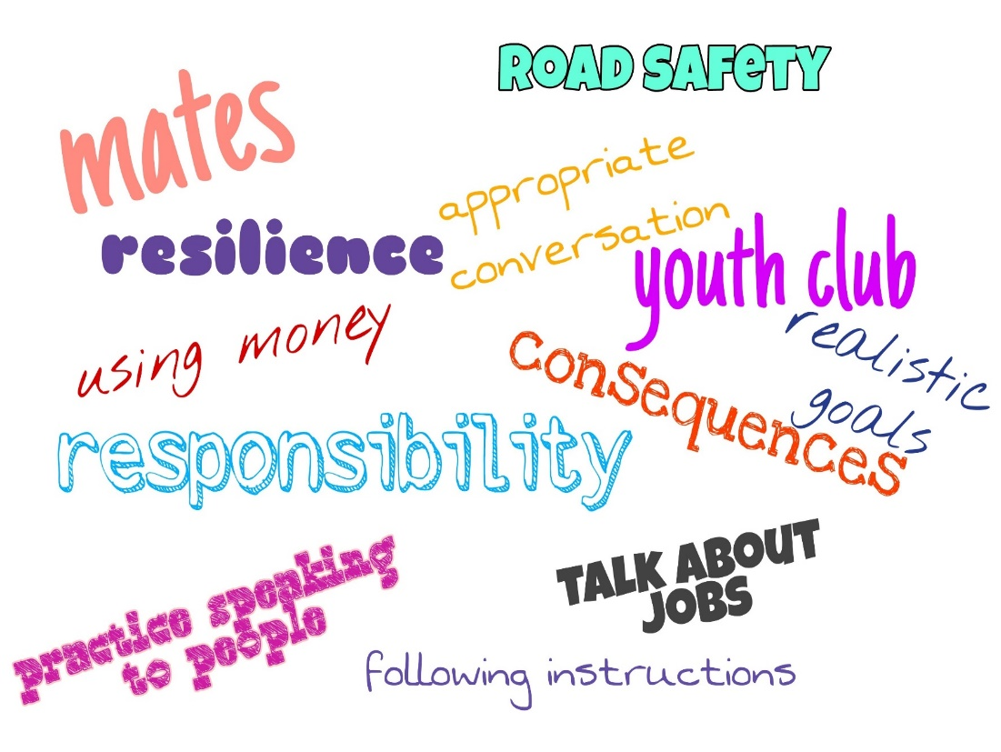
Independence skills need to be encouraged earlier
At school
At home
The more skills that can be learned at an earlier age, the less overwhelming the transition to adulthood will be

