Slide 2
Swindon’s Learning Disability Partnership Board was established in 2001
This followed the Government’s publication of it’s new strategy for the 21st century called Valuing People
The strategy promoted a new vision for people with learning disabilities with 4 key principles – Rights, Independence, Choice and Inclusion
In Swindon, the Partnership Board has worked hard to support change but recognises that there is still work to be done

Slide 3
Ensures adults with a learning disability and their families have their voices heard about things that affect their lives
Promotes choice and control for people with learning disabilities, improving their quality of life
Meets 6 times a year – 3 board meetings with invited membership, 3 forums for everyone
The membership includes 6 LD Reps, 2 Carer Reps and 2 LD Provider Reps as well as representation from the local authority, health, education, police, employment, voluntary sector, carers, benefits and leisure.

Slide 4
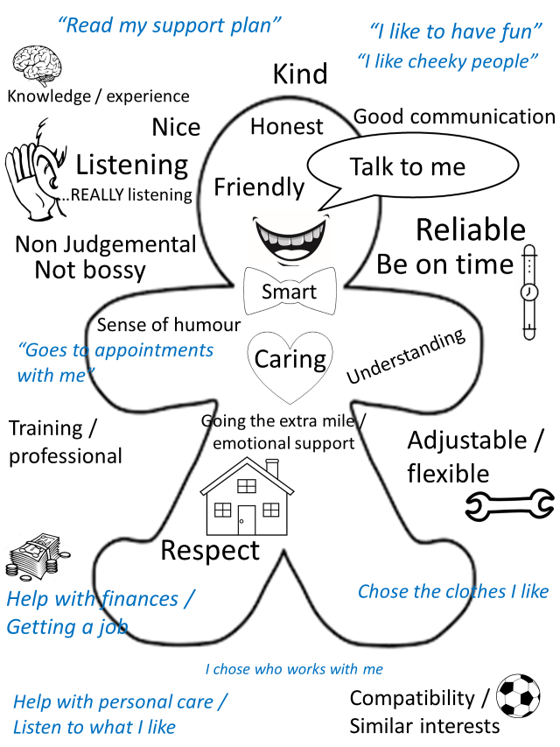
What forums have we done and what difference do they make?
Going to Hospital
What Does Good Support Look Like?

Slide 5
What forums have we done and what difference do they make?
My Annual Health Check
Talking About Relationships
Thinking About Work
Feeling Confident
Thinking About Money

Slide 6
How can you get more information about attending future LDPB forums?
Forums take place in March, July and November
Look on the Swindon Local Offer – search Learning Disability Partnership Board or open HERE
Contact Swindon Advocacy Movement (SAM) - 01793 542266

