Slide 1
Do you care?
Parent Carers and Swindon Carers Centre
Registered Charity No: 1061116
Registered Company No: 3305621

Slide 2
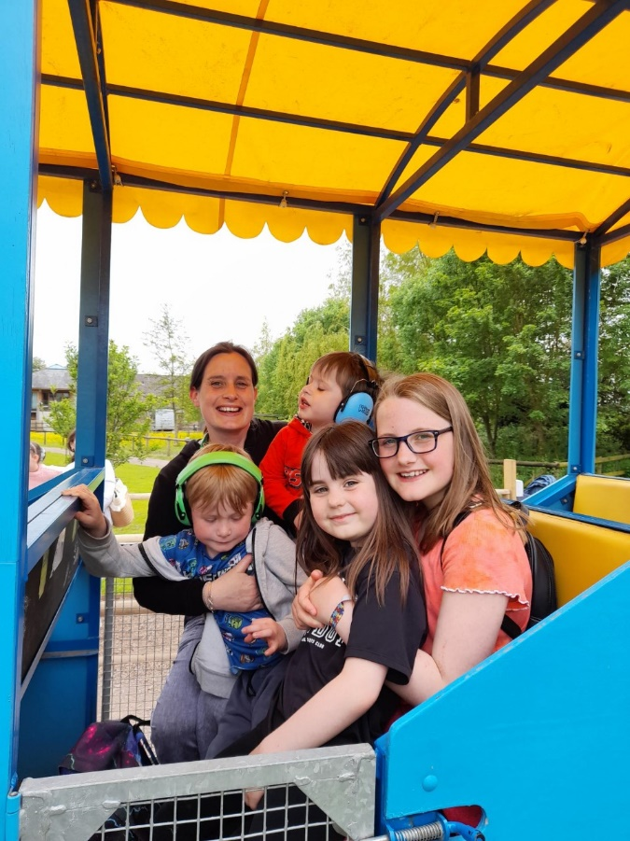
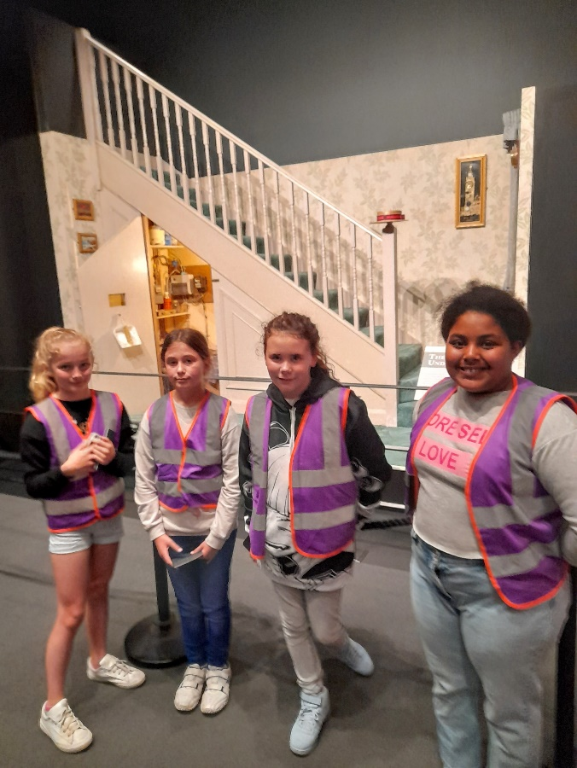
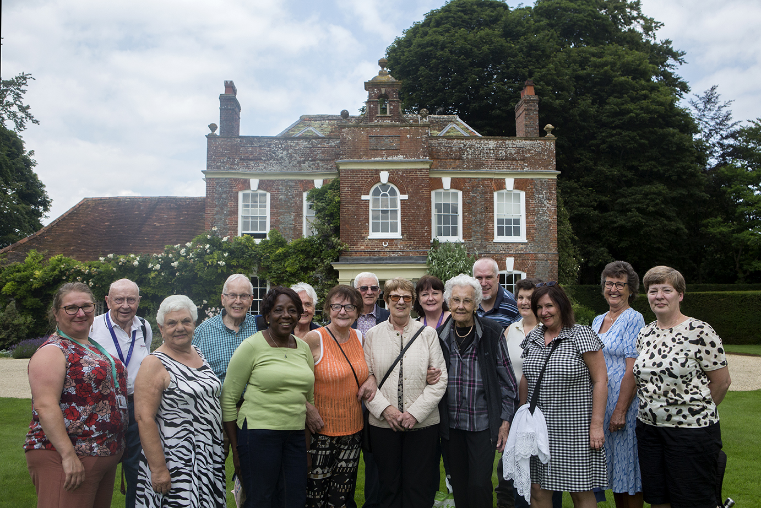
What is a carer?
A carer is a person who provides unpaid support to a family member, partner or friend who would otherwise be able to manage without this support.
This could be due to an illness, physical disability or autism and/or learning disability, mental ill health or substance misuse.

Slide 3
About us
We have dedicated teams who support Adult Carers, Parent Carers and Young Carers.
We work in partnership with many organisations such as:
SAMs, Mind, Alzheimer's Society.
Established since 1997
There are now an estimated 21,00+ Carers in Swindon.
At Swindon Carers Centre, we provide support, advice and guidance to Carers from age 5 and upwards.
Our vision: Creating a community where carers are recognised, valued and supported.
6 in 10 people will be carers at some point in their lifetime.

Slide 4
I am a Carer!
My name is Lorraine, and I am a Parent Carer support Practitioner at SCC. I am also a carer to my two adult children, both of whom have autism. I hope that my professional role, personal knowledge and experience as a carer helps others who may face similar issues as myself in their caring roles. I aim to help people overcome some of the many obstacles they face while trying to provide the right care and support for their own children, as well as being able to meet up and chat with those who access our many groups and activities specifically to provide the parents a break from their caring roles.

Slide 5
Isabelle
I joined Swindon Carers Centre at the beginning of June, as a Parent Carer Support Practitioner. have been so impressed by the carers that I have engaged with both face to face and over the phone. I feel passionately that carers should get the recognition and support they deserve.
I have come from the Early Years Sector where I worked as a SENCO - special educational needs coordinator for 9 years. I am also involved in youth work. I look forward to meeting many more of you in the near future.

Slide 6
How can we support you?
We support carers who look after children from 0 to 18, who have additional needs.
This can be anything from a physical disability, a neurological disorder or mental illness.
We engage with parent carers; completing assessments outlining how the child’s needs affect the carer and the family as a whole
Groups and activities will be offered to give the parent a chance for respite and support.
We will signpost or refer to either the benefits team within SCC or relevant organisations.
We explore funding options for the parent carer, to allow them to access recreational/practical activities they may not have been able to previously.

Slide 7
What our carers say…
It was lovely to speak to you yesterday, I was very surprised when I looked at the time that had passed! The information completed by you is all good, thank you and thank you for the list of what is available locally. Finally, thank you for your offer of support, it's great to know that this is available.
We had such a good night; it was great being able to see other people again and relax away from home. Thank you.
Thank you so much, I had no idea what was available out there, no one tells you. I have received more information in the last hour than I have been given in the last 5 years of trying to get help and support.

Slide 8
So…
If you think you may be a parent carer, please contact us using the following details.
We continue to work with organisations within the borough, to raise the profile of carers in Swindon by giving presentations and talks on the work of Swindon Carers Centre.
01793 401094
carers@swindoncarers.org.uk
www.swindoncarers.org.uk
Or Facebook and Twitter

Slide 9
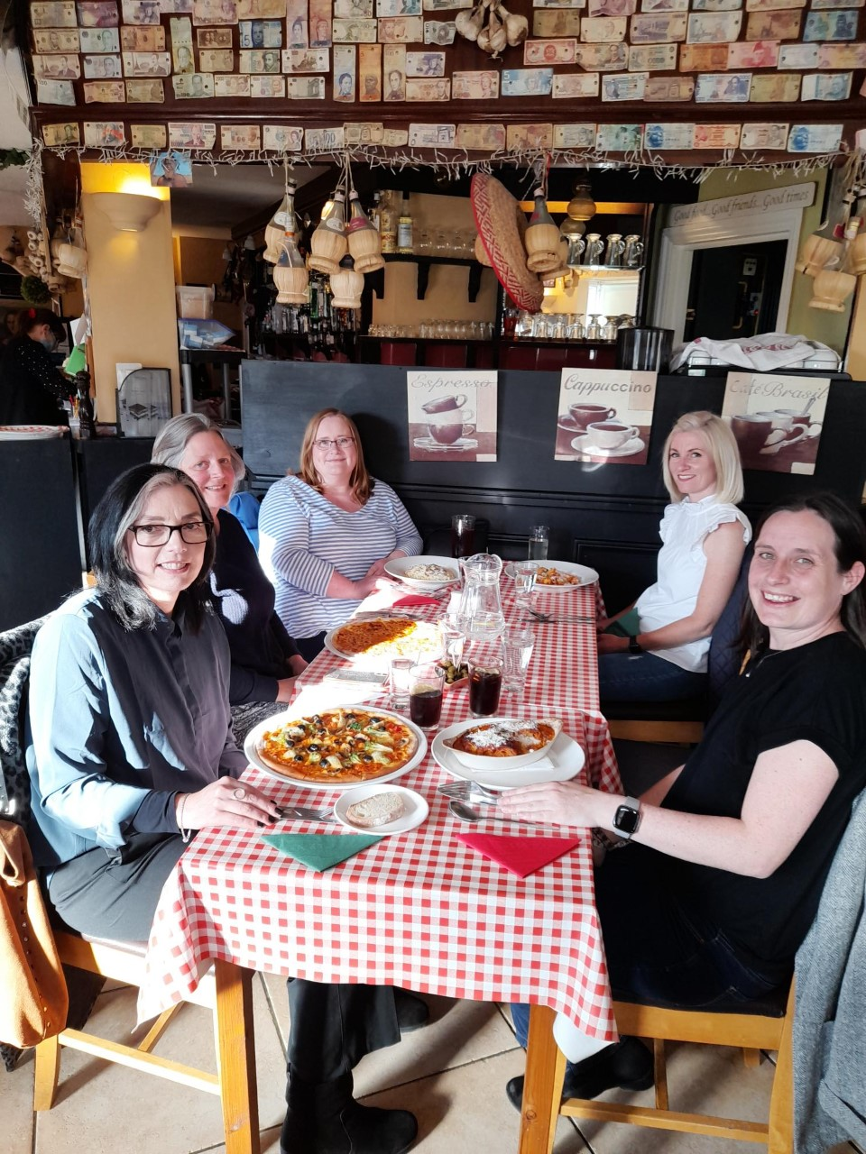
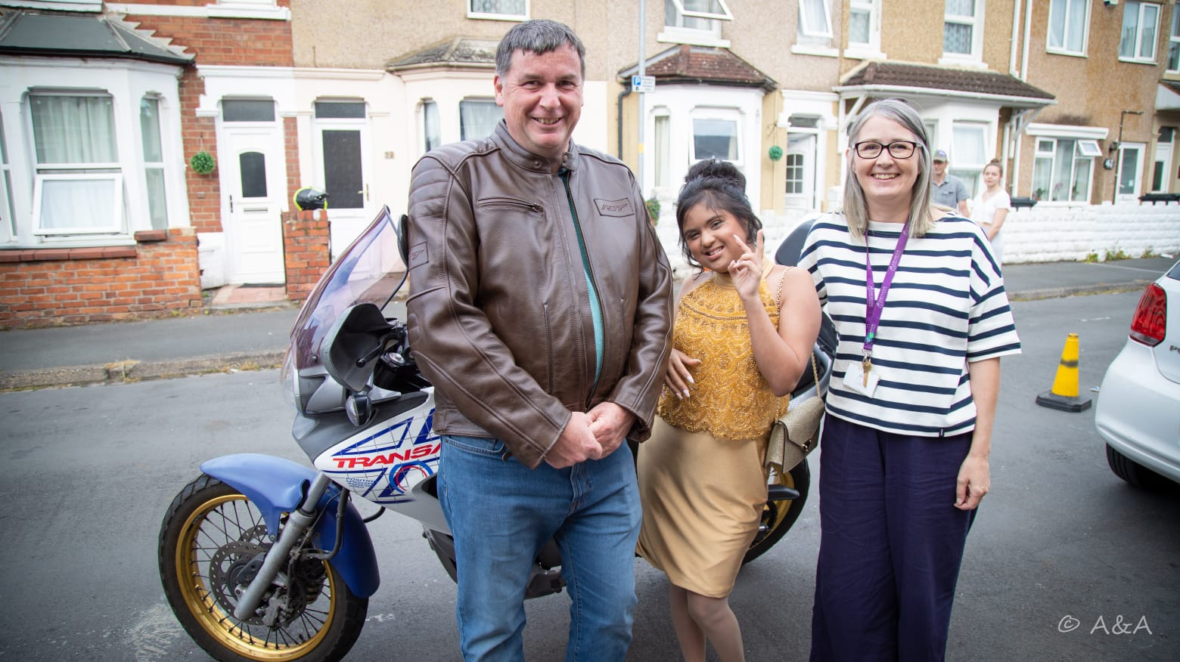
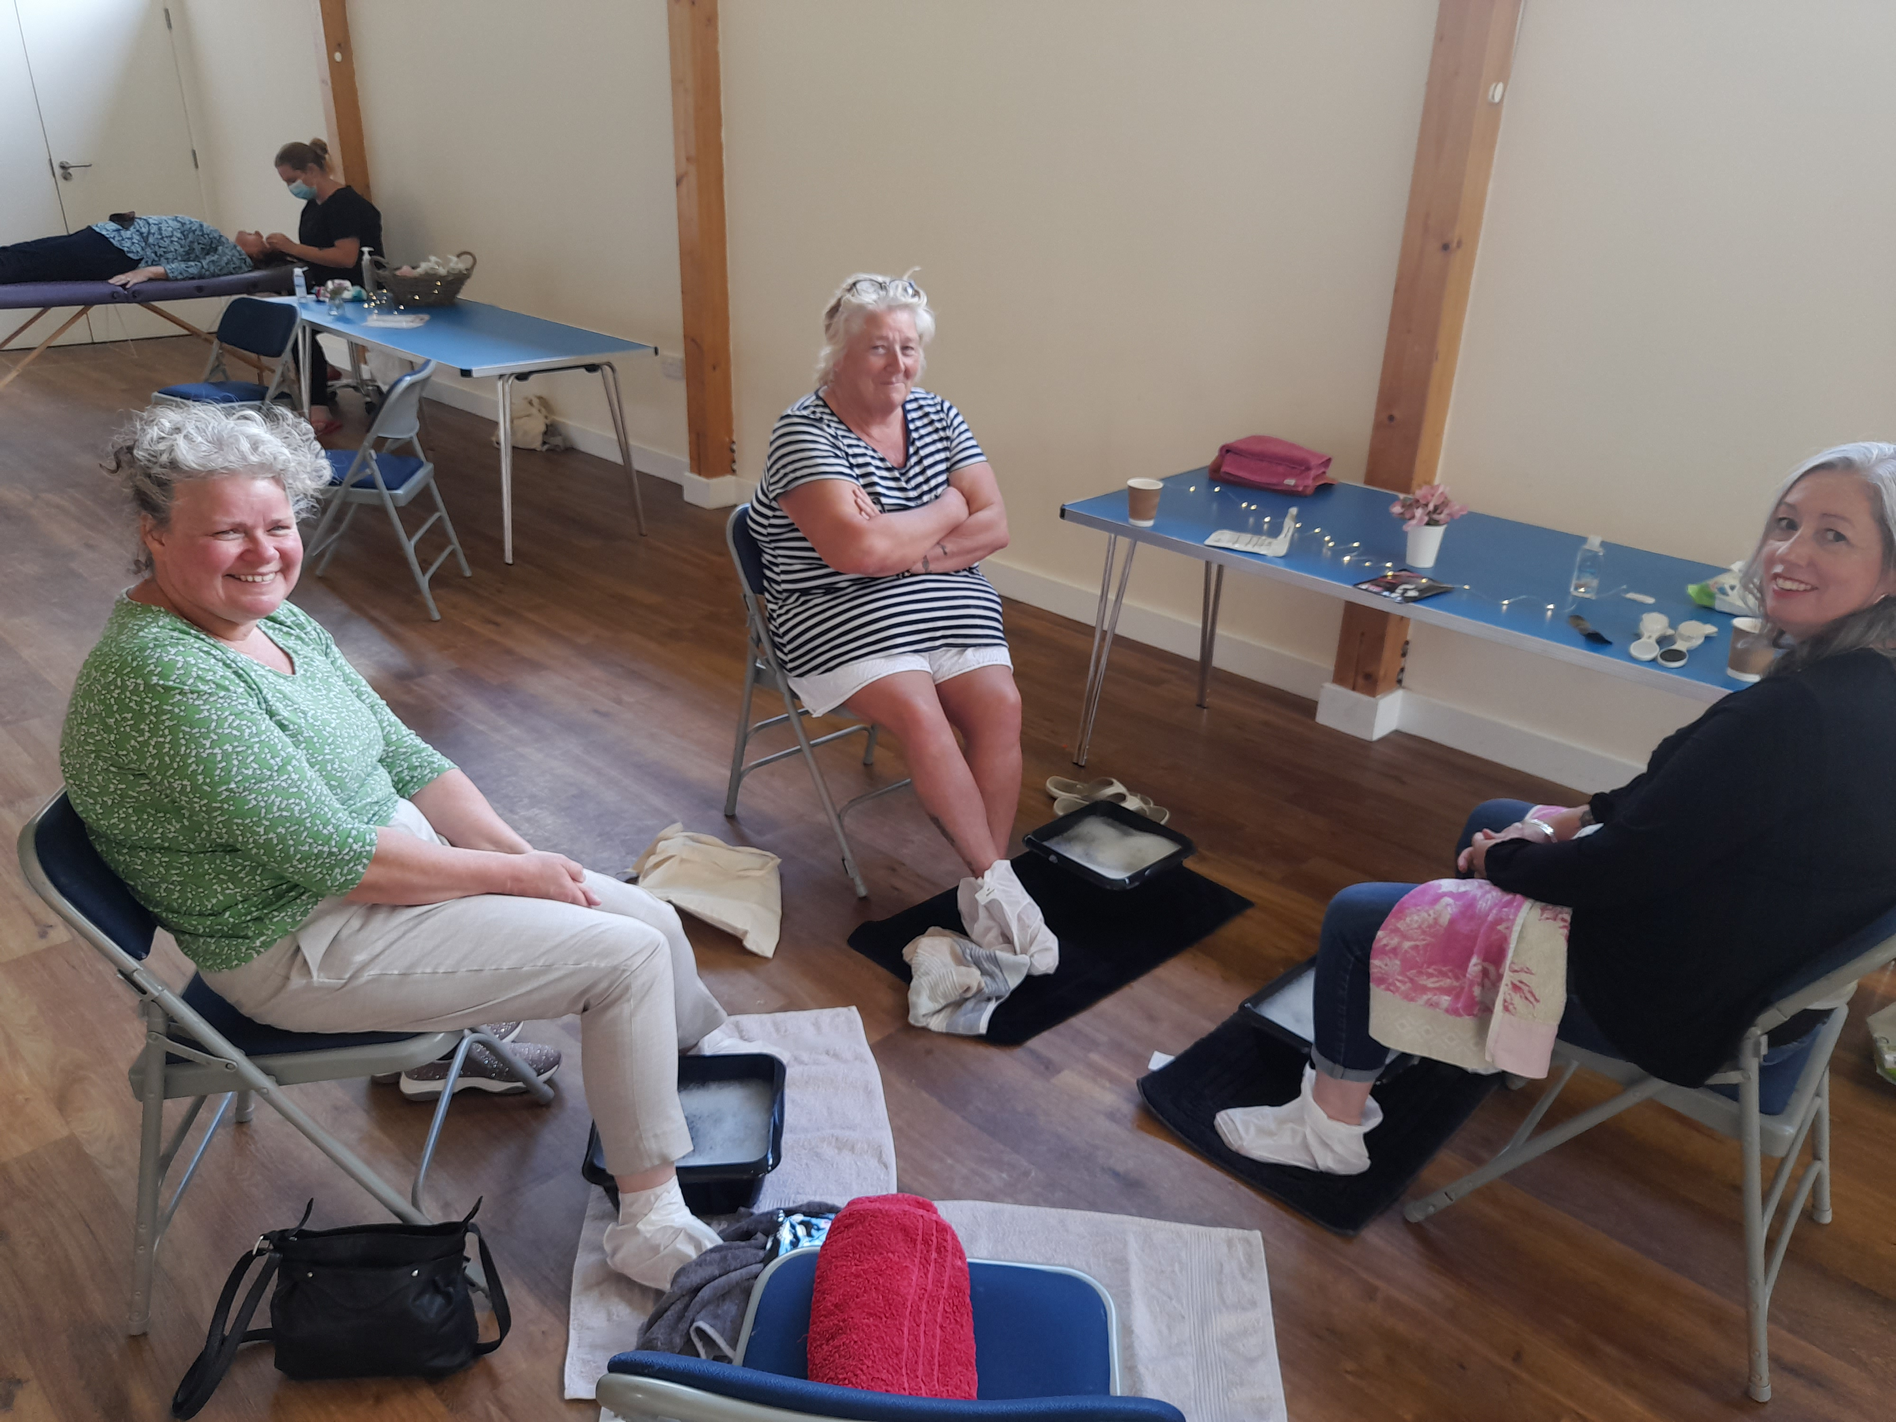
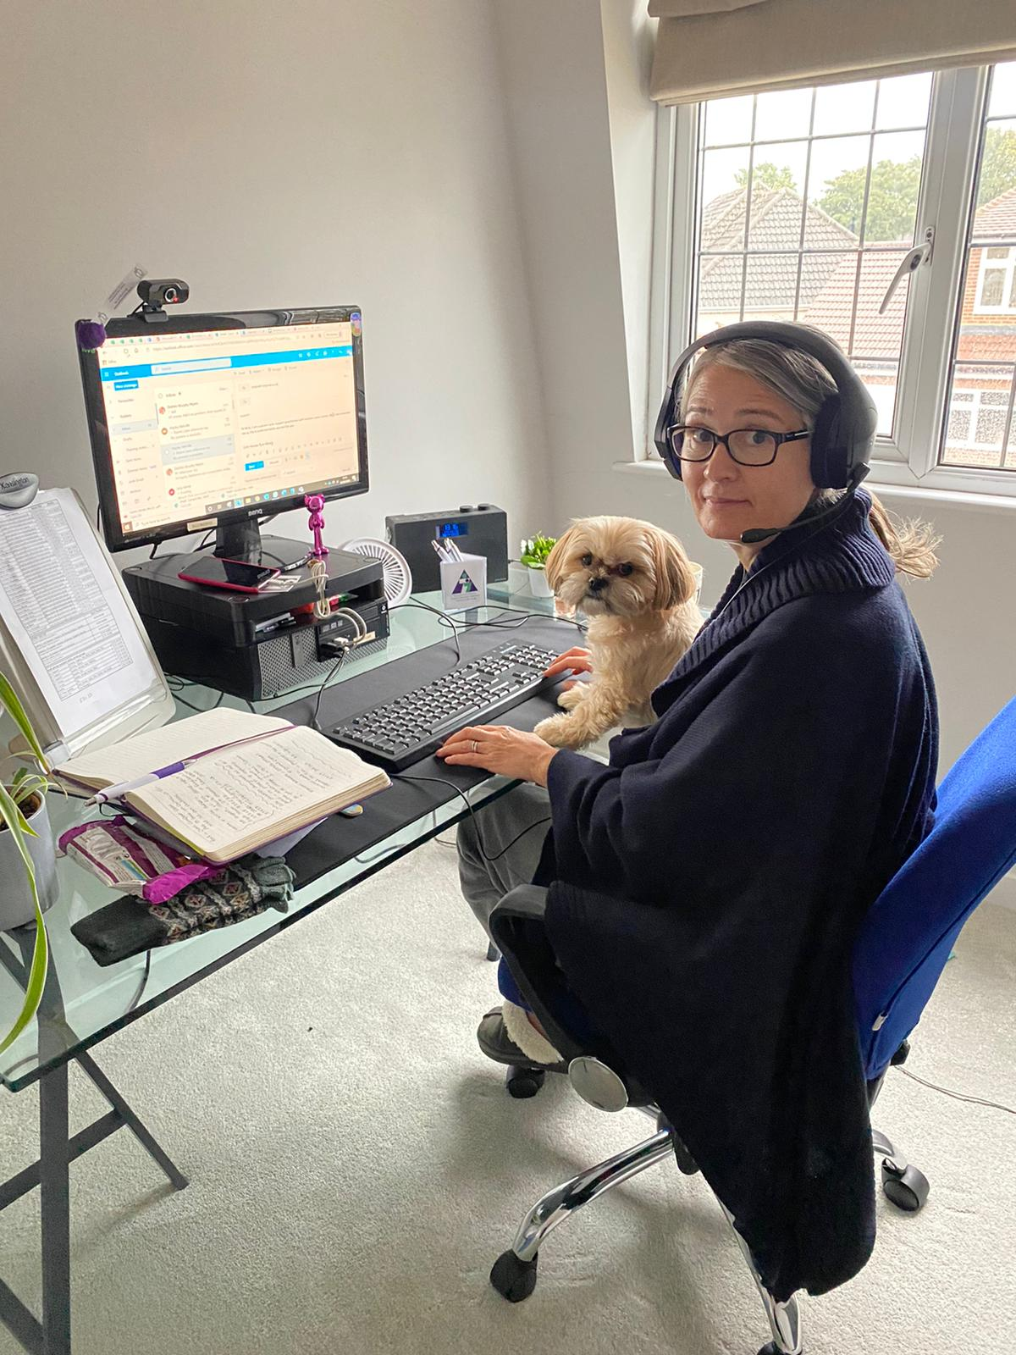
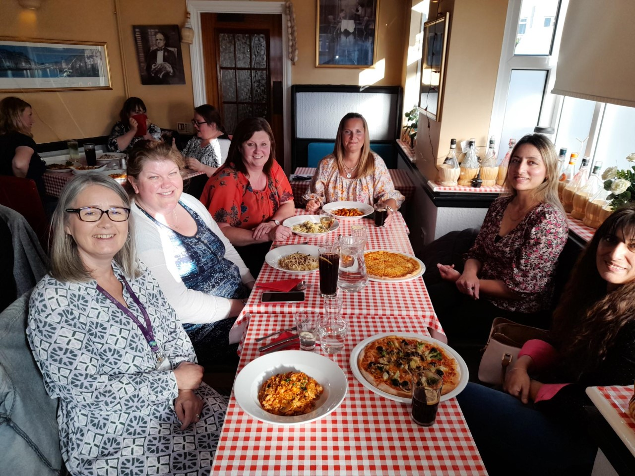
Do you care? Parent Carers and Swindon Carers Centre
Any questions?

