Slide 1
Swindon Local Offer
September 2021

Slide 2
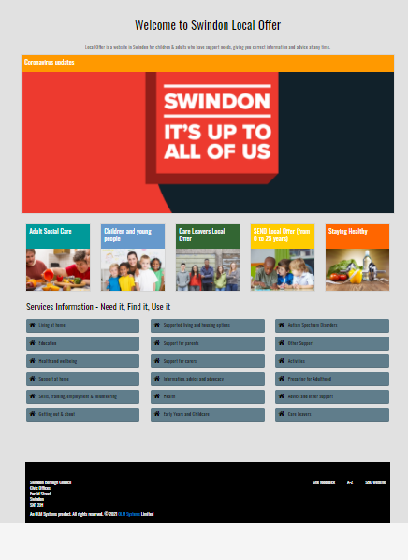
Swindon Local Offer
The Local Offer is a website which provides information and advice for children and adults who have support needs.
https://localoffer.swindon.gov.uk/home/

Slide 3
Swindon Local Offer
The site content is split into five main areas: Adult Social Care, Children and young people, Care Leavers, SEND, and Staying healthy

Slide 4
Swindon Local Offer
Adult Social Care section
Contains information on:
Support to help people stay at home
Equipment and adaptations
Support for carers
Social and leisure activities
Residential and nursing homes

Slide 5
Swindon Local Offer
Children and young people
section
Contains information on:
Education
Post 16 training and employment options
Health, leisure and activities
Support for parents
Preparing for adult life (transitions)

Slide 6
Swindon Local Offer
Care Leavers section
Contains information on:
Support and advice for care leavers
Financial rights and entitlements
Advocacy and independent support
Health, leisure and wellbeing
Education, employment and training support

Slide 7
Swindon Local Offer
SEND section
Contains information on:
The right support at the right time
Autism and ADHD support
SEND news and events
Heath visitor services
Education, Health and Care Plans

Slide 8
Swindon Local Offer
Staying healthy section
Contains information on:
Healthy eating
Managing your health
Activities and clubs to help you get more active
Mental health support
Drug/alcohol misuse support services

Slide 9
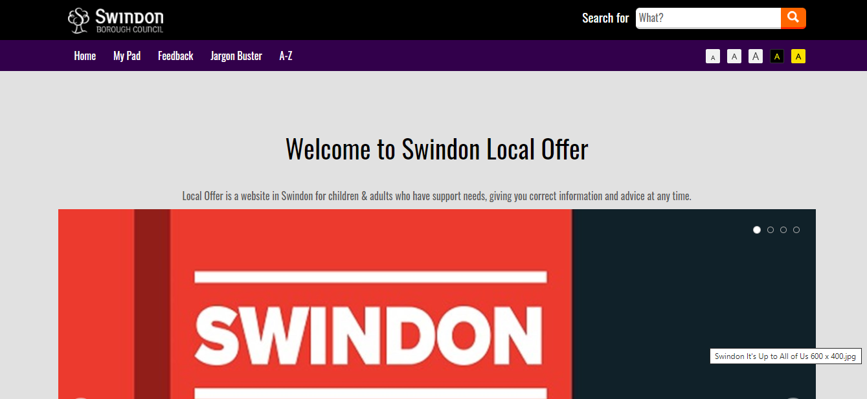
Swindon Local Offer
The site has a variety of options the user can change to make the site more suitable for their needs, such as increasing text size, and changing colour contrast.

Slide 10
Swindon Local Offer
You can search for content on the site using the search box in the page header.

Slide 11
Swindon Local Offer
You can also search for information using the Services Directory, which lists details of local organisations, charities, and providers of a variety of services (such as social clubs and groups, advice and advocacy services, health and wellbeing, care and support at home). This search will include both content pages and local services information.

Slide 12
Swindon Local Offer
You can also search for content on the site using the A-Z option. You can give any comments you have about the site using the feedback function. There is also a jargon buster where terms and acronyms, used in the services that you interact with everyday, are explained.

Slide 13
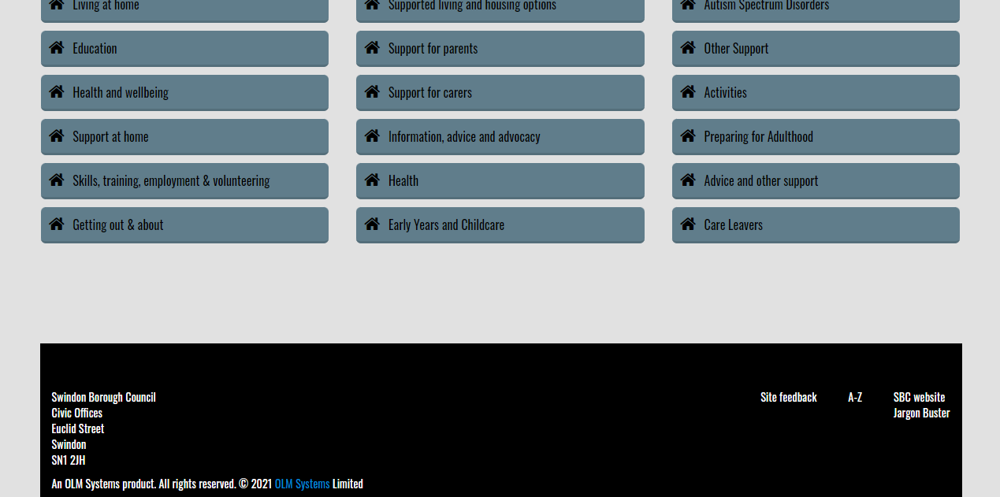
Swindon Local Offer
The footer also has a link to the site A-Z, site feedback, jargon buster and the Swindon Borough Council website.

Slide 14
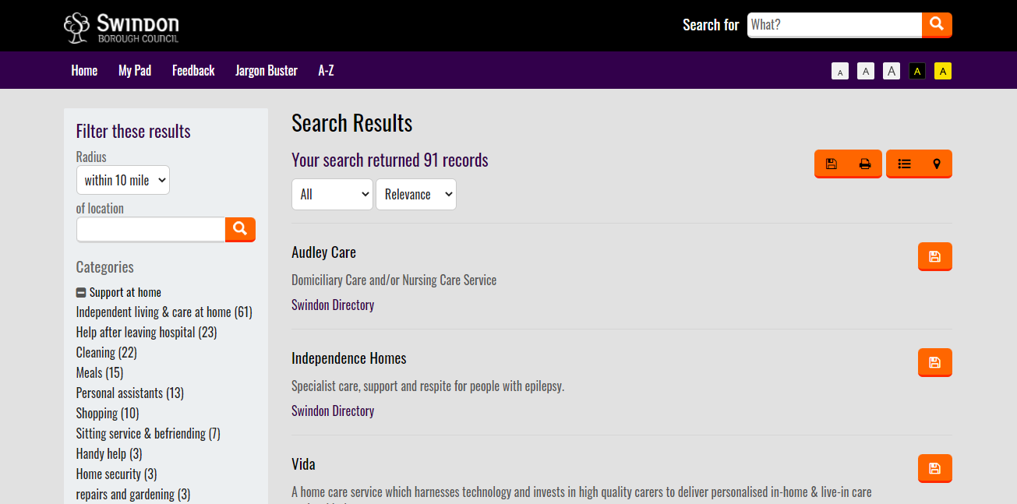
Swindon Local Offer
The search results page includes filters so you can refine your search by category. You can also filter by distance from a location.

Slide 15
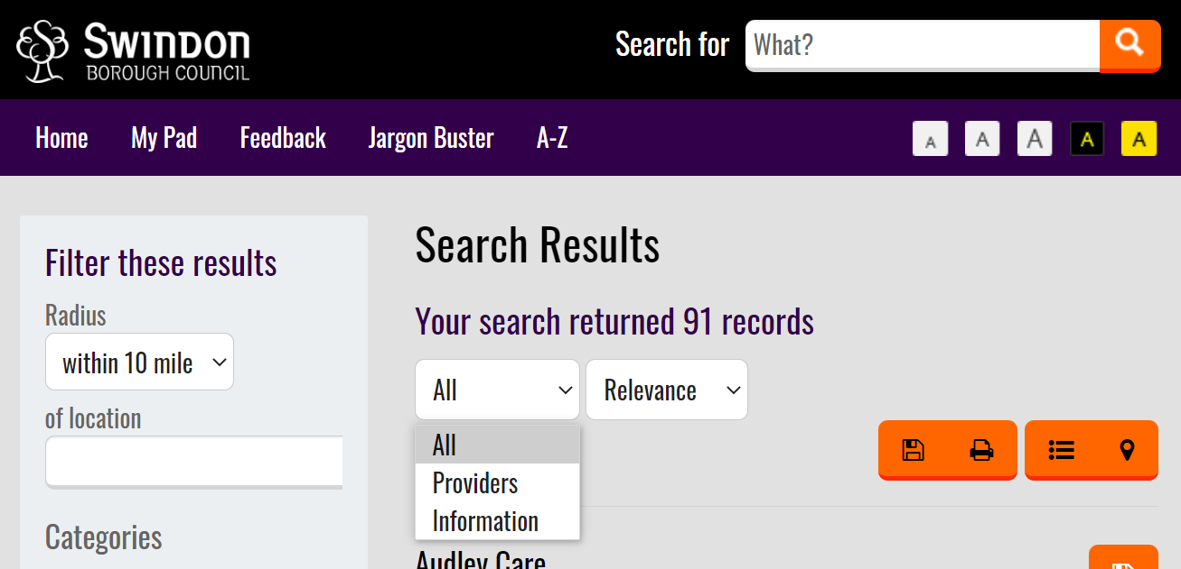
Swindon Local Offer
You can refine your search results by either information (content pages) or by service providers.

Slide 16
Swindon Local Offer
Or you can filter your search results by A-Z (or Z-A)

Slide 17
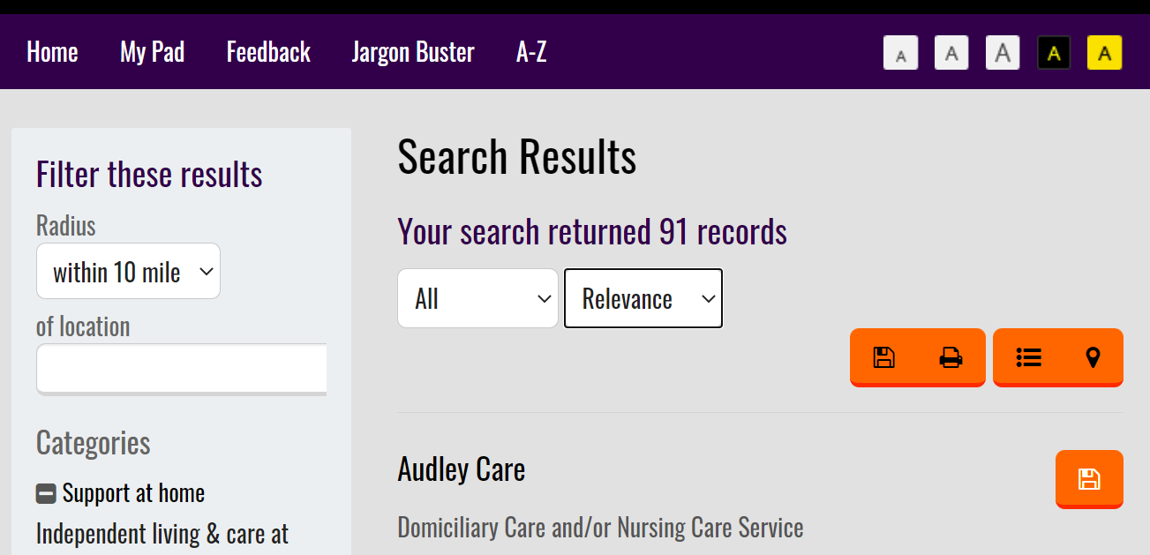
Swindon Local Offer
The search results can be viewed as a list or as a map.

Slide 18
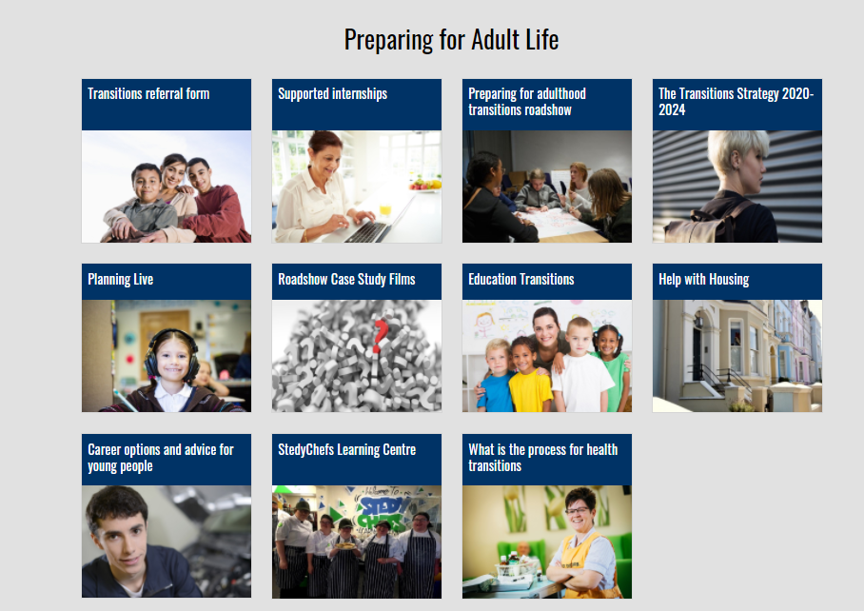
Swindon Local Offer
Preparing for Adult Life section
Contains information on:
Pathways into employment – including career advice and supported internships for young people
Transitions referral form
Health & education transition information
Transitions strategy

Slide 19
Swindon Local Offer
How to get in touch
Contact the Local Offer team:
Andrew Myrie
Cathy Jones
@
LocalOffer@swindon.gov.uk

