Slide 1
The role of the Adult Social Care Transitions Service
September 2021
Alison Forster
Service Manager for Transitions
Swindon Borough Council

Slide 2
How this session will work:
The session won’t be recorded. The slides will be available on the Local Offer after the session.
I will be the ‘host’ for the session, and my colleague Victoria will do the driving (moving from one slide to the next). I will be introducing Hannah Ferguson, the Team Manager for Transitions to present some of the slides.
There will be time for questions at the end of the presentation.

Slide 3
Microsoft Teams
Please could you ‘mute’ your microphone (symbol in toolbar on screen – this may be at the top of your screen, or in the middle of your screen if you hover your cursor) so that background noise is cancelled out and we are all able to hear the presenter.
Please make sure that your camera is turned off (symbol in toolbar) as this helps with the quality of the picture and reception.
There is a ‘chat’ function with Teams (speech bubble symbol in toolbar). When you click on this, a chat box will appear on your screen. This is linked to this presentation. If you wish to comment or ask a question during the presentation, just type your question in to the ‘chat’ function, and we will try to answer that at the at the end of the presentation. Note that all participants can see the ‘chat’ comments, so please don’t include any personal or individual information in that.
For the Question and Answer session, if you wish to ask a question, could you ‘raise your hand’. You will see the hand symbol in the toolbar.

Slide 4
The role of the Adult Social Care Transitions Service
Care Act criteria
Referring into the Transitions Service
Roles in the Transitions Team
Planning Live
Question and Answer Session

Slide 5
Care Act Criteria
Alison Forster, Service Manager Transitions
In Adult Social Care, one of the pieces of legislation we work to is Care Act, 2014.
The Care Act, 2014 includes an eligibility criteria
This eligibility is applied to determine whether people may go on to receive a service from Adult Social Care
After a referral is received, an assessment is completed with a young person and the people who are important to them. This will be a strengths based conversation.

Slide 6
Care Act Eligibility Criteria
There is a 3 part test to decide whether a young person meets the eligibility criteria under The Care Act, 2014.
Are the adults needs caused by a physical or mental impairment or illness?
And….

Slide 7
Care Act Eligibility Criteria
As a result of the adults needs they are unable to achieve two or more specified outcomes?
Managing and maintaining nutrition
Maintaining personal hygiene
Managing toilet needs
Being appropriately clothed
Being able to make use of the home safely
Maintaining a habitable home environment
Developing and maintaining family or other personal relationships
Accessing and engaging in work, training, education or volunteering
Making use of necessary facilities or services in the local community including public transport and recreational facilities or services
Carrying out any caring responsibilities the adult has for a child

Slide 8
The Care Act Criteria
And
As a consequence there is or is likely to be a significant impact on the person’s well-being

Slide 9
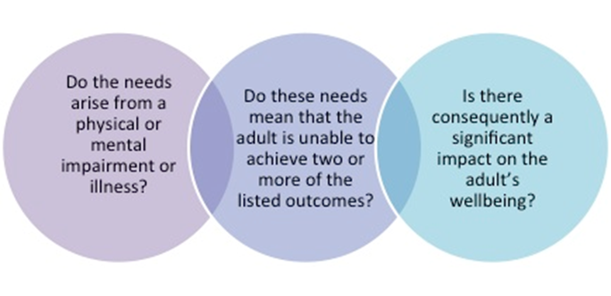
Care Act Criteria

Slide 10
Referring into the Transitions Service
Hannah Ferguson, Team Manager, Transitions Team. Adult Social Care
Why should I make a referral to the Transitions Team in Adult Social Care?
When should I make a referral?
Who can make a referral?
How can I check if a referral has already been made?
How do I make a referral? What sort of information is needed to make a referral?
Who can I talk to about making a referral? Email transitionsteam@swindon.gov.uk or call 01793 463333
What happens after a referral is received by the Transitions Team?

Slide 11
Referral to Transitions Team
Just search for ‘Transitions Referral’ at www.swindon.gov.uk

Slide 12
Roles in the Transitions Team at Swindon Borough Council
Alison Forster, Service Manager, Transitions.

Slide 13
Roles in the Transitions Team at Swindon Borough Council
Transitions Team structure
Their roles
Our key partners - SEND, Children’s Services, Health, Schools and Colleges, Employers, Housing, support in the community, voluntary sector and commissioned providers.

Slide 14
Transitions Team
Head Of Service
Transitions Service Manager
Team Manager & Assistant Team Manager
Senior Social Workers x 2
Social Workers x 4
Link Workers x 4
Assistant Care Managers x 3

Slide 15
Planning Live
Hannah Ferguson , Team Manager Transitions

Slide 16
What is Planning Live?
It’s a new approach to planning for adult life
It’s a ‘discovery conversation’, not an assessment
It’s a conversation with a young person and people important to them, to help them to think about their life, what’s important to them now, and what they aspire to achieve in the future
It explores and builds on young people’s gifts, skills, interests, to explore possibilities
The Planning Live question: what would it take for this young person to lead a good life?
Notes:
So what is Planning Live and how does it work? First of all, it’s NOT an assessment. It’s more a ‘discovery conversation’, an opportunity for the young person and the people important to them to have a facilitated conversation with the people who are important to them to think about their life, what is important to them now, and what they aspire to achieve in the future. And it’s a positive conversation.
The key question in a Planning Live event is ‘what would it take for this young person to live a good life?’
So it helps people to:
Explore their gifts, talents, capabilities, and explore possibilities
Think about their aspirations, what they as an individual can achieve, what their family and their community (that might be the school community) can do to help and steps to achieving a good life, during the week and at weekends
Create a first steps plan

Slide 17
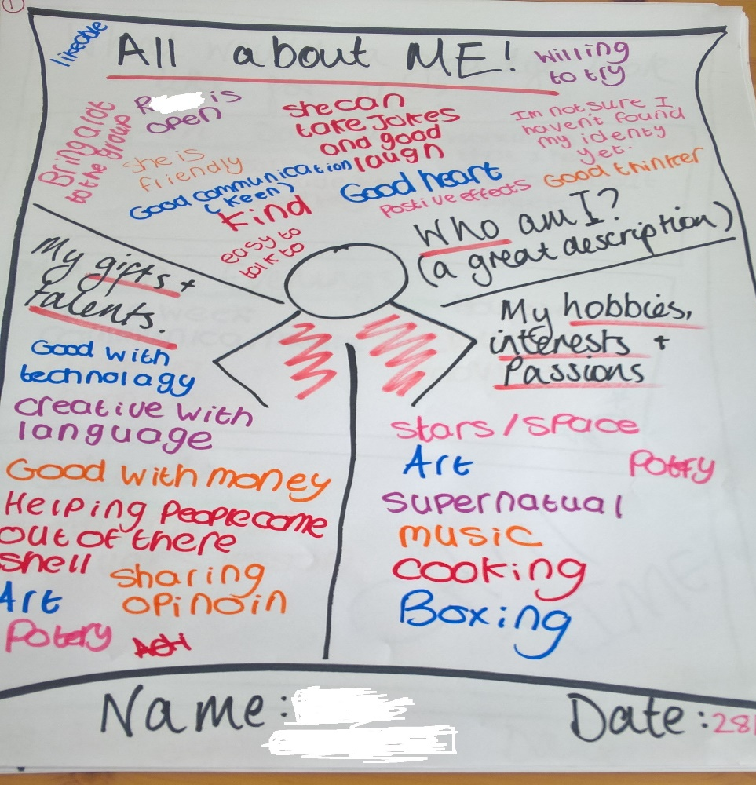
Notes:
One of the first posters is ‘All About Me’
Who am I – a great description
My gifts and talents
My hobbies, interests and passions

Slide 18
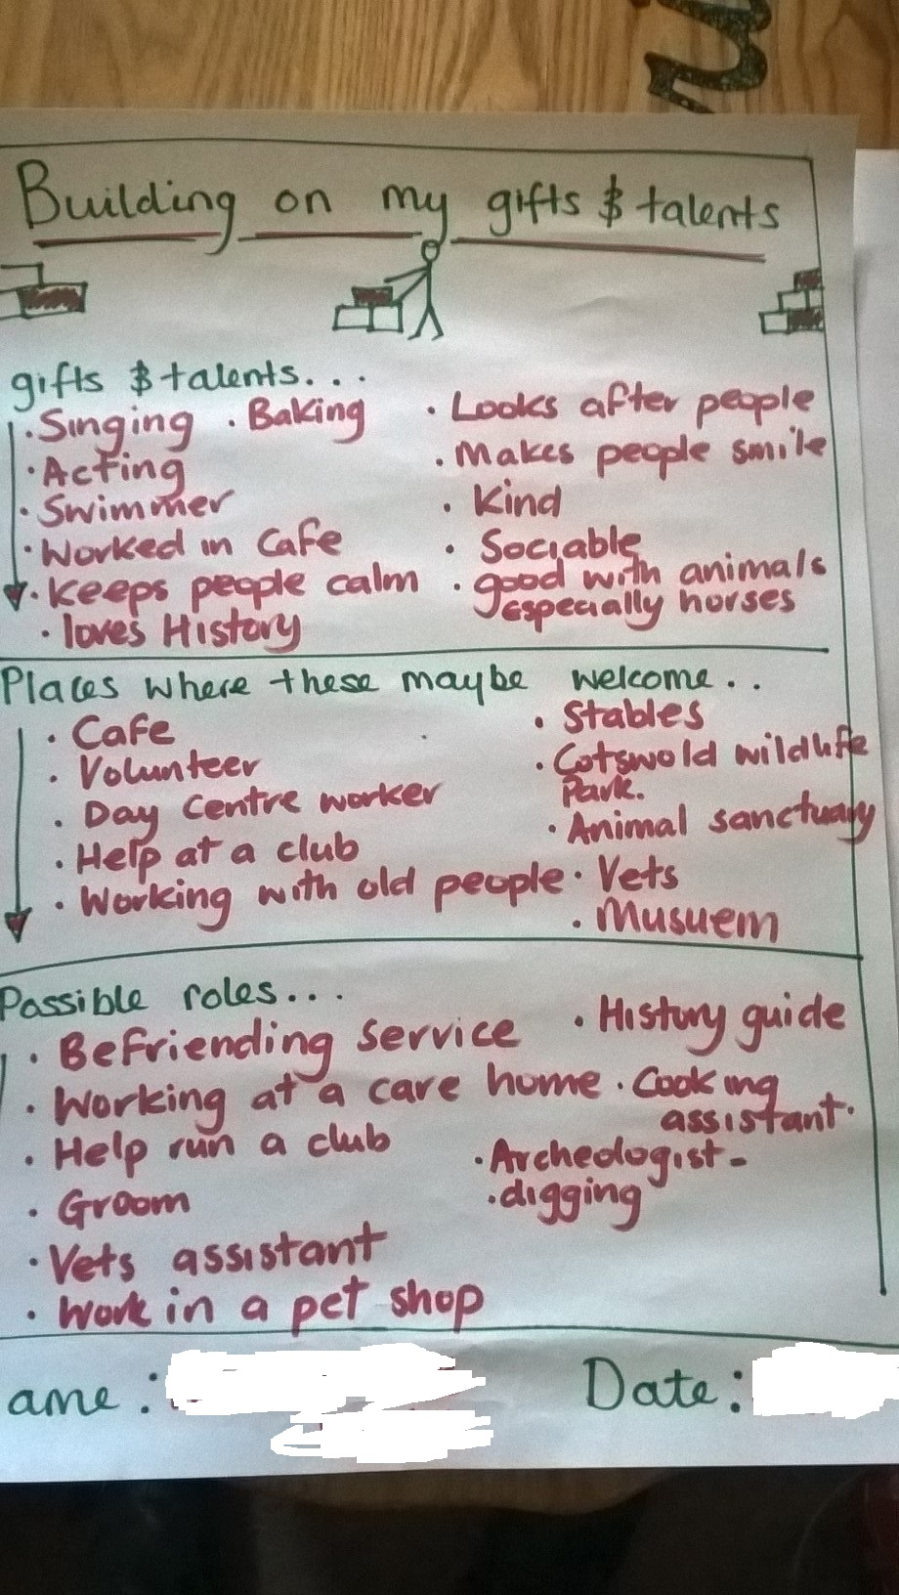
Notes:
The young person then builds on this, thinking more about their gifts and talents, and places where they might be welcomed, helpful, useful, and for older children, possible roles, so for volunteering, work experience, internship or paid work. We often find that the young person identifies gifts and talents that have never been talked about before.

Slide 19
Planning Live
If you want to find out more about Planning Live https://localoffer.swindon.gov.uk/content/send-local-offer/landing-pages/preparing-for-adult-life-landing-and-content-pages/planning-live/ (Commonweal School video)

Slide 20
Question and Answer Session
Alison Forster, Service Manager, Transitions
Hannah Ferguson, Team Manager, Transitions

Slide 21
Thank you and your feedback
Alison Forster – Aforster@swindon.gov.uk
Hannah Fergusuon – Hferguson@swindon.gov.uk

