Slide 1
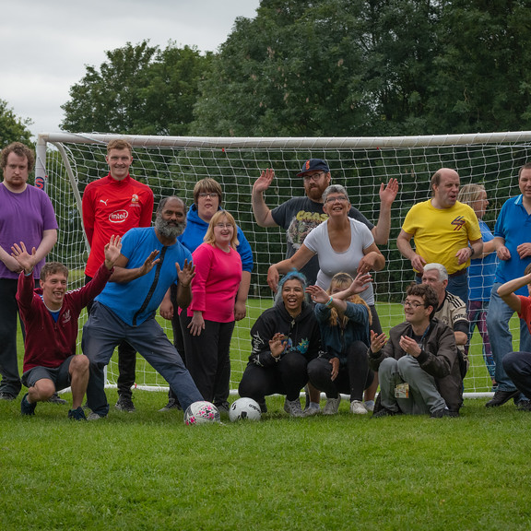
Phoenix Enterprises
Making a difference by supporting mental health and learning disabilities

Slide 2
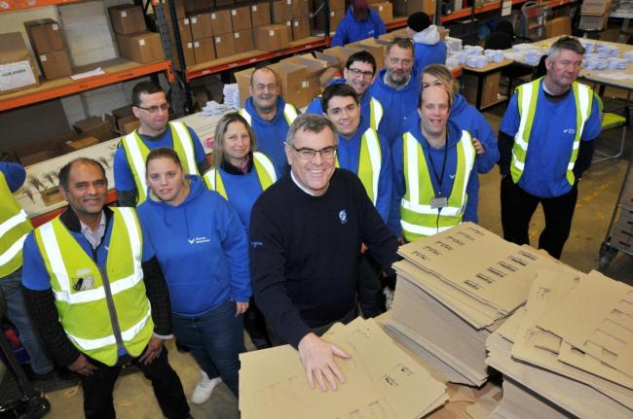
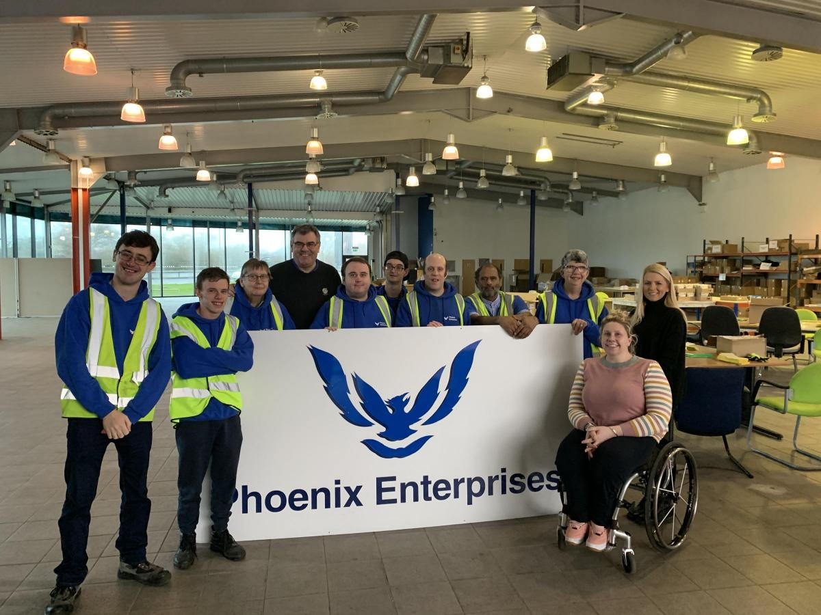
About Phoenix Enterprises…

Slide 3
Stepping Forward with Phoenix!

Slide 5
What is Stepping Forward with Phoenix?
Stepping Forward is a brand new project we have started here at Phoenix, which aims to help communities in Swindon get the extra support and advice to allow the individual to make their first steps into employment.

Slide 6
What the project offers
Creating an up-to-date CV
Support with job searching and applications
Interview practice
Support in finding and completing further educational courses or work experience
Support in transitioning into paid employment
In house training at Phoenix

Slide 7
More on the project
The project is set out over 18-months
It is a structure, supported and tailored plan to the individual
We aim to act as a stepping-stone towards their future employment and we want to maximize their potential to help reach their career goals

Slide 8
Am I eligible?
The Swindon Borough Council and the Government has identified three communities in the Swindon area that are not receiving the same employment opportunities as others.
These are;
Members of the BAME community
18 to 24 year olds living in areas of low employment
Women’s refuge or anyone with a history of domestic abuse

Slide 9
Want more information?
You can register your interest by either;
Call 01793 542321
Email Hannah@phoenixenterprises.co.uk or Mackenzie@phoenixenterprises.co.uk
Or visit our website www.phoenixenterprises.co.uk

