Slide 1
GWH Careers Talk
Adult Transitions Roadshow
Service Teamwork Ambition Respect

Slide 2
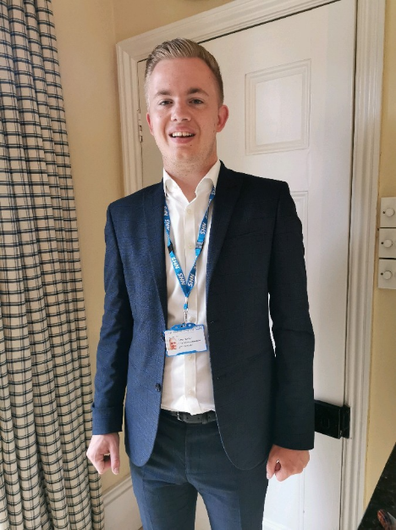
About Us…
Arie Peursum, Recruitment Consultant at the Great Western Hospital.
What does my role entail?
How did I get into my role?
What do I most enjoy about my role?

Slide 3
Roles Available
Medical Secretary
Administrator
Parking Attendant
Roles Available
Healthcare Assistant
Apprentice
Domestic Assistant
Ward Clerk / Patient Coordinator
Receptionist
Notes:
Currently both Inductions

Slide 4
Careers Hints & Tips
When searching for new opportunities look for what transferable skills you have that would be suitable for the role.
Keep you CV up to date with all job roles and their duties.

Slide 5
More information & how to Contact us
Great Western Hospital Website - https://www.gwh.nhs.uk/
Recruitment Team – 01793 607975
General Recruitment Email – GWH.recruitment@nhs.net
NHS Jobs - https://www.jobs.nhs.uk/
@GWH_CAREERS
@CAREERSGWH
Great Western Hospitals NHS Foundation Trust

