Slide 1
Empowering learners to shape their future

Slide 2
Empowering learners to shape their future
Preparing For Adulthood Transitions Road Show September 2021

Slide 3
Who are we? what do we do?
Empowering learners to shape their future
Post 16 Independent Specialist Provider
Two Campuses
Our care and support for our Learners are always at the heart of what we do, where our Learners learn new skills and are better equipped for the future. Our College community depends on us staying focused on what make us excellent: a place of innovative and inclusive learning community for all, and a safe, stimulating Learner focused environment.

Slide 4
Transitions Preparing for Adulthood
Empowering learners to shape their future
“The transition from childhood to adulthood is a time of celebration, change and challenges for all young people between 13 and 25 years old. Careful planning for this process is key to helping all young people make decisions about their future: about their career, their continuing education, their social life and where they might like to live. Having access to timely and comprehensive information, advice and guidance can be enough to help them reach their goals.”
www.Swindon.GOV.UK
Notes:
Horizons college is the final piece of the puzzle in your young persons education. We want to support you and your son/daughter in their transition to adulthood. We know that the here and now is important but we also want to work with you all from the start to ensure the be possible outcome for your young person when they leave Horizons. This presentation will give you an overview of what to expect as well as an opportunity to meet staff who work with your young person.

Slide 5
Our Vision: Empowering learners to shape their future
Empowering learners to shape their future
To be an innovative and inclusive learning community for all.
To provide a safe, stimulating learner centred environment.
To equip learners with skills for work and life.
To collaborate with our local community and employers through effective partnerships.
To develop independence and the confidence to carry on their journey through adult life.
Notes:
I WOULD LIKE TO INTRODUCE THE TEACHING TEAM WHO PUT THIS INTO PRACTICE EVERY DAY

Slide 6
Our Cohorts of Learners
Empowering learners to shape their future
Young people with moderate learning needs some of whom have the potential to progress to supported Internship
Young people on the autistic spectrum and/or with complex learning needs who require:Assesses the starting point- APPS-BKSB-Therapies and WAT
Young people with profound, multiple learning needs who require: specialist setting and therapy support

Slide 7
Know the Curriculum
Empowering learners to shape their future
Our curriculum is:
Based around the individual learner EHC plan
Preparing for Adulthood Pathway
Pictures of potential ( Individual)
Assesses the starting point- APPS-BKSB-Therapies and WAT
Cultural Capital – Essential knowledge that learners need to prepare them for future success
Notes:
So bringing this altogether we can see how the learners curriculum has been built during the past three weeks:
EHCP
Picture of potential
Pathway to adulthood
Baseline assessment which includes: maths, English, soft skills, therapies, wellbeing
This ensures that we know and can answer:
Why we do, what we do
Why we provide, what we provide
Why this curriculum for this learner?
3 I’s are embedded throughout everything
Task: Can a new member of staff say what APPS means

Slide 8
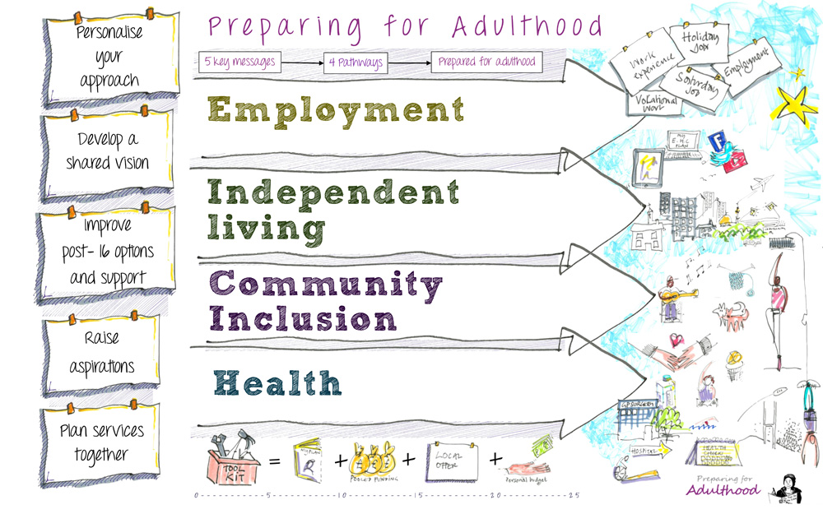
Curriculum Flow chart
Empowering learners to shape their future
Notes:
As you will see our curriculum compliments the outcomes for preparing for adulthood:
Employment: Our learners access work and enterprise activities
Independent living: All aspects for example: Activities for daily living
Community inclusion: Accessing the community, sense of belonging
Health: Personal Development, wellbeing and exercise

Slide 10
Questions?

Slide 11
Empowering learners to shape their future
Contact Us
Genti Mullaliu Principal of College Telephone Number: 01793 481493 Email: gmullaliu@uetcollege.ac.uk
Find us on Facebook
Uplands Educational Trust
Follow us on Twitter
@UETSwindon

