Slide 1
Preparing for Adulthood Transitions Roadshow
Sept 2021
Morag Sullivan
Children’s Services – Employment and Skills

Slide 3
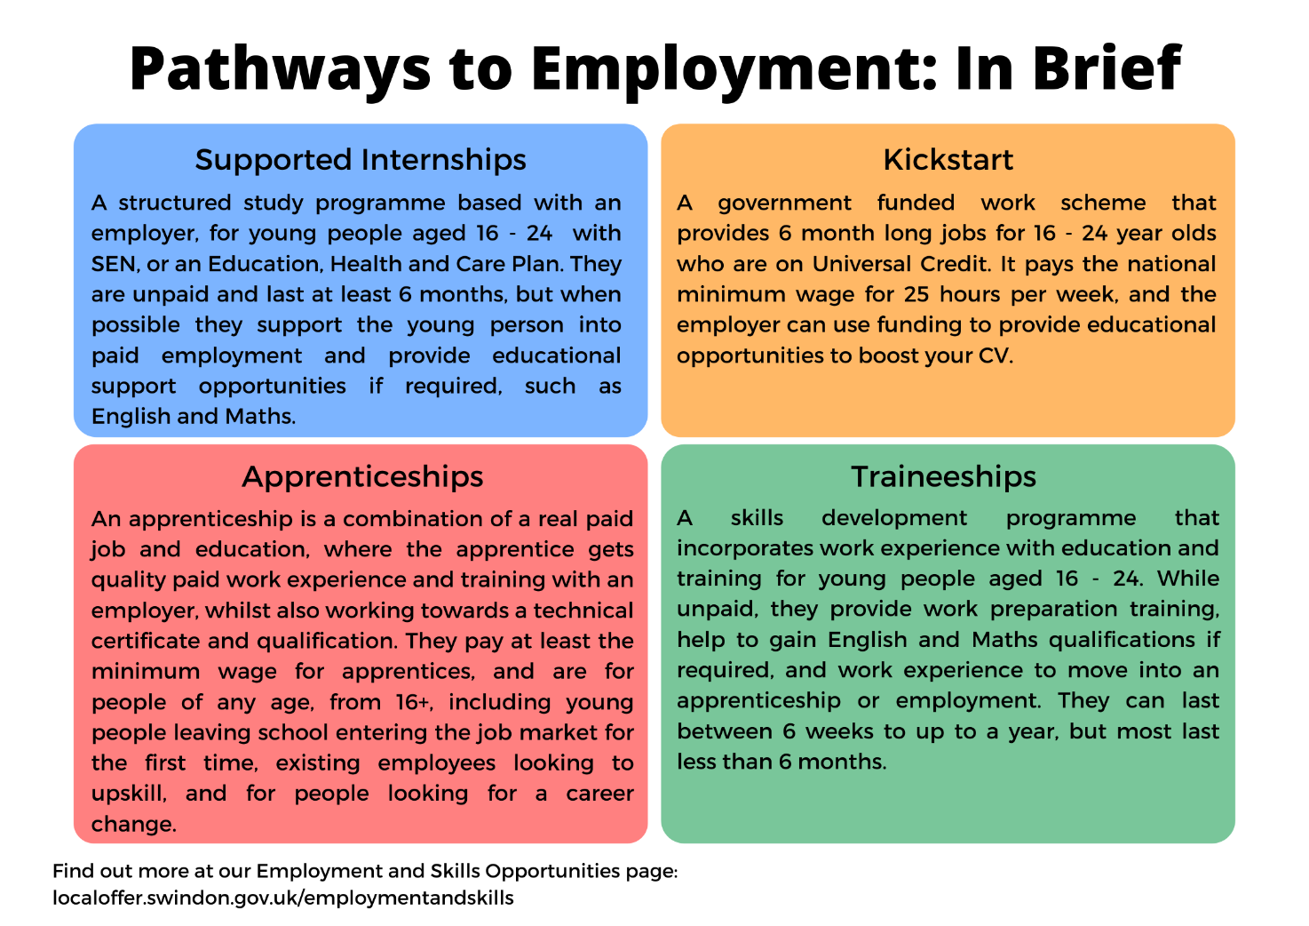

Slide 4
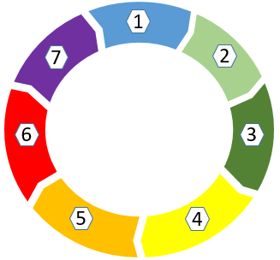
Higher Education across Swindon and Wiltshire
Wiltshire College and University Centre
Campuses – Lackham, Salisbury, Trowbridge and
Chippenham
Courses – various: Education, Engineering, Life Sciences
Swindon and Wiltshire Institute of Technology –(IOT)
Campus – North Start campus, New College Swindon
Courses – focus on Science Technology, Engineering & Maths
(STEM) – also Health and Creative & Media
7
Minute Briefing
Oxford Brookes University
Campus –Delta Business Park, West Swindon
Courses - BSc Nursing (Adult)
Wilkes Academy of Performing Arts
Campus – Westmead, Swindon
Courses - BA Hons in Musical Theatre
Independent Training Providers (ITPs)
Examples –Green Labyrinth, QA
Courses - Higher Level Apprenticeships
Royal Agricultural University (RAU) –Cultural Heritage
Institute
CHI Campus – London Street - railway heritage quarter of Swindon
Courses – Postgraduate courses in archaeology, applied heritage and historic environment management
RAU Campus – Cirencester
Courses –Agriculture, Food Sciences and the Environment
New College Swindon
Campus – Queen’s Drive, Swindon
Courses - Various – e.g. BA (Hons) Advanced Make-Up, Hair and Prosthetics, Education, Performing Arts – refer also to IOT

Slide 5
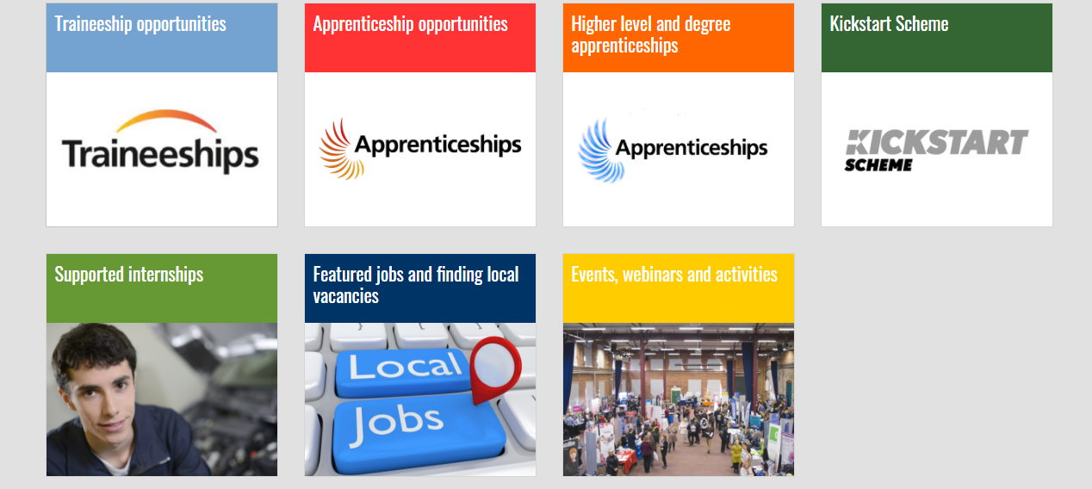
Local Offer – Employment and Skills Opportunities
https://localoffer.swindon.gov.uk/employmentandskills

Slide 6
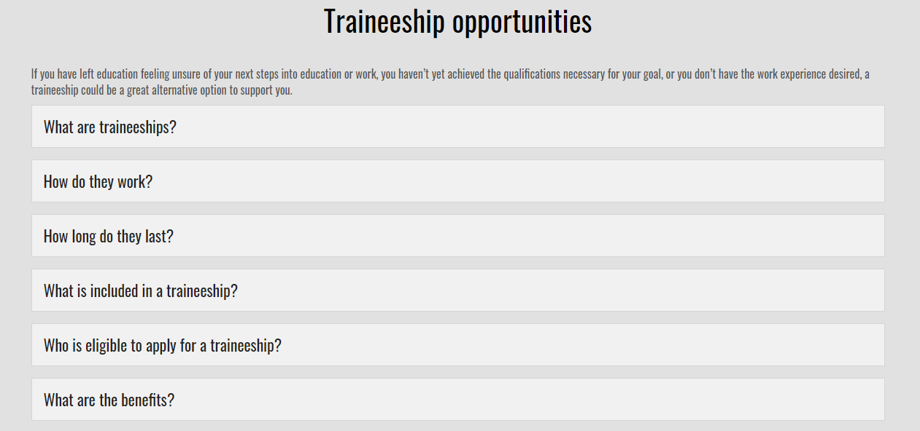
Local Offer – Employment and Skills Opportunities
https://localoffer.swindon.gov.uk/employmentandskills

