Slide 1
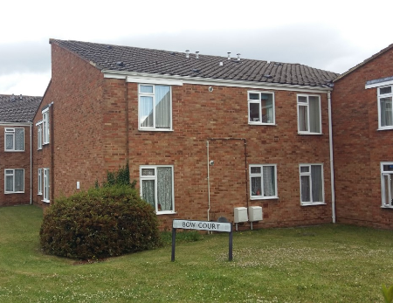
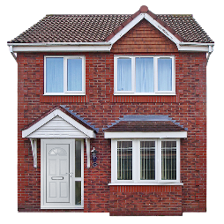
Supporting you to access the right accommodation

Slide 2
Who are we and what is our role?
Chelsie Eddolls & Jess Little
Lettings team predominantly supporting ASC colleagues
Elaine Turner
Commissioner Learning Disabilities, Adult Social Care Commissioning

Slide 3
Objectives of today
To understand types of accommodation available
Understanding processes involved
To understand who to contact and when

Slide 4
First Steps
Start thinking about the future
Lots of people want to stay living with family
Other people may want to live somewhere else
Talk to your social worker or link worker to help decide what is the best option for you

Slide 5
If you think you might want to live somewhere else away from your family
Your social worker or link worker can explain the different options that would work for you.
They will look at what support you will need to keep you healthy, well and safe.
They will talk to you about what you want to achieve, what are your goals.
They will talk to you about how you can be more independent

Slide 6
When to register for housing
You can register at any time.
The sooner the better.
You can do this, or your family, or your social worker can help you.
Apply for council housing | Swindon Borough Council https://www.swindon.gov.uk/info/20025/homes_and_property/276/apply_for_council_housing
We need you to be registered on Home Bid for any of the Councils accommodation offers

Slide 7
Housing applications.
When to complete?

Slide 8
How long does it take until I can move?
The Housing Team work with lots of people wanting accommodation, it can take some time.
We have accommodation just for young adults who are supported by Adult Social Care, so this can be quicker.
Once you are registered on Home Bid, it helps us understand what you might need, and when, so we can plan properly.
Your social worker will help you with this

Slide 9
There are currently 5,983 people on the housing register. Average waiting times for properties are:
1 Bedroom
(for single people or couples)
2 years
2 Bedroom
(for families or people who need overnight support)
1 year 8 months
3 Bedroom
(for families)
1 year 8 months

Slide 10
Different types of accommodation
The council has different accommodation available.
Your social worker can help you decide what type is best for you.
Some people want to live on their own and be really independent
Other people will want to have some support around or to live in a shared house with support
The next few slides will explain what accommodation we have

Slide 11
General Needs Housing
How to apply
Who is it for
Eligibility
Setting expectations
Waiting lists

Slide 12
Housing with support from Adult Social Care

Slide 13
Supported Housing
Bow Court
Booker House
These are single flats in a scheme where support staff are available.
Supported Housing is great for people who need a little bit of support with things like money, bills and shopping.
Most people there have about 2 or 4 hrs of support a week.

Slide 14
Move on accommodation
Maryfield
Firethorn Bungalows
William Robins Court
The above accommodation can have higher support in place.
The support you need will be agreed before you move in
This accommodation in not a home for life, most people move on to something
more independent after 2 or 3 years

Slide 15
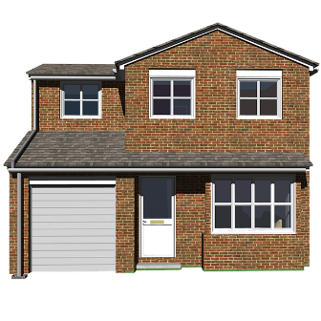
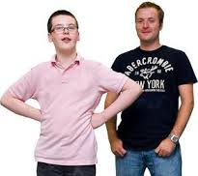
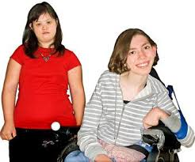
Shared Supported Living
This is where 3 or 4 people share a house and have support in place generally during the day and over night.
It is important that you like the people you are living with and that they like you.
The support staff will help you to be more independent and achieving the things that are important to you. We call these goals or outcomes.
You can move on from shared supported housing, your support provider and your social worker will help you do this.

Slide 16
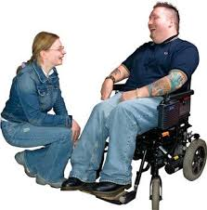
Individual accommodation for complex needs
There will be some people (not many) who struggle to live with others, or who might have challenges or very high needs.
We can look at an individual service for you, to have your own home with your own staff team to support you.
We do not do this very often as most people can be supported in other accommodation.
Your social worker will help you if you feel you need this kind of accommodation.

Slide 17
Housing application
ASC form completed
Support Plan shared

Slide 18
If you lack capacity to sign a tenancy, then you will need a Court of Protection Deputyship in place.
In most cases a family member will apply on your behalf.
Please talk to your social worker who can help you with this application.
Your Tenancy can only start once the Court of Protection Deputyship has been applied for or is in place.
Capacity & Deputyship

Slide 19
Tenancy Services & The Portal
In your 'My Housing Tenancy' account, you can:
make rent payment, view your rent payments and check your account balance
report and manage housing repairs
update your personal details and household information
update details of your Neighbourhood Housing Officer
To create an account, you will need to have your tenancy, rent or application reference number to hand.

Slide 20
Assisting residents of Swindon who are homeless or threatened with homelessness
Homelessness Reduction Act 2017
Temporary tenancies/private renting/emergency housing
Supported Housing –
St Ives
Baileys
Underwood
Tyndale
All the above are temporary low level supported housing
HOptions@swindon.gov.uk or call 01793 445503
Emergency Accommodation and Housing Options

Slide 21
If your query involves:
rent collection and problems with rent payments
problems with anti-social behaviour
changing tenancy details, for example, an application for joint tenancy or ending a council tenancy
general enquiries about your tenancy
You can contact a member of the team below:
Neighbourhood Management Team 1
Areas include: Stratton, Lower Penhill, Outer Penhill, Inner Penhill, Highworth, Blunsdon and North rural villages.
Email: HousingTeam1@swindon.gov.uk
Neighbourhood Management Team 2
Areas include: Pinehurst, Gorsehill, Rodbourne, Moredon, Railway Village, Toothill, West Swindon and Freshbrook.
Email: HousingTeam2@swindon.gov.uk
Neighbourhood Management Team 3
Areas include: Park North, Park South, Walcot, Wroughton, Eldene, and Liden.
Email: HousingTeam3@swindon.gov.uk
Housing officers

Slide 22
Adaptations and OT involvement
Any adaptations required within housing will require an Occupational Therapist involvement and a full report which will be attached to your housing application.
Please ensure housing are aware of these adaptations are communicated to housing with as much notice as possible.

