Slide 1
Voyage Care

Slide 2
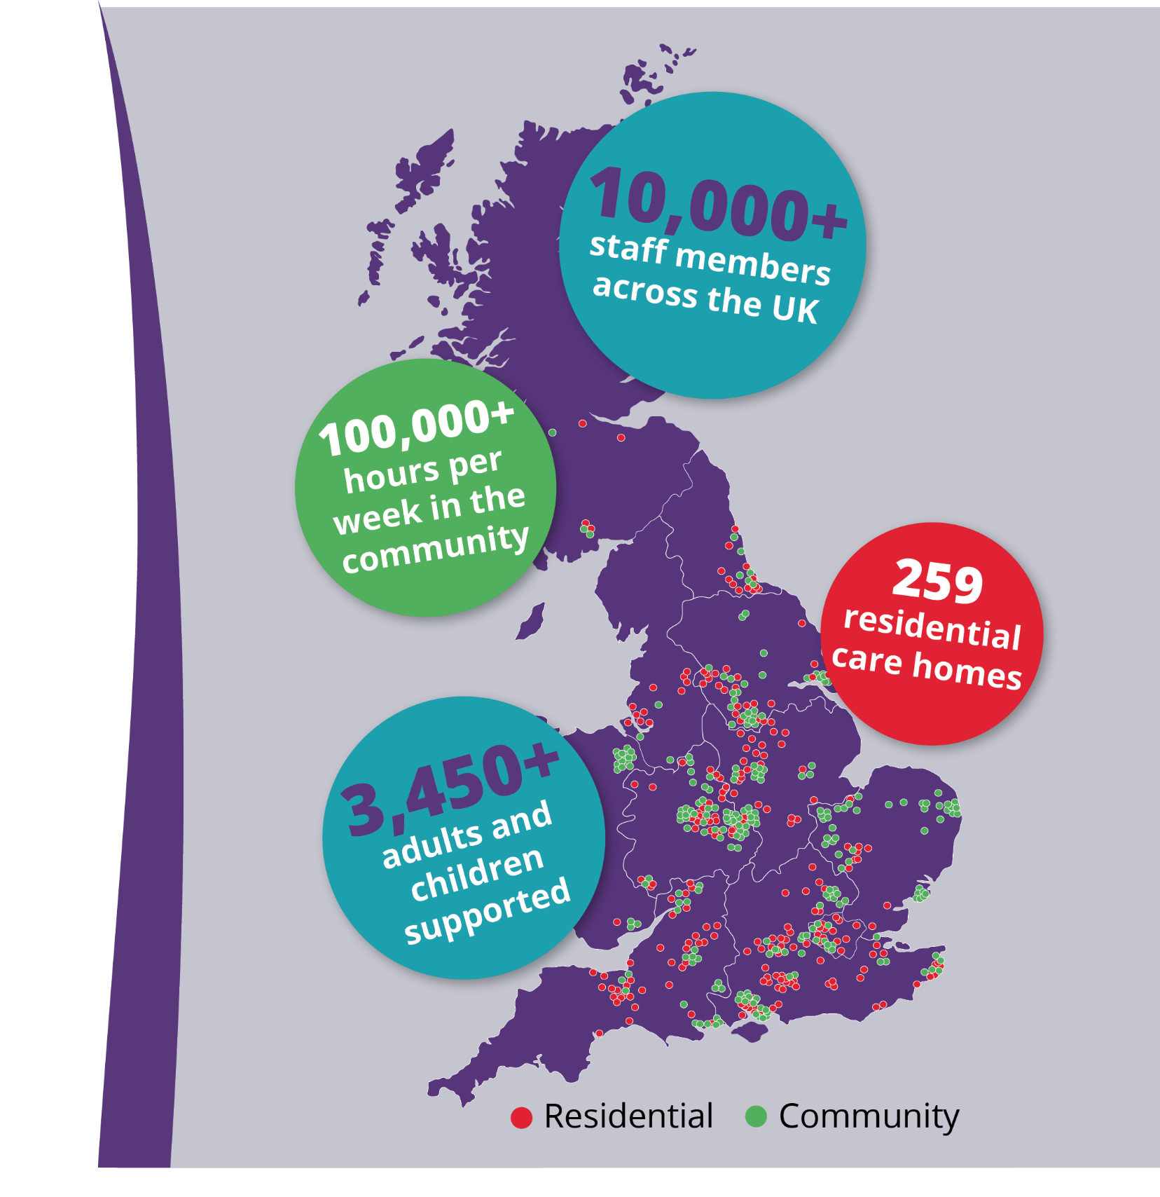
About Voyage Care
Voyage Care are the sector leading specialist provider of care and support with over 30 years of experience. Our person-centred approach enables adults with learning disabilities, autism, brain injuries and complex needs to live the life they choose.

Slide 3
Types of support in the Swindon area
We work with the people we support, their families and their support network to identify and source the setting that best suits their needs. Whether that’s in their home, in supported living or in a registered care home, the individual can rely on us for safe, flexible and personalised support in the right setting.

Slide 4
Our specialisms
Everybody is different and it’s important to us that the individual’s care and support is tailored to their individual needs. To achieve this, we take the time to get to know them and put their preferences at the centre of everything we do.

Slide 5
Person-centred approach
We have four key stages to ensure a successful transition
Our proactive and person-centred approach to active support ensures an individuals transition, at whatever stage of life, is positive and smooth. This includes:
Working together with the individual and their support network.
Creating a structured and flexible transition plan to help alleviate any worries.
Open and honest communication throughout, providing clarity and reassurance when it is needed most.
Active support in a way to suit the individual as they move into their new home and going forward. This means providing just enough support with the individual.
1
Introductions
2
Developing the
transition plan
3
Implementing the
transition plan
4
Reviewing the
transition plan

Slide 6
Transition support
Our transition plans are:
Designed with you and focus on your individual needs.
Flexible and reviewed regularly.
Help to promote and understand good mental health and emotional wellbeing.
Recognise your strengths, skills, challenges and triggers.
Include action plans to help achieve your hopes and aspirations relating to education and employment, community inclusion, independent living, health and emotional wellbeing.
Transitions should be as positive as possible for the young person and their family.
We work in partnership with young people, families and their teams to develop positive relationships, including spending time with transition teams in schools and colleges and support teams in hospital units. These relationships support us to create clear pathways that ensure young people are at the heart of the transition processes at every stage.
Our transition plans are co-produced with you. Young people are treated as equal partners in transition and ongoing support planning. They are supported to develop the skills they need to make informed decisions and increase choice and control.

Slide 7
Making the move
Case study
Mark* lived at one of our residential care homes that that specialises in working with individuals to prepare them for transition into supported living.
He has autism, a learning disability and wanted to increase his independent living skills before transitioning into supported living. Our team helped Mark to plan skills that he could gain. This included improving his cooking skills, his kitchen safety awareness and using a temperature probe to check if something was fully cooked.
Mark also wanted to increase his confidence in accessing the local community. We helped him to achieve this in stages. First, we went to the shops together, then we would walk behind him at a distance until he felt comfortable enough to travel into town by himself. As part of this, we encouraged Mark to consider road awareness and the traffic light system.
Once Mark felt confident enough, we helped him to find his perfect supported living property. Here, we supported him to transition to his very own home! Through helping him to learn basic money skills and use a budget planner, Mark is continuing to live a happy and independent life.
Transitioning to adults’ services can be daunting for you and your loved ones.
We work in collaboration with your health, care and support network to ensure:
You are in control and have choice.
Each step of the process is clear.
Your support plan is centred on your needs and wishes.
Your transition to our support is smooth and successful.
Advance planning allows for a clear and smooth transition process. We believe in transparency and collaboration. This means that everyone involved knows exactly what is happening.
*Names have been changed for confidentiality

Slide 8
Supported living
Supported living empowers people to choose the right amount of support, letting them lead an enriching and fulfilling life. This support can be from a few hours a week up to 24 hours per day if needed.
Our support is tailored to the individuals needs. We work with people to create personalised support plans based on their interests and aspirations. We work closely with specialist registered housing providers who will support the people we support with managing their tenancy.
We can support people to find a home that is right for them, whether that is living alone, in shared housing or in an apartment block.

Slide 9
Community support
Day opportunities
We can support individuals in their own home or out in the community, and we work with them to create a tailored support plan that involves their goals, interests and preferences. The experiences people we support take part in will give them the chance to learn new skills, engage in their local community, gain a new found independence and enjoy plenty of interactive activities.
Our staff regularly review support and activity plans to ensure the people we support accomplish their goals and are receiving the right level of support.
Our passionate and caring teams will help individuals get the most of out their day and their budget, so they can lead a happy life without limits. Our teams to support people with the following:
Community inclusion like day trips as a group or individually or accessing leisure activities.
Health and well-being such as exploring opportunities to exercise and leading a healthy lifestyle.
Developing your skills and confidence in the community by supporting people to travel independently, providing training and teaching money managing skills.
Preparing for work or education by learning about CV writing and gaining interview skills.

Slide 10
Residential care
We have a vacancy at
Westwood
House!
Our specialist residential care homes are more than somewhere to live, we offer somewhere for people we support to make their home.
This can be a good choice for college leavers to continue with the structure and planned activities that they been enjoying.
Our experienced staff deliver safe, personalised care and support for the people who live in our residential services, 24 hours a day.
Our residential services can also be a fundamental part of a stepping stone plan to meet an individual’s wellbeing outcomes and become part of a transitional plan into supported living.
Westwood House, Wiltshire

Slide 11
Residential care
We have a vacancy at Cote House!
Our focus is on finding the right home for the people we support, within their chosen community.
Our residential care homes offer long-term, safe and personalised support, 24 hours a day.
Each of our homes have been carefully designed and adapted to meet the needs of the residents.
We support people to do the things that are important to them, both at home and out in the community. This can include continuing with their education or looking for volunteer work.
Cote House, Wiltshire

Slide 13
Meet our team!
If you would like to find out how we can support you or your loved ones through the transition process and to find out about our service vacancies, please contact our team today!
Jen Magill, Occupancy Manager
07540 330 133
JenniferMagill@voyagecare.com
www.voyagecare.com

