Slide 1
Stonewater Supported Accommodation

Slide 2
About Stonewater
A leading Housing Association with nine housing projects in Swindon
Projects include Mental Health, Learning Difficulties, Young People, Domestic Abuse
We offer support from 24 hours to floating support
Fully trained and experienced staff teams

Slide 3
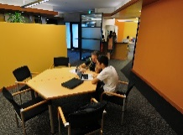
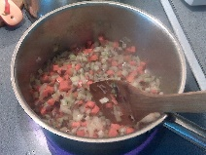
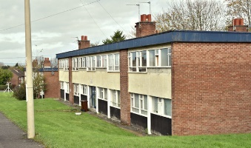
WHAT WE OFFER
To return to or get into Work
To return to Education
To develop independent living skills
Emotional and practical support
To move on to Independent Living

Slide 4
All clients are allocated key worker
Opportunities for on-line training
Apprenticeship Opportunities
Job search, Interview experience
Our Supported Living Services

Slide 5
Q&A

