Slide 1
Warm and Safe Wiltshire
Free and impartial advice for energy use in your home
Elliot Clark
Project Officer
warmandsafewiltshire@cse.org.uk

Slide 2
Who Are We?
A charity called the Centre for Sustainable Energy
Running since 1979
Vision - sustainability, reduced carbon emissions, eliminate fuel poverty
Mission - share knowledge and practical experience, empower others to change their actions around energy
Notes:
Our vision is a world where sustainability is second nature, carbon emissions have been cut to safe levels and fuel poverty has been replaced by energy justice.
Our mission is to share our knowledge and practical experience to empower people to change the way they think and act about energy.

Slide 3
Who Are We?
Warm and Safe Wiltshire is in partnership with Wiltshire and Swindon Councils + Dorset & Wiltshire Fire and Rescue
WarmAndSafeWiltshire.org.uk

Slide 4
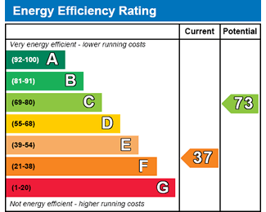
Energy Efficiency of Homes

Slide 5
Energy Efficiency of Homes
 |  | South West %
Energy Efficiency Rating Band | A | 0%
 | B | <1%
 | C | 8%
 | D | 31%
 | E | 38%
 | F | 15%
 | G | 7%
Average band ‘B’ bill is £530 – band ‘G’ is £2200
Moving from ‘D’ to ‘B’ is likely to half your bills
It is now illegal to rent properties that are F or G rated

Slide 6
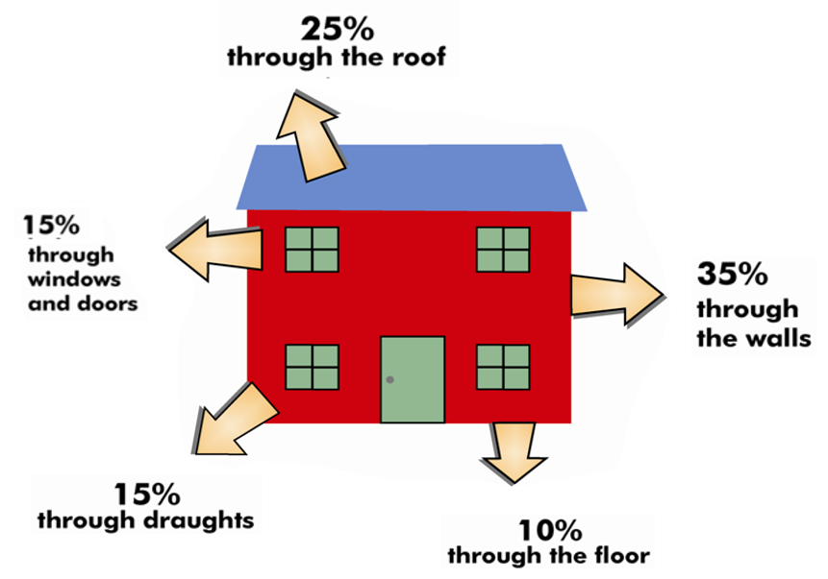
Energy Efficiency of Homes

Slide 7
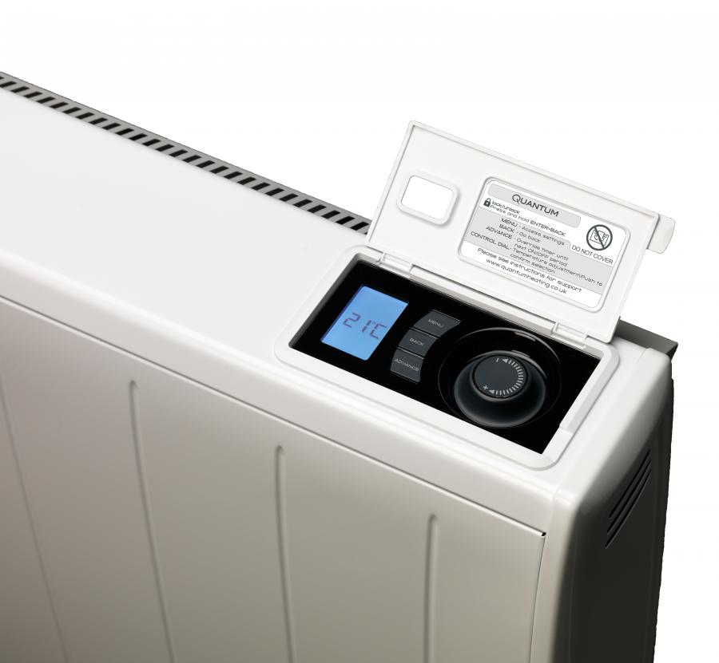
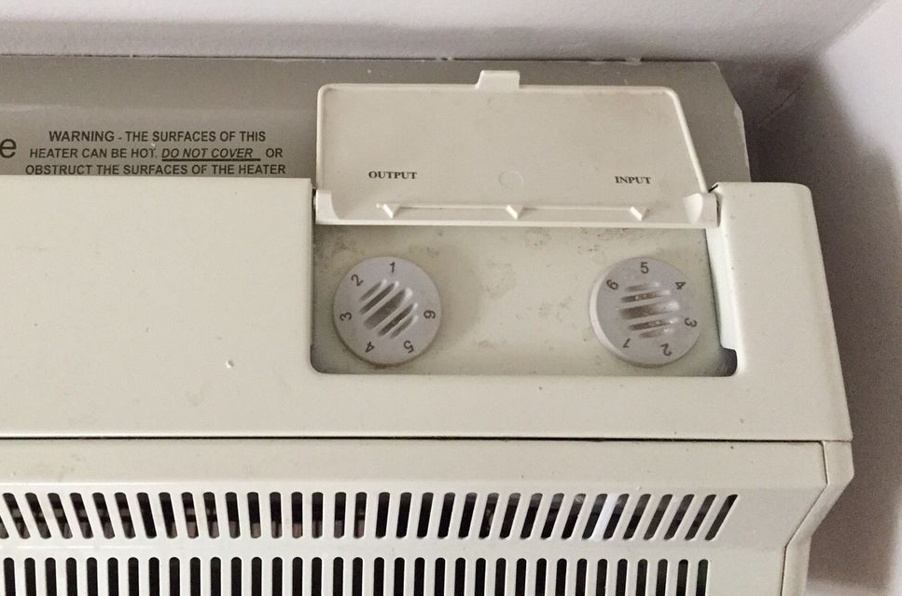
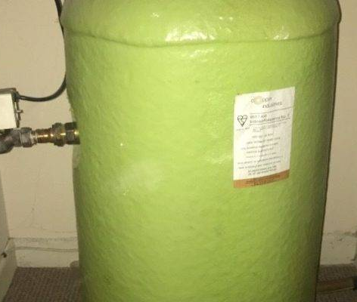
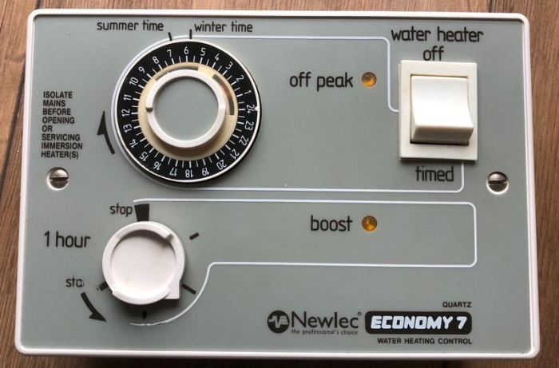
Heating

Slide 8
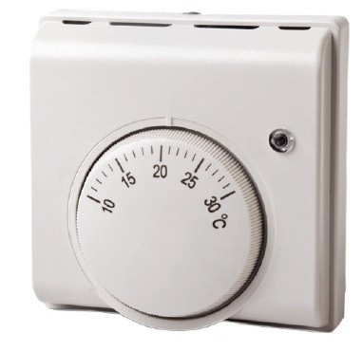
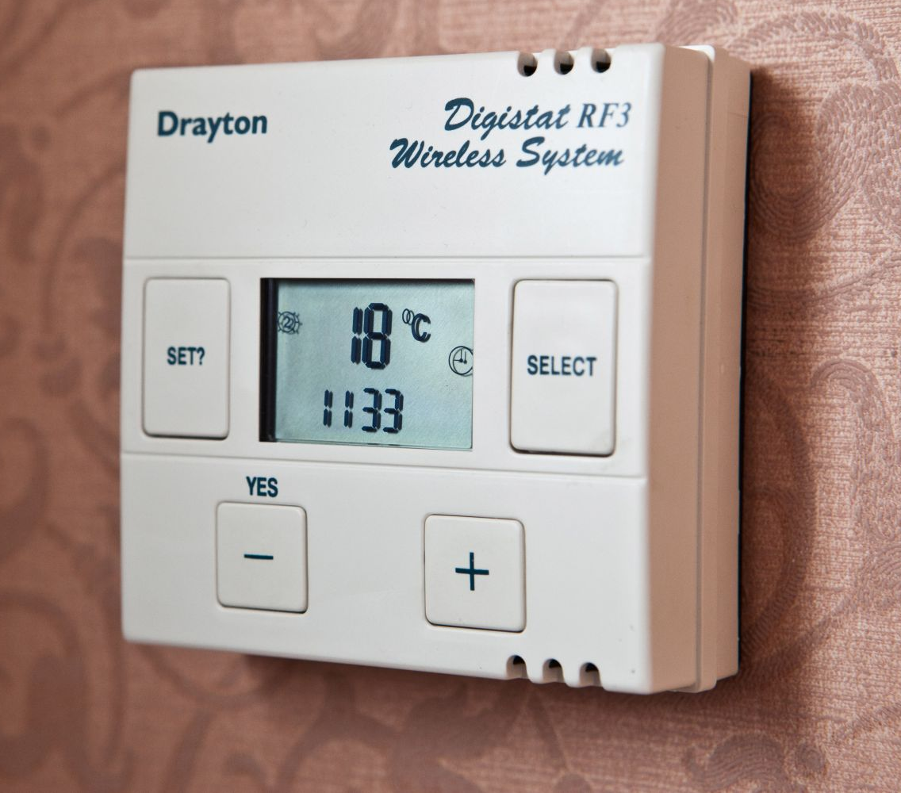
Heating

Slide 9
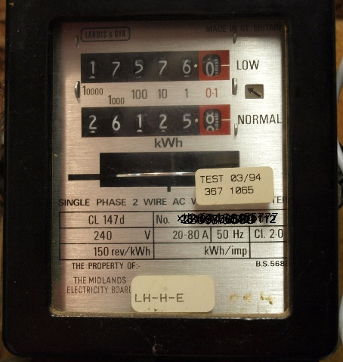
Energy and Water Bills

Slide 10
What We Do
Free and impartial energy advice and casework support
Available to any Wiltshire or Swindon resident
Tariffs checks and help switching supply
Behaviour change and diagnosing reasons for high bills
Schemes applications (e.g. £140 Warm Home Discount)
Help with energy and water debt
Home improvement funding assistance
Partially/fully funded boilers / new heating systems
Fully funded insulation (even as a private tenant)
Supported referral to other relevant services
Free benefits check through Citizens Advice
Free Home Safety checks from the Fire Service

Slide 11
How to Contact Us
Advice Line:
0800 038 5722 (free from mobiles and landlines)
Website:
WarmAndSafeWiltshire.org.uk

