Slide 1
Hearing Support Team
Transition Roadshow
Friday, 24 September 2021

Slide 2
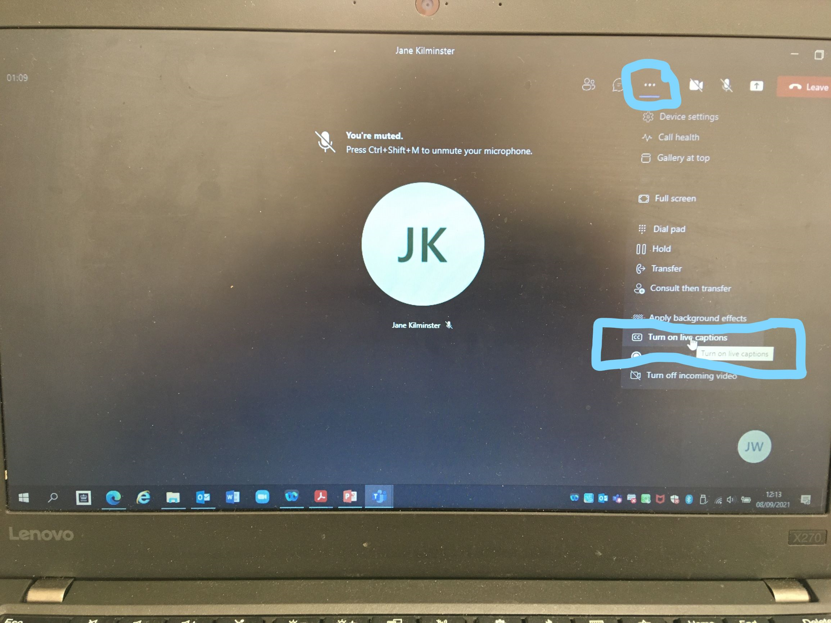
Before we start…
Can you all turn on the subtitle facility on Teams
Notes:
JW

Slide 3
What we do….. the Hearing Support Team
We are Teachers of the Deaf who visit all young people with diagnosed deafness or a hearing loss at school. Contact us at: https://www.swindon.gov.uk/hearingsupportteam
We advise on the best listening and communication environment. This can mean Deaf Friendly Tips on communication and also advice on assistive listening equipment and acoustics.
We can support those on an EHC Plan up to age of 25 in an education environment but are involved in Transition for all young people with hearing loss.
So what can we do to help young people after the age of 14+, still at school or to prepare them for College/University or Work?
Notes:
JK degrees of hearing loss. Different types of hearing aids or none. Different Assistive Listening devices, radio aids/soundfield

Slide 4
Access to….. Further Education
The Hearing Support Team can still support at College. This might mean Deaf Friendly Training for staff, advice on acoustics, notetaker support or loan of Assistive Listening Equipment, such as a radio aid or soundfield system.
Audiology: As you get older you can take more responsibility for your hearing aids. Great Western Hospital have a very useful Transition leaflet. For further information please contact Sharon Bindon who is is the dedicated Transition Audiologist. Email Sharon at s.bindon@nhs.net
Travel: There can be help with rail and bus travel if you are profoundly or severely deaf.
https://www.swindon.gov.uk/info/20031/roads_parking_and_transport/332/concessionary_bus_pass_and_travel_vouchers
Notes:
JW

Slide 5
Access to….. Higher Education
Check your eligibility to funding for support / equipment while studying at University / Higher Education – prepare well in advance:
Disabled Students' Allowances (DSAs): What's available & how to apply - GOV.UK (www.gov.uk)
Equipment you may need and other useful links:
Home | Connevans
Technology and assistive devices - RNID
Technology Test Drive (ndcs.org.uk) – you could test out equipment for CYP aged 8-18 years before purchasing via the National Deaf Children’s Society’s website.
Using your mobile or smartphone - RNID
Useful links for travel:
https://www.swindon.gov.uk/info/20031/roads_parking_and_transport/332/concessionary_bus_pass_and_travel_vouchers
Disabled Persons Railcard | Official Retailer | National Rail (disabledpersons-railcard.co.uk)
16-25 Railcard | Young Persons Railcard | National Rail
Notes:
JK Prepare well for DSA interview. Laptop software etc
Other technology e.g. vibrating alarm clock

Slide 6
Access…..to Work
An Employer must make Reasonable Adjustments to allow you do your job or Apprenticeship (Equality Act 2010). Several organisations can help and support on this. Duty to make reasonable adjustments for disabled people - Citizens Advice
The National Deaf Children’s Society is a very helpful national organization. Families and professionals can join NDCS for free
NDCS Helpline Tel: 0808 800 8880 www.ndcs.org.uk.
A particular useful free publication is linked below:
Next steps: Supporting successful transitions into post-16 education and employment for deaf young people in England (ndcs.org.uk)
Local NDCS website : www.swindonandnorthwiltsdcs.org
There are also Government sites that can advise on this . If you need extra help such as an interpreter or specific help related to deafness you can apply for an Access to Work grant. https://www.gov.uk/access-to-work
Notes:
JW

Slide 7
Any Questions?

Slide 8
Thank You!
Please do not hesitate to contact us
if you have any more queries:
Jenny Wilkins/Jane Kilminster
Jwilkins@swindon.gov.uk
Jkilminster@swindon.gov.uk

Slide 10
Please keep this slide for attribution.

