Slide 1
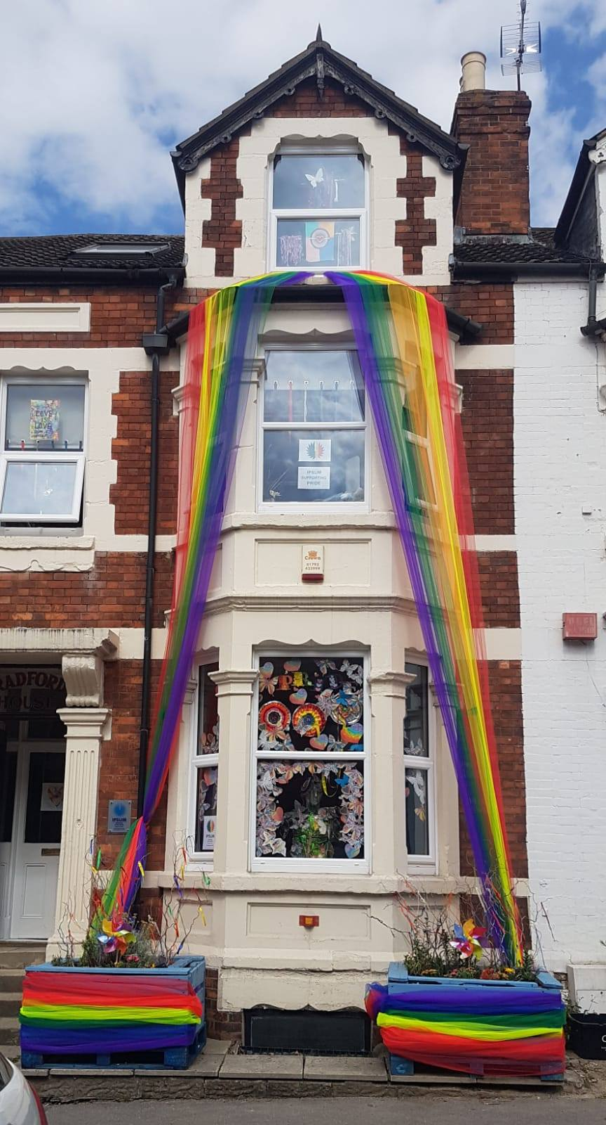
Welcome to Ipsum Mental Health Charity

Slide 2
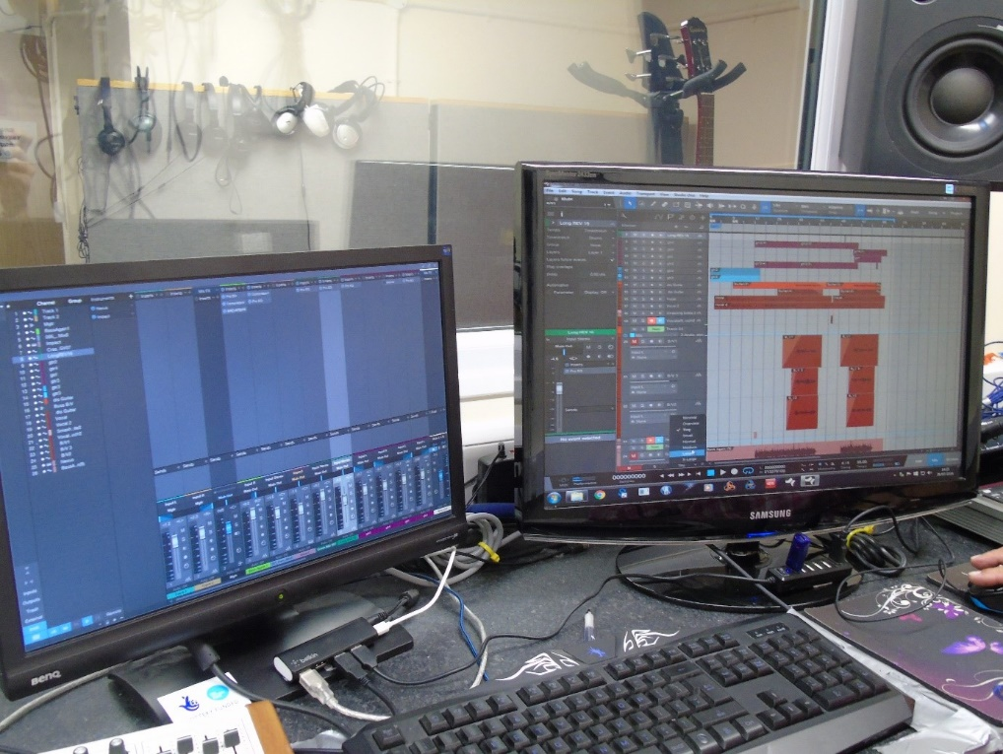
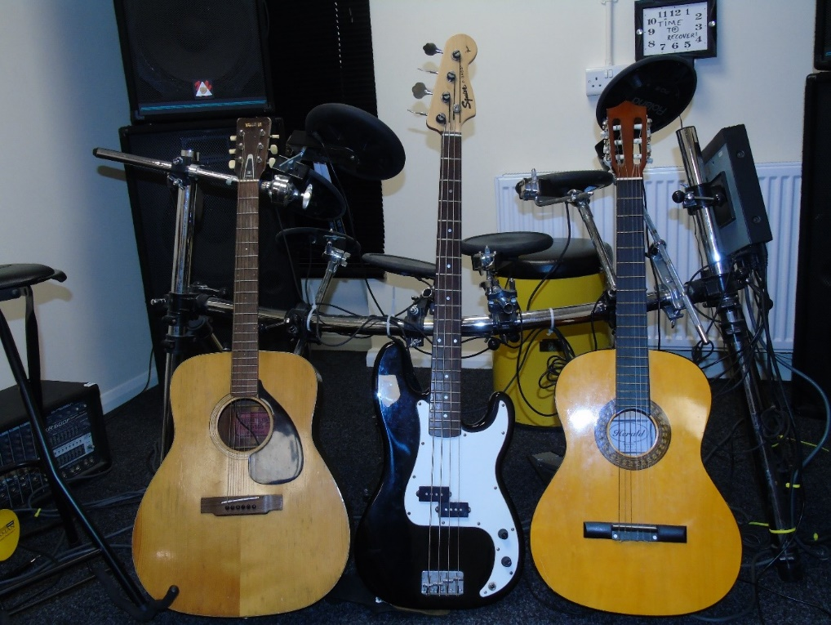
Ipsum is Latin and along with our .care domain we spell ‘self care’ We offer support to ages 11 upwards using therapeutic music and art. We offer BACP counselling to ages 16 and over.

Slide 3
Let us introduce you to Tom
https://youtu.be/qsMSM2IuW44

Slide 4
Who can access Ipsum?
Those aged 11 and over who feel that their mental health will be improved by using Ipsum services.

Slide 5
Is there a cost involved?
Ipsum is a charity and relies on donations to continue.
We try to keep our services affordable and offer between £4 and £10 sessions in art and music.
There may be funding available from the referring professional.
We try to help where we can.

Slide 6
How can you access Ipsum?
Referral from a professional
Ipsum has a handy referral form on our website that can be completed and returned by a professional.
www.Ipsum.care

Slide 7
Do you have any Questions?

