Slide 1
Swindon SEND Families Voice
Focus on services and support during Covid-19 outbreak
240 responses
Friday, June 12, 2020

Slide 2
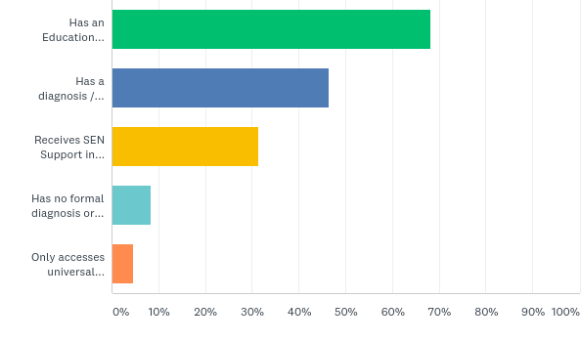
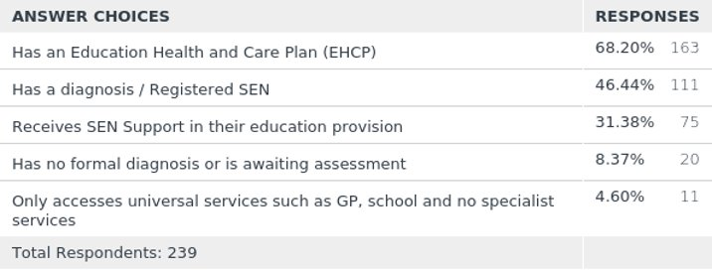
Q1: Which of the following best describes your child in relation to their additional needs?
Answered: 239 Skipped: 1

Slide 3
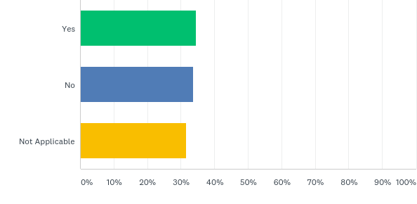
Q2: If your child has an EHCP, when schools closed to the majority in March were you still offered a place in school if you wanted it?
Answered: 240 Skipped: 0
"No, I had to fight for it"
"My husband is a frontline worker and we were offered nothing"

Slide 4
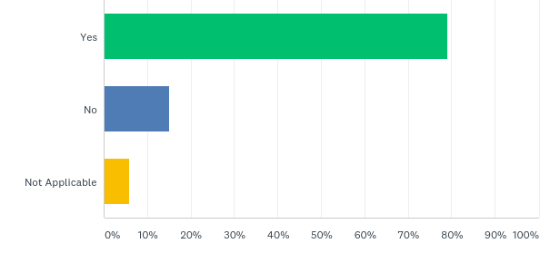
Q3: Have you received home learning either online or in paper format from your child's educational setting?
Answered: 239 Skipped: 1
36 said No: Who were they?
Age | Number
0-4 | 3
5-11 | 20
12-16 | 10
17-18 | 3
 | 36
Setting | Number
Mainstream | 9
SRP | 2
Specialist | 23
Other | 2
 | 36

Slide 5
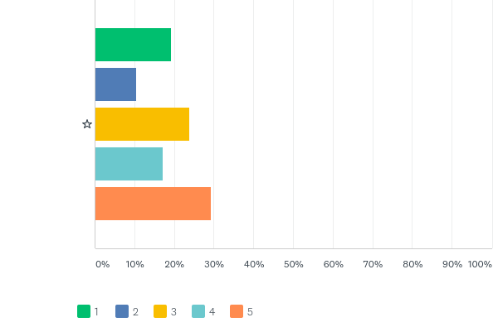
Q4: How supported do you feel with home schooling during this time? Please score from 1-5 (1 = poor to 5 = excellent)
Answered: 239 Skipped: 1

Slide 6
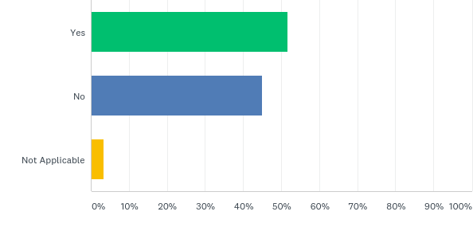
Q5: Have you received information from your child's educational setting about how to support your child's mental health and wellbeing?
Answered: 240 Skipped: 0

Slide 7
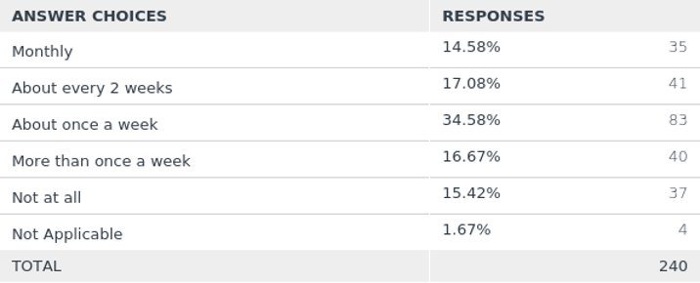
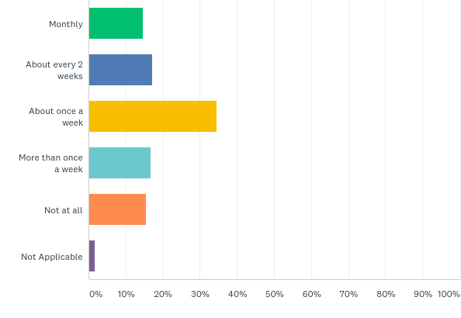
Q6: How often has your child's educational setting (Teacher, TA or SENCO) been in contact with you (via phone or email)
Answered: 240 Skipped: 0
37 Said Not At All: Who were they?
Age | Number |  | Setting | Number
0-4 | 1 |  | Mainstream | 19
5-11 | 18 |  | SRP | 2
12-16 | 14 |  | Specialist | 15
17-18 | 4 |  | Other | 1
 | 37 |  |  | 37

Slide 8
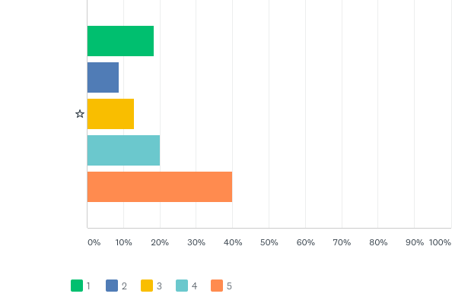
Q7: Are you happy with this amount of communication? Please rate from 1 - 5 (1 = not enough to 5 = just right)
Answered: 240 Skipped: 0

Slide 9
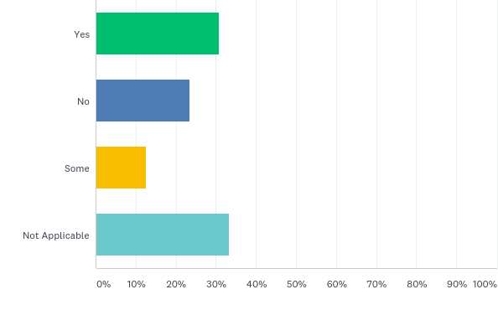
Q8: If your child currently receives health related services, have you had support/contact with the service provider ie SaLT, Complex Care Team?
Answered: 240 Skipped: 0
“We’ve tried to get hold of the school nurse regarding toilet training to no avail.”
“Zero support from any services including LD CAHMS really disappointed”

Slide 10
Q9: Have any appointments/meetings been cancelled due to the Covid-19 outbreak?
Answered: 225 Skipped: 15
All answers that stated appointments have been cancelled
Yes (No other info given) | 28 | Orthodontics/ Dental | 7
Yes but by choice | 3 | Social Care AR | 1
Annual Review cancelled | 11 | SaLT | 3
TAC | 12 | X-ray | 1
Paediatrician | 7 | Ophthalmology | 5
Psychologist | 2 | Audiology | 1
Therapy | 4 | Dietician | 1
Camhs | 7 | Neurology | 1
Hospital (dept not specified) | 2 | Tamhs | 2
Social Worker | 1 | Enuresis | 1
OT | 6 | ENT | 1
PT | 5 | General School Meeting | 2
 |  | EHCP coproduction meeting | 1
Total Appointments cancelled | 115

Slide 11
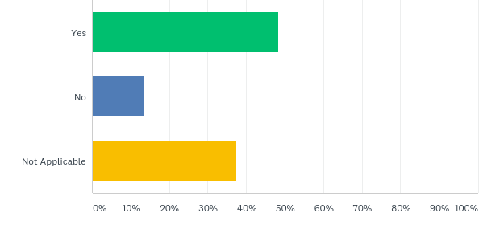
Q10: If you have had any appointments over the phone/video instead of a face to face appointment, did it go well?
Answered: 238 Skipped: 2
“Daughter won’t speak on the phone”
“Better than expected, as Paediatrician was able to see my son relaxed in his home environment”
“Went very well and much easier for me, I'd like it if it was a long term thing.”

Slide 12
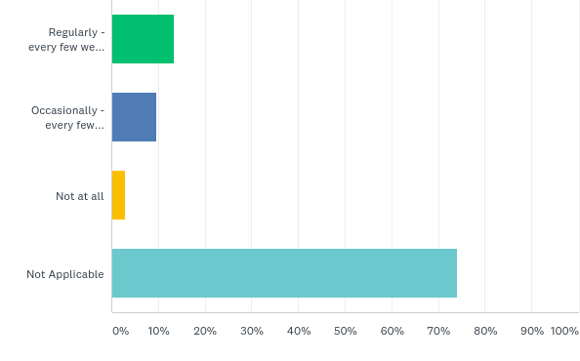
Q11: If you have a Social Worker, have they been in contact?
Answered: 239 Skipped: 1

Slide 13
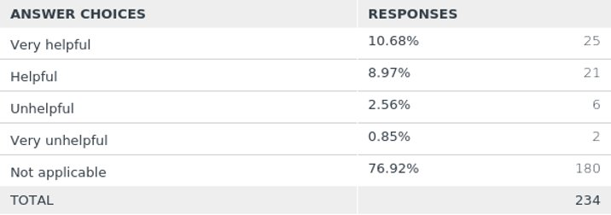
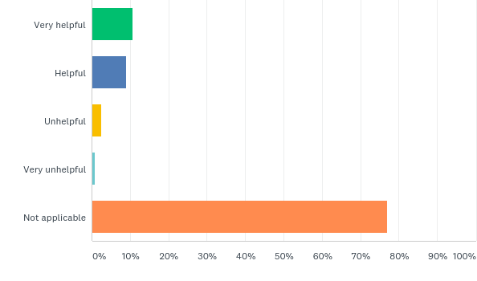
Q12: If a Social Worker has been in contact please tell us how helpful this was?
Answered: 234 Skipped: 6

Slide 14
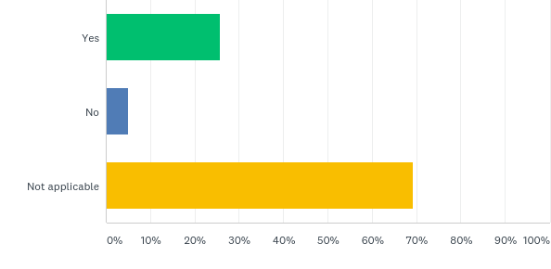
Q13: Do you know how to contact your Social Worker at the moment if you needed to?
Answered: 238 Skipped: 2

Slide 15
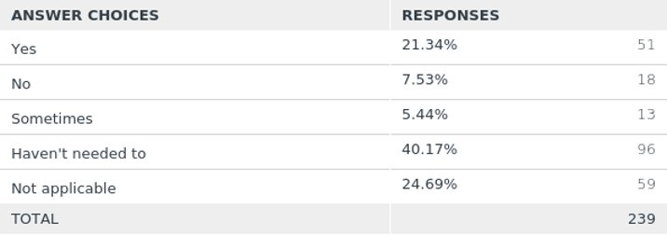
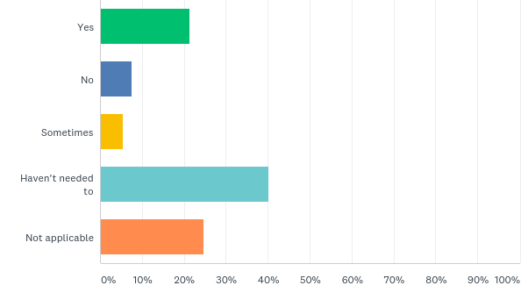
Q14: Have you been able to contact the SEND Services Team (formerly SENAT Team) if you needed to?
Answered: 239 Skipped: 1
"Actually pleased with support"
"They haven’t responded to me"
"I phoned up, and got a call back the next day"

Slide 16
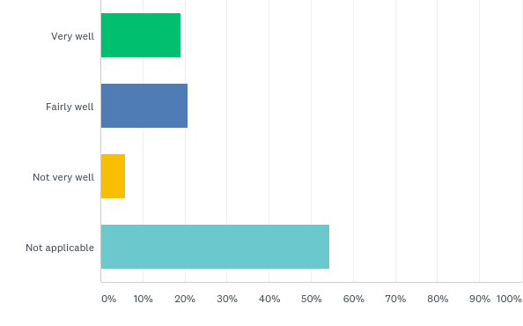
Q15: If you have been in contact with the SEND and/or Health Services in Swindon during this time, how well have you felt listened to?
Answered: 237 Skipped: 3

Slide 17
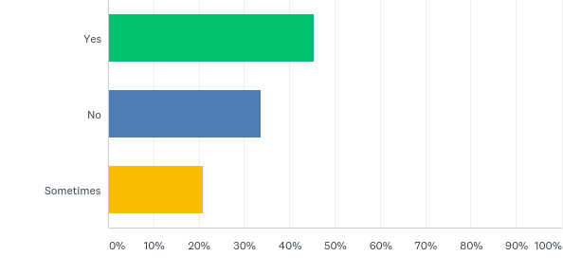
Q16: Swindon Borough Council shared regular communication updates with 1) Swindon SEND Families Voice 2) on the Swindon Local Offer website 3) to schools. Did you see any of this information?
Answered: 238 Skipped: 2
"Local offer has been good"
"Had some information from Hop skip and Jump emailed out."
"Swindon SEND Families Voice only"
"I have no support, I have to search myself for information."

Slide 18
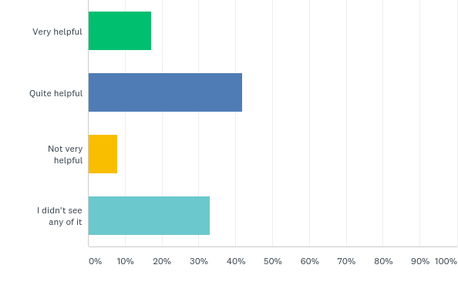
Q17: How helpful did you find this information?
Answered: 239 Skipped: 1

Slide 19
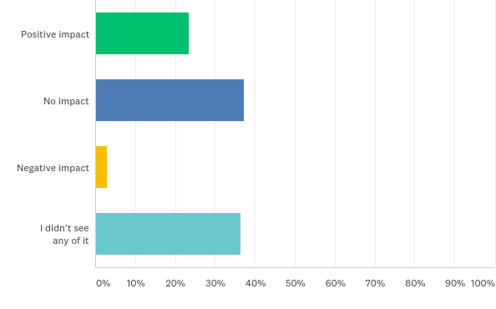
Q18: Did having access to this information and resources have any impact on your child/family situation?
Answered: 239 Skipped: 1

Slide 20
Q19: If you didn't see the regular communication, how could the communication channels be improved in the future?
By Email - 48 ​
By Post - 19 ​
More on Social Media - 8 ​
Phone/text - 6
“I think sending emails is the best way. Many people like me have needed to step away from social media which would be my normal way of getting this type of info.”
“It may have been available to see on social media/email but home schooling an SEN child can be timely, so may have been missed. If sent in the post, I would have taken more notice, as emails get lost in amongst other emails.”

Slide 21
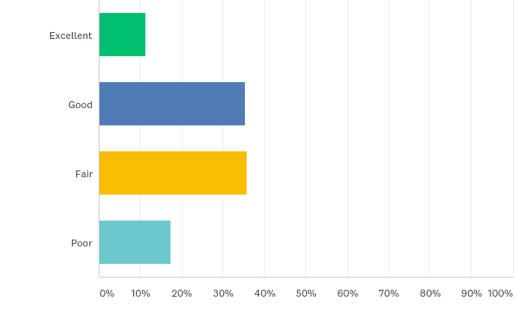
Q20: How well do you feel communicated to generally regarding all of the SEND and Health Services in Swindon during this time?
Answered: 237 Skipped: 3

Slide 22
Q21: Is there a particular area that you would like support and information on but have been unable to access?
Answered: 149 Skipped: 91
17 comments – 7 were relating to support with Home Schooling
"What the options were if child can't access remote learning via email or video, there were no other options"
"Home school tasks for my child. The school have taken a broad brush approach and just told us to look at online resources."
"Feel all services have been adequate in the current situation"

Slide 23
Q22: What has been the biggest challenge for you during the Covid-19 outbreak?
Answered: 223 Skipped: 17
Variety of responses:
Lack of respite
Difficulties around accessing shopping
Home schooling children with SEND alongside neurotypical children
Financial difficulties
Challenging behaviour escalating within children
Increased anxiety/mental health issues

Slide 24
Q23: What are your concerns for the future for your child/young person with SEND in relation to the Covid-19 outbreak and returning to normal?
Answered: 223 Skipped: 17
4 main areas of concern:
1) School/Education was the highest concern with 138 comments
Transitioning back to their current school
How to cope with starting a new school in September
Falling behind with their education
2) General worries/fears was next with 58 comments
Anxiety
Fear of leaving the house
Mental Health
3) Respite received 24 comments
Nearly all said they were worried about the future of HSJ
4) General uncertainty received 15 comments
Being left as services can’t support like they used to
Been waiting a long time for an appointment, now have to wait even longer

Slide 25
Q24: What has helped you during the Covid-19 outbreak?
Answered: 210 Skipped: 30
What has helped you during the Covid-19 outbreak?
School/College checkins | 27 | DCT/ Family Support Worker/ Aiming High | 8
Hop Skip and Jump welfare checkins/ videos on page | 25 | Having partner/husband support | 8
Family | 22 | Financial support (Govt/ able to use DP money in other ways | 7
Friends | 22 | Staying Home/Staying Safe | 6
Online classes set by school/college | 15 | Nursery/ School Place | 6
SSFV info / SEND room | 14 | Cahms | 5
Social Media | 13 | Community nurses/ Paediatricians/ SaLT etc | 5
Walks/ Bike rides/ Outdoor exercise | 13 | Online non school resources - Joe Wicks, BBC Bitesize Twinkl etc | 5
Social Worker support | 12 | ARC | 5
Nothing | 12 | Social Groups/ Church/ Local community support | 5
Good weather | 12 | Assistive Technology e.g Voice Interaction/ school laptops | 4
Family / 1-1 time | 11 | Online/Click & Collect Shopping | 3
Structure / Daily Routine | 11 | Private councillor | 2
Slower Pace of life/ Less pressure | 10 | Medication | 2
Acceptance / day by day/ Staying positive | 8 | Knowing help is available | 2
Zoom/ FaceTime etc | 8 | Staying away from social media/ news | 1

Slide 26
Q25: What could have been done better to help you during the Covid-19 outbreak?
Answered: 180 Skipped: 60
3 Core Themes:
More/better support from schools – 67 comments
More/better communication from SBC and Government – 31 comments
Respite – 31 comments
“All parents with a child with an EHCP should have received contact from their school Senco. This did not happen to me and I had to fight for my place at school. This is wrong and I believe this is why attendance is so low because people do not realise they are entitled to a place. I have not had any contact from school Senco at all. Children still need support and so do the parents especially at this worrying time."

Slide 27
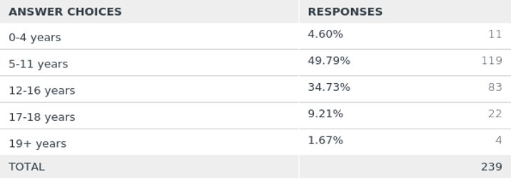
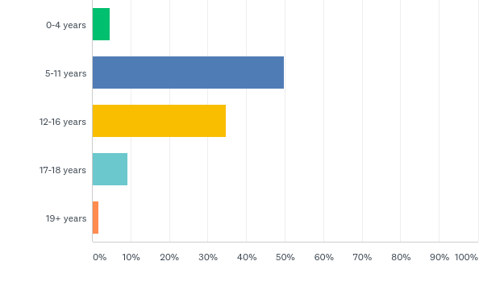
Q26: What age is your child?
Answered: 239 Skipped: 1

Slide 28
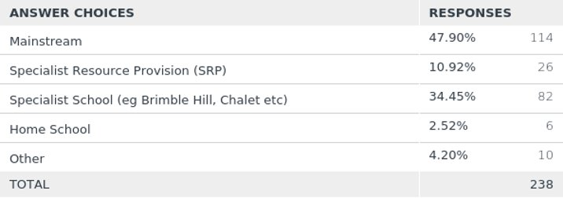
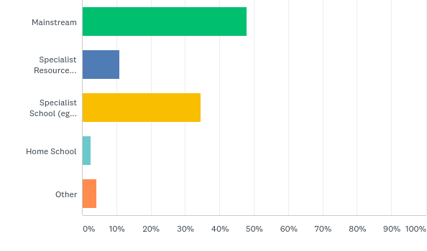
Q27: What is your child's usual educational setting?
Answered: 238 Skipped: 2

Slide 29
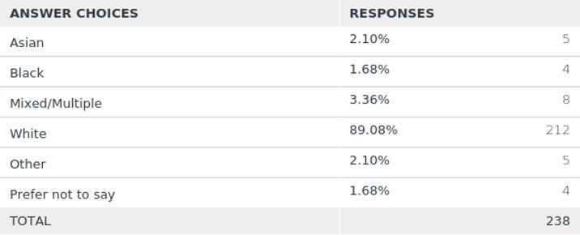
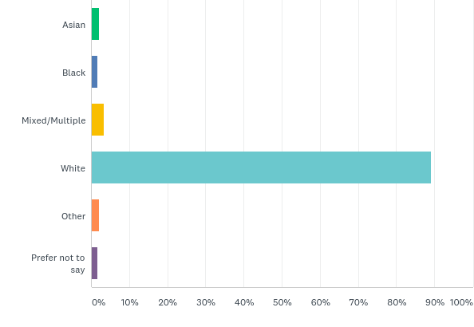
Q28: What is your ethnicity?
Answered: 238 Skipped: 2

Slide 30
Q29: Any other comments?
No. of positive comments - 10 No. of negative comments - 9
“Well done SEND Families voice I feel you’ve handled everything really well, I’ve seen non-stop support online and seen you help those who are truly in need with no-one else to help. You guys are amazing!”
“I think a lot of us have just been left to get on with it with. No one to help me. I just feel tired and sad and just need some rest.”
“I would like to thank my social worker from DCT and also the manager of Hop, Skip and Jump as they have supported me a great deal and it means so much to me.”

