Slide 1


SEND Annual Survey 2020
Martin Bell
29/01/2021
Place photo
No clipart
Performance, Intelligence & Insight

Slide 2
Overview of Consultation
Survey open from 8th October to 14th December 2020
Aim – understand the experience of children and young people and their parents and those who provide and shape services to know if our improvement plan is working
Comparison of responses compared to 2019
Online survey, SBC contact centre, sessions with SEND Families Voice, SENDIASS and STEP
574 responses submitted in the survey period
Performance, Intelligence & Insight

Slide 3
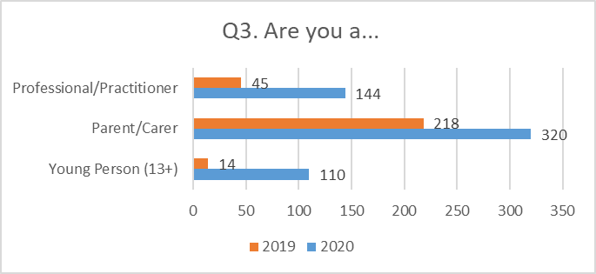
Breakdown of Respondents
Increase in total number of responses from 277 to 574
Performance, Intelligence & Insight

Slide 4
Key Themes – Young People
Teaching Assistants and STEP identified as a good sources of support
Increase in levels of satisfaction with SEND services
Increase in young people not knowing if they have an EHCP
Increase in levels finding that support has improved on last 12 months
Young people would like to be more involved in discussions and for us to check understanding with them. They want services to listen more to them and to work together better by asking questions.
Young people are most concerned about independent living in the future.
Little usage of the Local Offer website by young people
Performance, Intelligence & Insight

Slide 5
Key Themes – Parent/Carers
Stable levels of satisfaction with SEND services however a reduction in the satisfaction of levels of support
Reduction in satisfaction of providing support at right time, mainly linked to a general lack of support, long waiting lists, inaccessible support from TAMHS/CAMHS and length processes/assessments
Reduction in satisfaction that support has improved in the last 12 months
Parents/Carers finding that Schools and SENDCO’s have been the thing that has worked best over the last year. Also an increase in home schooling and elective home education linked to Covid-19
Parent/Carers would like shorter waiting lists and more accessible services. They would like to be listened to more and for there to be better communication between services. They also would like faster, simple and more transparent processes. They feel less listened too in 2020 than in 2019
Parents/Carers most concerned about independent living and social life/relationships
Performance, Intelligence & Insight

Slide 6
Key Themes – Professional/Practitioner
Increase in levels of satisfaction with SEND services and with levels of support for young people.
Also an increase in feeling that we provide the right support at right time – this is in contrast to parents/carers feelings.
Practitioners are finding that waiting times and referrals are too long. Also that complicated procedures clog up the system. They feel that services for SEN support need to be better as the thresholds for some services for EHCP support are too high
Professionals have felt that there has been better joined up working and communication and have adapted well to new working arrangements. Improvements in the statutory services were noted as a result of the restructure
They would like an increase in specialist provision as well as improving processes in the SENAT e.g. responding quicker, more consistent staff, up to date paper work. They would also like referral routes and processes to be improved to reduce paperwork and duplication – this in turn would reduce waiting times
Performance, Intelligence & Insight

Slide 7
Key Themes – Professional/Practitioner
Increase in levels of satisfaction with SEND services and with levels of support for young people.
Also an increase in feeling that we provide trhe right support at right time – this is in contrast to parents/carers feelings.
Practitioners are finding that waiting times and referrals are too long. Also that complicated procedures clog up the system. They feel that services for SEN support need to be better as the thresholds for some services for EHCP support are too high
Professionals have felt that there has been better joined up working and communication and have adapted well to new working arrangements. Improvements in the statutory services were noted as a result of the restructure
They would like an increase in specialist provision as well as improving processes in the SENAT e.g. responding quicker, more consistent staff, up to date paper work. They would also like referral routes and processes to be improved to reduce paperwork and duplication – this in turn would reduce waiting times
Performance, Intelligence & Insight

Slide 8
Young People
Main types of support received:
Teaching Assistant (30)
School / Teacher (22)
Maths and English (4)
Scribe (4)
Extra Time (4)
College (3)
Key Worker (3)
Parents (2)
Speech and language (2)
Reader (2)
Performance, Intelligence & Insight

Slide 9
Young People
Main types of support received:
Doctor / Hospital (17)
Mental health / Counsellor / Psychologist / CAMHS / TAMHS (9)
School / Teacher (6)
Medication (ADHD) (5)
Parents (5)
Keep fit / Exercise (4)
Physio / OT / Physical Therapist (4)
Performance, Intelligence & Insight

Slide 10
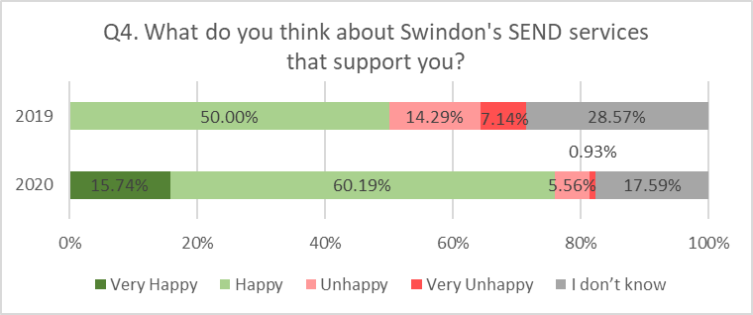
Young People
In 2020, 75.9% of respondents were either Very happy or Happy with support form SEND services. 26% increase of Happy customers since 2019
6.5% of respondents feel Unhappy or Very unhappy – drop from 21.4% since 2019
28.6% of respondents do not have an opinion about SEND services, 11% more than in 2019
Performance, Intelligence & Insight

Slide 11
Young People
Significant proportion of respondents is 15 or younger (71%)
Just 9 out of 108 respondents is 19 or older
Performance, Intelligence & Insight

Slide 12
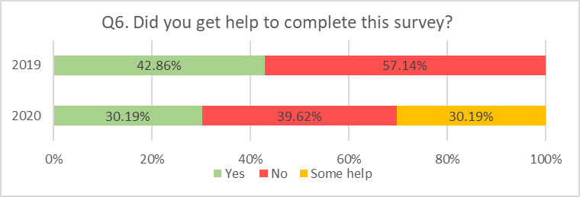
Young People
In 2020, 60.3% of Young People needed help/some help to complete the survey. It is 17.4% more than in 2019 however in 2019, ‘some help’ was not an option.
Performance, Intelligence & Insight

Slide 13
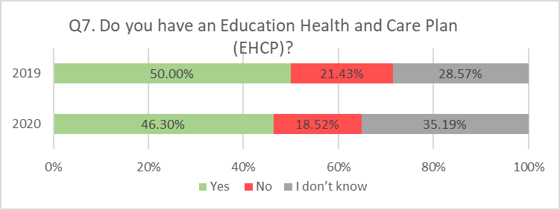
Young People
3.7% decrease of young people with EHCP in 2020
Increase of 6.6% of Young people, who do not know if they have an EHCP
Performance, Intelligence & Insight

Slide 14
Young People
69% of respondents Always or Most of the time receive support at the right time
Performance, Intelligence & Insight

Slide 15
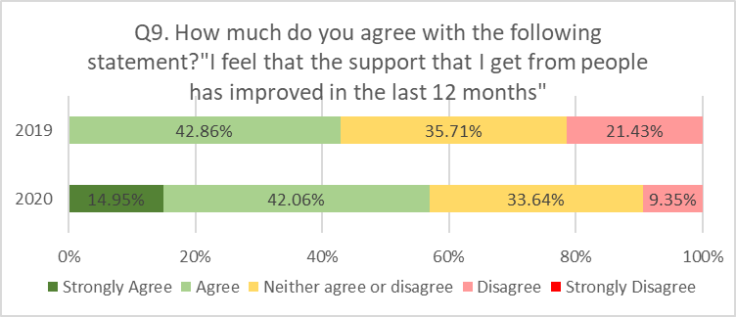
Young People
In 2020, 57% of respondents Agreed or Strongly agreed with the statement above
Significant decrease by 12% of respondents, who Disagreed or Strongly disagreed with the statement, comparing to 2019
Performance, Intelligence & Insight

Slide 16
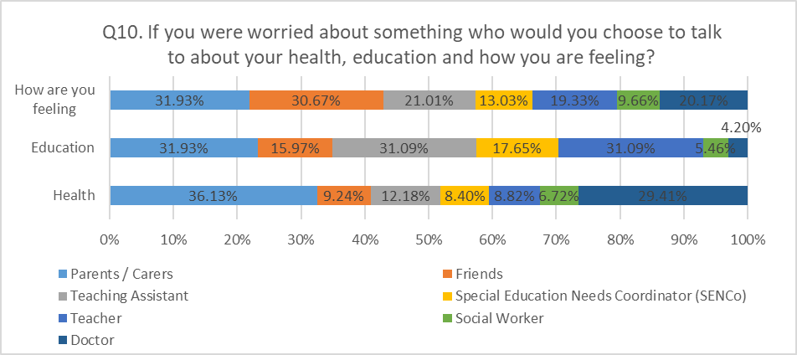
Young People
Young people are more likely to speak to their friends about their feelings than health concerns or educational problems
Every third respondent would speak to parent/carer about feelings, health problems or education worries
Performance, Intelligence & Insight

Slide 17
Young People
What could we do better to involve you?
Check understanding (6)
Not involved in discussions or opinions (6)
Talk to parents (4)
Listen more (4)
Involved in discussions about changes (4)
Talk about other options (2)
Talk more (2)
Performance, Intelligence & Insight

Slide 18
Young People
What could they do better to listen to your ideas?
Services don't listen / needs to change (6)
Services Listen / nothing needs to change (4)
Parents are listened to more than young person (4)
Services need to explain better / check understanding (4)
Don't ask how young person feels / involve them (3)
Performance, Intelligence & Insight

Slide 19
Young People
13. What has worked well for you over the last year? Please tell us about any good support that you have had.
School / College (25)
Teaching Assistant (8)
STEP (7)
Parents / Friends (6)
Medication / Dr (5)
Started a new course / new skills (4)
Support for tests (4)
Counsellor / Mental Health (4)
Talking about feelings (3)
ARC Liberty (2)
Performance, Intelligence & Insight

Slide 20
Young People
14. How could SEND services be better for you - and everyone else in the future?
What could we do better?
More support in school (6)
Communication / Work together more / ask more questions (4)
More activities / social clubs / sports (4)
Listen to young people more (3)
Careers guidance / planning for future (3)
More independence (2)
Wider curriculum / more interesting (2)
Mental Health (2)
Explain things better (2)
Performance, Intelligence & Insight

Slide 21
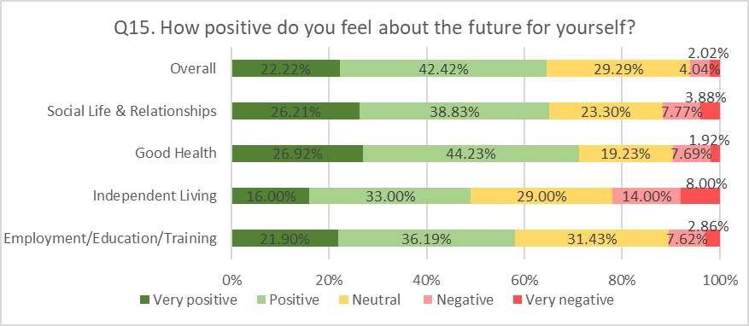
Young People
Young people are more likely to feel positive about their Social Life & Relationships and Good Health (65% or more Very Positive/Positive) than Independent Living (49% Very Positive/Positive)
22% of respondents feel Negative/very Negative about Independent Living, what could be justified by a young age of respondents
Performance, Intelligence & Insight

Slide 22
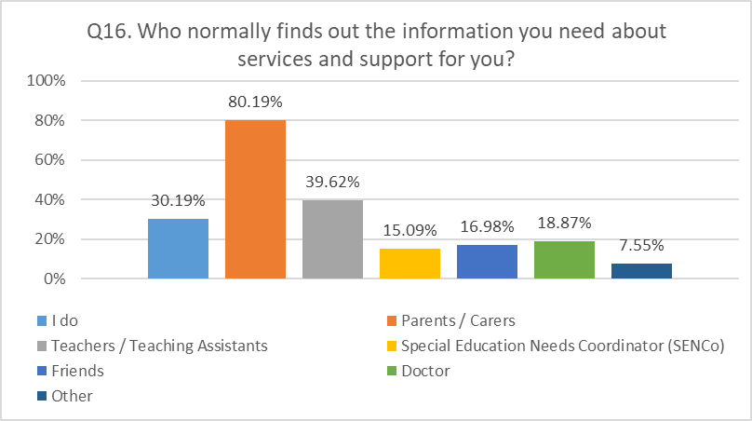
Young People
Majority of Young People get the information about services and support from Parents/Carers and Teachers
30% of respondents independently search the information about SEND support they need
Other: Other member of family (3), STEP (2), Social worker (1)
Performance, Intelligence & Insight

Slide 23
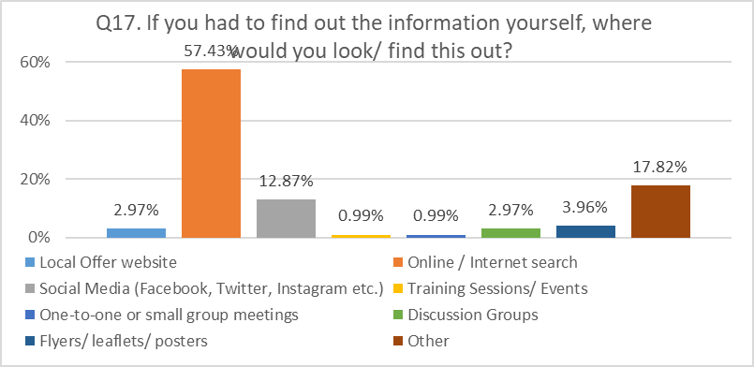
Young People
Majority of Young People find information about services in internet
Other sources of information: Parent/carer (3), Social worker (3), School (3)
Performance, Intelligence & Insight

Slide 24
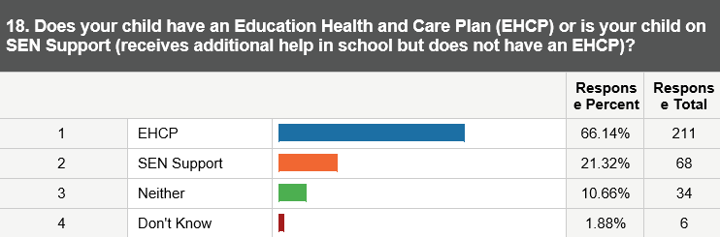
Parent/Carers
Performance, Intelligence & Insight

Slide 25
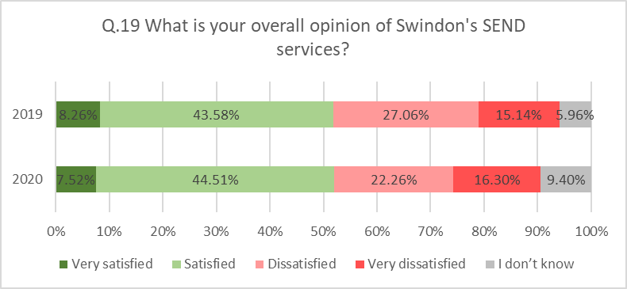
Parent/Carers
In 2019 and 2020 – similar proportion of respondents (52%) was Satisfied/Very satisfied with SEND services
In 2020, 4% less parents were Dissatisfied, Very dissatisfied with SEND services
Performance, Intelligence & Insight

Slide 26
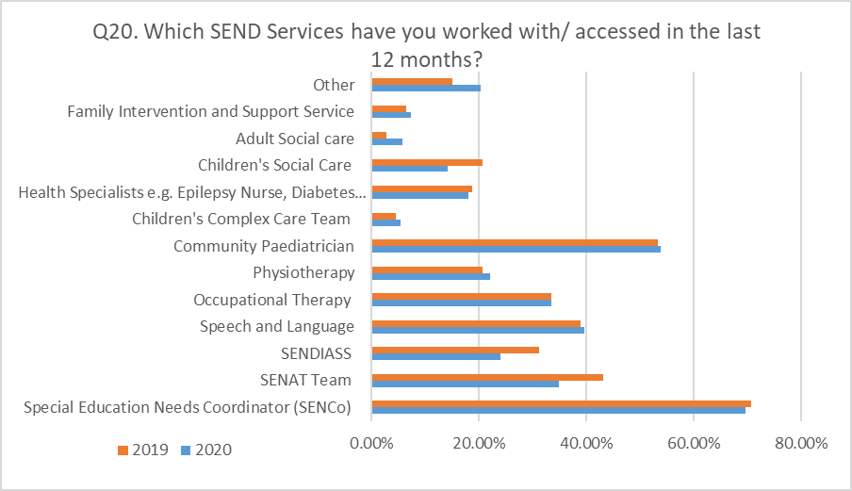
Parent/Carers
Other:
CAMHS (15)
TAMHS (9)
Early help hub (4)
EP (educational psychologist) (3)
Aiming High (3)
Special school (2)
GP (2)
Post adoption support (2)
SSFV (2)
Performance, Intelligence & Insight

Slide 27
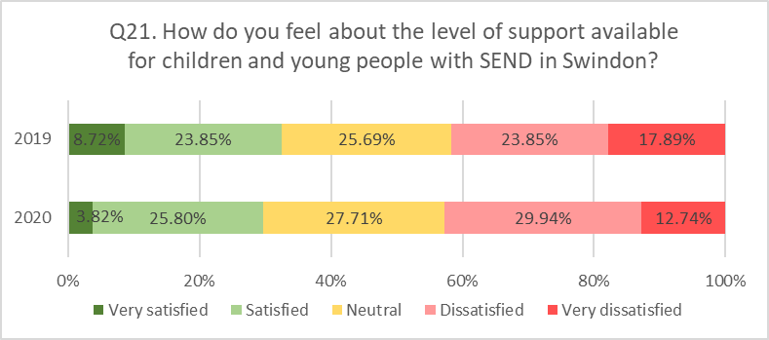
Parent/Carers
In 2020, 4% decrease of parents/carers who are Satisfied or Very satisfied with SEND support
No change in proportion of parents/carers Dissatisfied or Very dissatisfied, in comparison to 2019
Performance, Intelligence & Insight

Slide 28
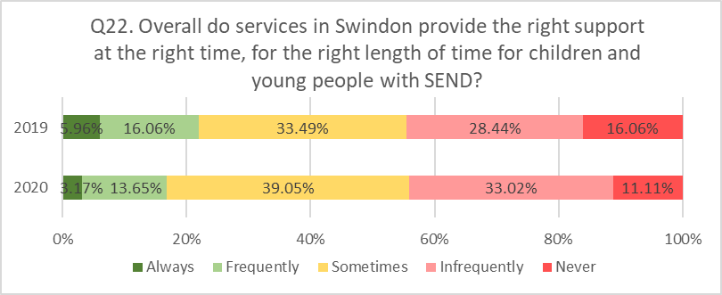
Parent/Carers
Explanations and Examples:
General lack of support(42)
Long waiting lists (38)
Lengthy process/assessment(16)
Lack of support from school(16)
Inaccessible /lack of support from TAMHS,CAMHS(20)
Overall good services/support(9)
Lack of long term support(8)
Lack of information about SEND support(7)
Positive support from SENDCO(7)
Lack of support from SENDCO(7)
Lack of mental health support for a child(6)
Service delays due to Covid (5)
Performance, Intelligence & Insight

Slide 29
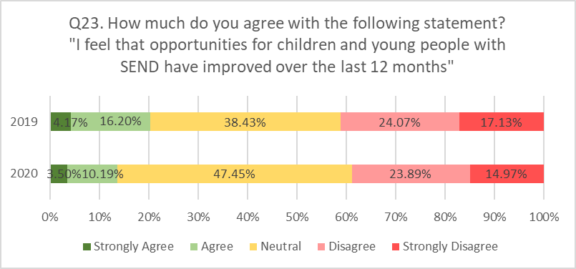
Parent/Carers – Working with you
Increased proportion of respondents with Neutral feelings about statements above by 9%
Less respondents Agree and Disagree with statement, comparing to 2019
Performance, Intelligence & Insight

Slide 30
Parent/Carers – Working with you
Q24. What has worked well for your child over the last 12 months?
Most popular answers:
School (45)
SENCO (28)
Nothing (13)
OT (12)
Home schooling during lockdown (10)
SENDIASS (10)
Starting in specialist provision (9)
Change of school (9)
Elective home education (5)
GP/Hospital/Paedriatric (5)
Lockdown (5)
Speech and Language support (4)
ARC (4)
Learning support (4)
Cooperation with social worker (4)
Physiotherapy (4)
Performance, Intelligence & Insight

Slide 31
Parent/Carers – Communication
Q25. How could SEND services be better for you in the future?
Top suggestions:
Shorter waiting lists (31)
More accessible services (29)
Listen to parents (27)
Better communication with parents/carers (27)
Fast, simple and transparent procedures (21)
More support for parents/carers (18)
More information about services available (16)
More staff/fundings for services and schools (16)
Better trained SEND and school staff (12)
Better communication/coordination between professionals (12)
Be more supportive (10)
More support during lockdown (7)
Performance, Intelligence & Insight

Slide 32
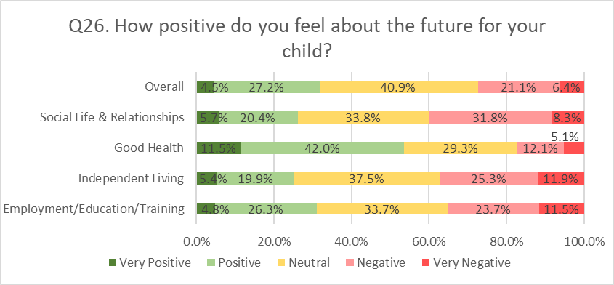
Parent/Carers – Communication
Parents/carers feel more optimistic about children’s Good Health (53.5% Positive/Very positive) than their future Independent Living (25.3% Positive/Very positive)
Social Life & Relationships are main areas of concern about children’s future – 40.1% of respondents feel Negative or Very Negative
Performance, Intelligence & Insight

Slide 33
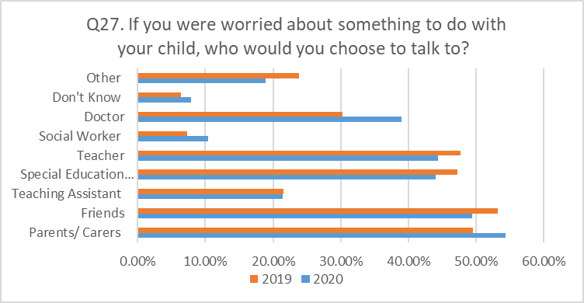
Parent/Carers – Communication
In 2020, more parents would talk to Doctor or Other parents about their concerns
Less parents would talk to Social worker or SENCO (-3% since 2019)
Other responses:
Other professionals (12)
Family (7)
CAHMS (7)
No one (5)
SENDIASS (3)
Performance, Intelligence & Insight

Slide 34
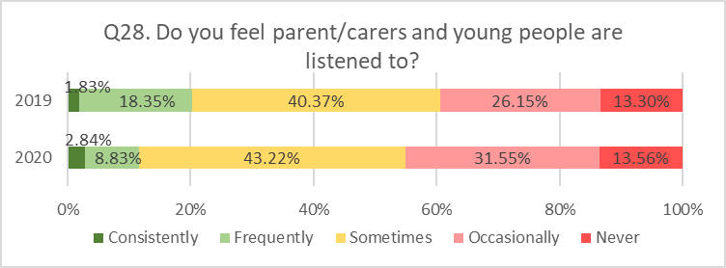
Parent/Carers – Communication
8.4% less parents/carers feel Consistently or Frequently listened to, comparing to 2019 figures
5.6% more parents/carers feel listened Occasionally or Never, in comparison to last year
Performance, Intelligence & Insight

Slide 35
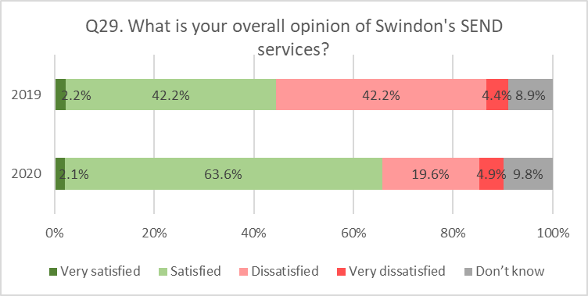
Practitioner/ Professionals - Opinion about SEND Services
Significantly more respondents is Satisfied or Very Satisfied with Swindon SEND Services, comparing to 2019
Percentage of respondents Dissatisfied or Very Dissatisfied in 2020 stays the same as in 2019
Performance, Intelligence & Insight

Slide 36
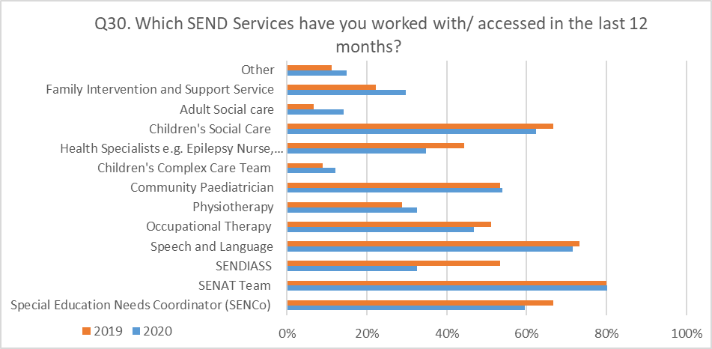
Practitioner/ Professionals
Other Services:
CAMHS / TAMHS (8)
Ed Psych (9)
ASC Outreach (4)
VI and HI Team (3)
Dyslexia service (2)
SEMH Team 2
Performance, Intelligence & Insight

Slide 37
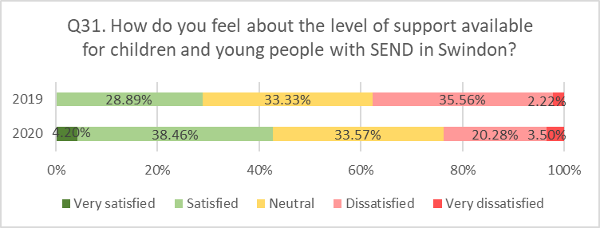
Practitioner/ Professionals
In 2020, significantly more respondents feel Very satisfied or Satisfied about level of support for children with SEND – increase by 13.77%
Performance, Intelligence & Insight

Slide 38
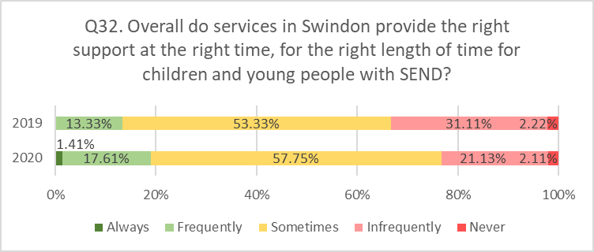
Practitioner/ Professionals
19.02% of professionals think that Children with SEND receive the right support at the right time. That is an increase by 5.69%
Performance, Intelligence & Insight

Slide 39
Practitioner/ Professionals
Q32 - Explanations and Examples:
Waiting /referral times too long (35)
Early intervention and services for SEN support to be better / thresholds for EHCP support to high (13)
Unnecessary referrals / complicated procedures clog system (10)
Insufficient specialist placements / provision (10)
SENAT / Statutory services response not good enough (9)
Pressure on system - budget, understaffed, equipment, caseloads (8)
Unmet SEND needs in schools (quality first teaching, graduated response, , core standards, not inclusive, not using funding) (7)
Inconsistent practice / services 7
Services not taking responsibility for actions (7)
Support ends too soon / not appropriate level (5)
Mental health support only at crisis point / uncoordinated (5)
Performance, Intelligence & Insight

Slide 40
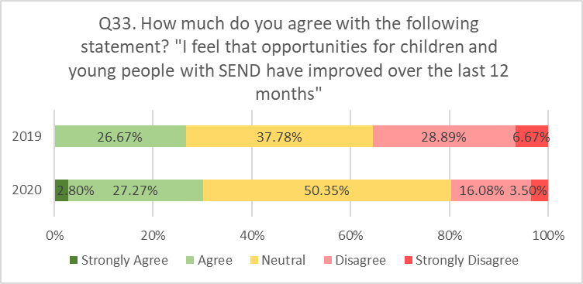
Practitioner/ Professionals
3.4% increase of professionals Agree/Strongly agree with the statement above
Increase of 12.57% of respondents feel Neutral about statement above
Performance, Intelligence & Insight

Slide 41
Practitioner/ Professionals
Q34. What has worked well for your service over the last 12 months?
Joined up working / communication (20)
Adapted working arrangements during lockdown (11)
Support from advisory services e.g. speech and language, SALT (9)
Improvements by statutory service (8)
SEND service restructure (7)
Education Psychology (5)
SENCO feedback (5)
Early Interventions (ELSA) (4)
Simpler templates (3)
Improved EHCP quality (2)
Bespoke support to meet needs (2)
SENDIASS (2)
Transitions (2)
Health support (2)
Training (2)
Performance, Intelligence & Insight

Slide 42
Practitioner/ Professionals
35. How could SEND services be better for you in the future?
Increase specialist provision (12)
Improve SENAT - out of date EHCPs, paperwork not processed, quicker responses (11)
Improve communication / joint working between services (10)
Reduce waiting times (10)
More consistent staff in SENAT (10)
Improve processes / Referral routes / Reduce duplication / paperwork (9)
Listen to young people / their needs (8)
Improve information sharing (7)
Early interventions (6)
Improve opportunities in mainstream settings - alternative curriculums/ more inclusive (6)
Improve social services support (6)
Listen to professionals (5)
Improve consistency in practice (5)
Performance, Intelligence & Insight

Slide 43
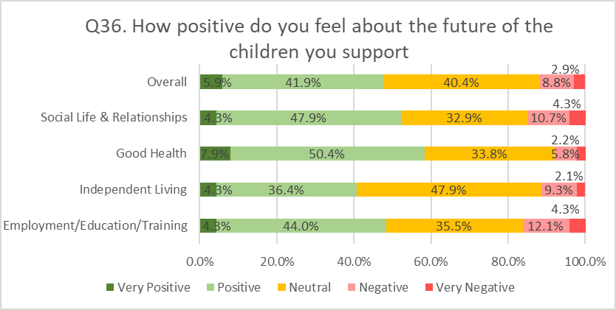
Practitioner/ Professionals
Over 40% of respondents feel Positive or Very positive about the future of children they support, across all type of aspects
At least 1 out of 3 of professionals feel neutral about children’s future
Performance, Intelligence & Insight

Slide 44
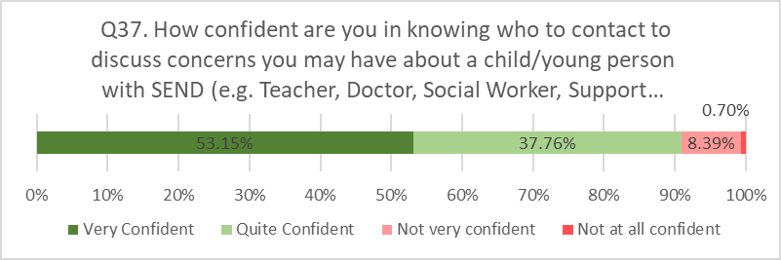
Practitioner/ Professionals
90% of professionals feel Confident or Very confident on who to contact
0.7% - not confident at all
Performance, Intelligence & Insight

Slide 45
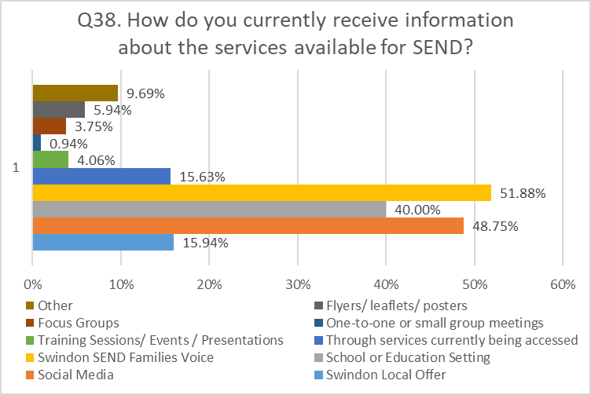
Parent/Carers - Staying Informed
Q38. How do you currently receive information about the services available for SEND? (Tick as many as apply)
Other sources of information:
Don’t receive (12)
Through work (2)
Email (2)
Social media (2)
Internet (1)
Other parents (1)
School (1)
Advocate (1)
Performance, Intelligence & Insight

Slide 46
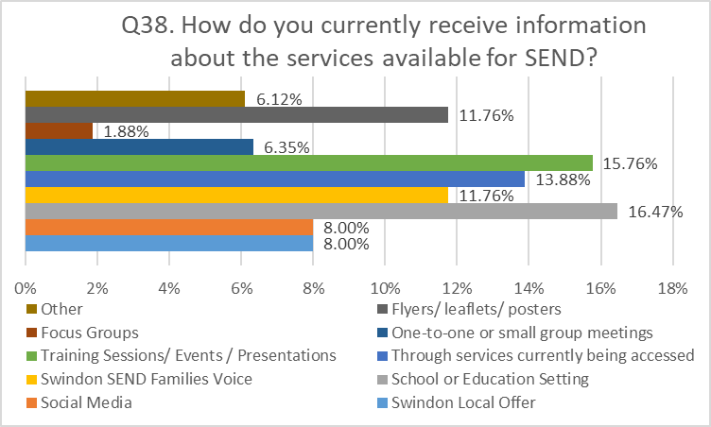
Practitioner/ Professionals - Staying Informed
Q38. How do you currently receive information about the services available for SEND? (Tick as many as apply)
Other sources of information:
SPLASH newsletter (8)
Colleagues/Team network (8)
Email (6)
Word of mouth (4)
EY advisor (1)
Performance, Intelligence & Insight

Slide 47
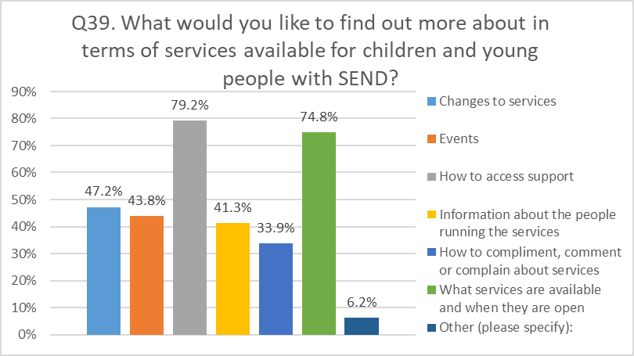
Parents/carers- Staying Informed
Other:
Where to go for help / how to make referrals (4)
Eligibility criteria (2)
Waiting list times (1)
Timeframes to received contact from services (1)
Positive news stories (1)
Training on EHCPS (1)
Performance, Intelligence & Insight

Slide 48
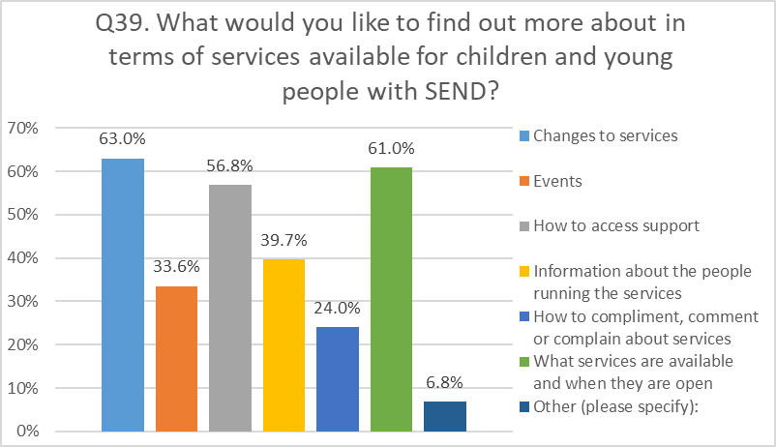
Practitioner/ Professionals - Staying Informed
Other:
Where to go for help / how to make referrals (1)
Eligibility criteria (2)
Waiting list times (1)
Data transparency (1)
Examples of good practice (1)
Performance, Intelligence & Insight

Slide 49
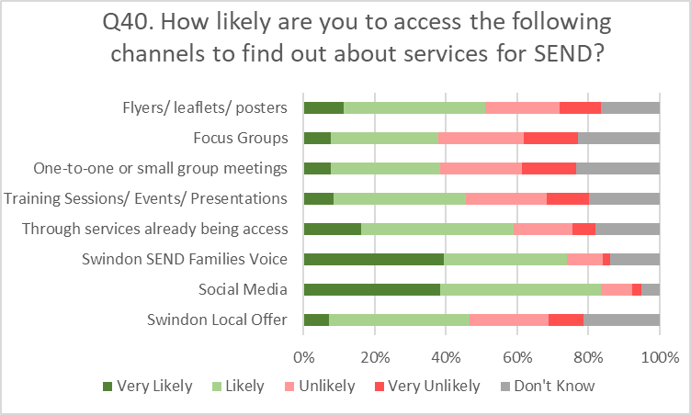
Parents/Carers - Staying Informed
83.4% of Parents/carers are Likely or Very likely to search for information about SEND services via Social Media
Just 1 out of 10 Parents is very likely to get the information during One to One sessions
Performance, Intelligence & Insight

Slide 50
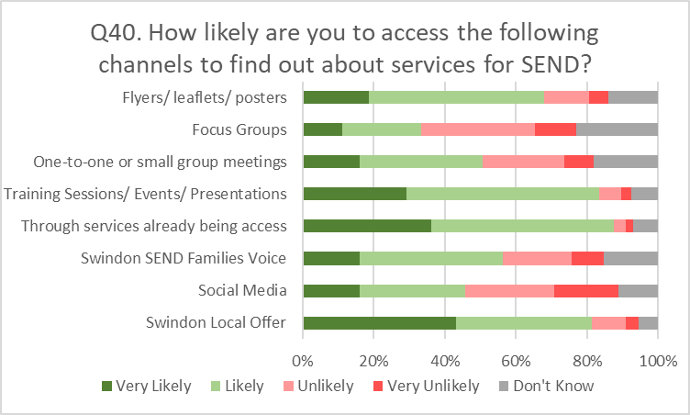
Practitioner/ Professionals - Staying Informed
43.1 % of Professionals are Very likely to get information from Swindon Local Offer (43.1%)
Social media are least popular source of information among Professionals (29.2% Likely or Very unlikely)
Performance, Intelligence & Insight

Slide 51
Thank you
www.swindon.gov.uk
Performance, Intelligence & Insight

