Slide 1
SEND Annual Survey 2022
Performance, Intelligence & Insight
19/01/2023
Place photo
No clipart
Performance, Intelligence & Insight

Slide 2
Overview of Consultation
The aims were to gain insight into the young people, parents/carers and practitioners/professionals who engage with SEND services in Swindon
The survey opened on 27th September and closed on 16th December 2022
363 responses were received in this period
The results have been compared to the results from the previous annual survey in 2021
The questions relating to the pandemic have been removed this year, and some questions have been added
It was an online survey promoted through SEND communications, internal SBC communications, STEP and the Local Offer.
Performance, Intelligence & Insight

Slide 3
Summary – Young People
66 responses, 38 more than last year
More responses, and generally less satisfaction
‘Always’ decreased and ‘Most of the time’ increased
Over 67% feel happy about Swindon's SEND services
A lower percentage felt support has improved over the last 12 months
More young people feel positive about social life and relationships
More young people said they receive Mental Health support and Medication
If worried about health, education and how they are feeling, less people would talk to Social Workers, Teachers, Teaching Assistants, or SENCos
Performance, Intelligence & Insight
Notes:
28 in 2021

Slide 4
Summary – Parent/Carers
205 parents responded, 56 less than last year
Similar results to last year, but generally more positive
More parents are feeling positive or neutral about the future of their child
56% are satisfied that the main education setting meets their child’s needs, and 29% are dissatisfied
Since last year, more parents selected Aiming High and Speech and Language as services they have accessed
Less parents selected SENCo and TAMHS than last year
If they were worried about something to do with their child, they would talk to teachers and doctors more than last year, and SENCo less
Performance, Intelligence & Insight
Notes:
261 in 2021

Slide 5
Summary – Professionals/Practitioners
92 responses, 5 less than last year
Overall more positive results than last year
A higher percentage feel positive about the level of support available, and that opportunities for children have improved over the last year
A higher percentage feel positive about the future of the children they support overall
Less professionals said they work with SENCos and Speech and Language, though these are still the most selected
More professionals said they work with Aiming High than last year
They receive information mostly via Colleagues/Team Network, SEND News Splash and the Swindon Local Offer
Performance, Intelligence & Insight
Notes:
97 in 2021

Slide 6
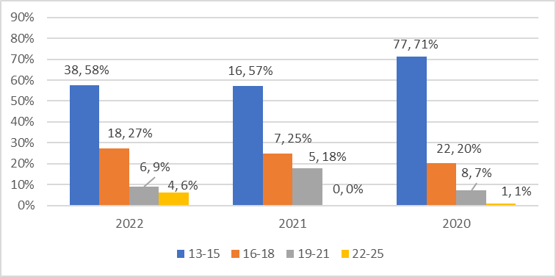
Breakdown of Respondents
363 responses – 23 less than last year (386)
Q1 Are you a…
Young Person: 66 (18%): 38 more than last year (28)
Parents/Carers: 205 (56%): 56 less than last year (261)
Professionals - 92 (25%): 5 less than last year (97)
Q2. What age are you?
Lower % aged 19-21
4 YP aged 22-25

Slide 7
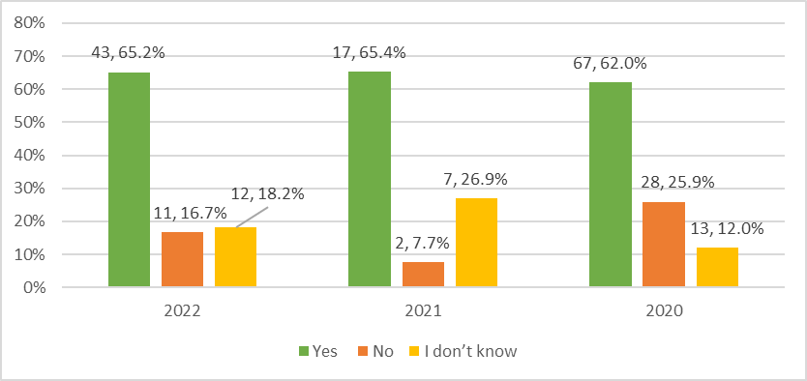
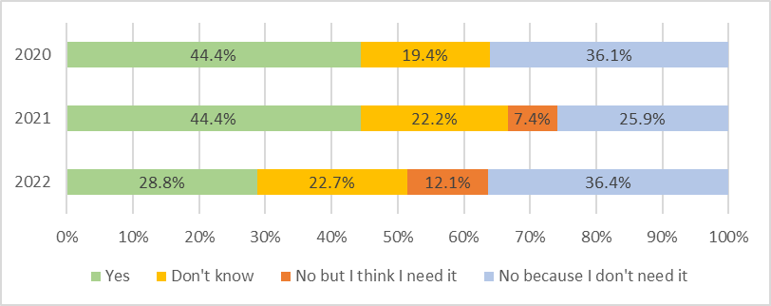
Young People
Q3. Do you receive extra support to help you with your learning / training / employment?
Yes: no change
No +9.0%
I don’t know -8.7%
Q5. Do you receive extra support to help you with your health?
Yes -15.7%
No because I don’t need it +10.4%
Performance, Intelligence & Insight
Notes:
Q5: Total: 66 (27 in 2021).
In 2020 ‘No’ was combined
Yes: 19 (12 in 2021)
No because I don’t need it: 24 (7 in 2021)
No but I think I need it: 8 (2 in 2021)

Slide 8
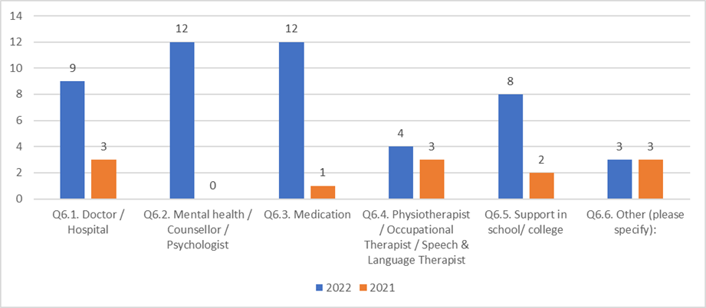
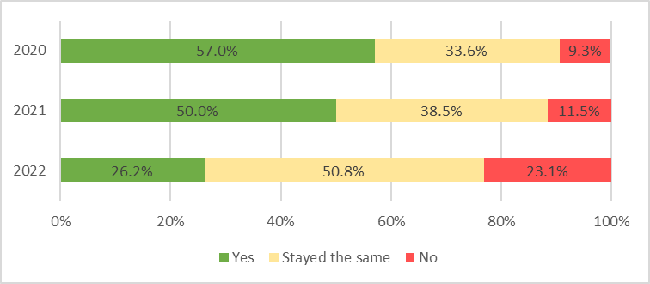
Young People
Q6. If yes, what are the main types of support you receive (select all that apply):
Most support was for Mental Health and Medication
These had the largest increases since 2021
Q7. Do you feel that the support you’ve had from people over the last 12 months has improved?
Yes -23.8%
No +11.5%
Notes:
Q6: Total: 66 in 2022
Q7: No 15 (3 in 2021), Yes 17 (13 in 2021), Stayed the same 33 (10 in 2021)

Slide 9
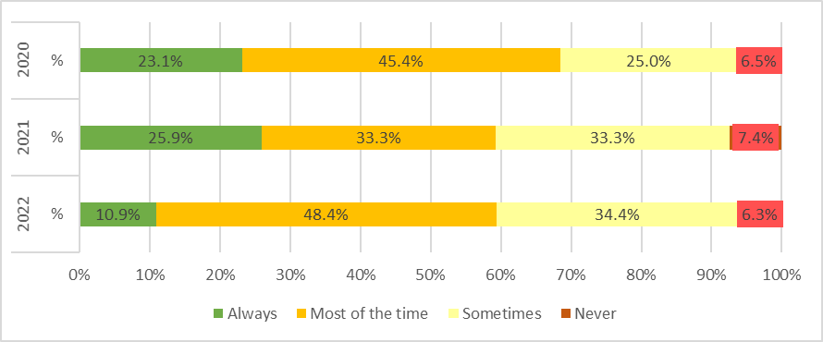
Young People
Q8. When you need help or support with your education, your health or how you are feeling, do you get the right support at the right time?
Always -15.0%
Most of the time +15.01%
Performance, Intelligence & Insight
Notes:
Q8: Total: 64 in 2022; 27 in 2021
Always: 7 (7 in 2021)
Most of the time: 31 (9 in 2021)
Sometimes: 22 (9 in 2021)
Never: 4 (2 in 2021)

Slide 10
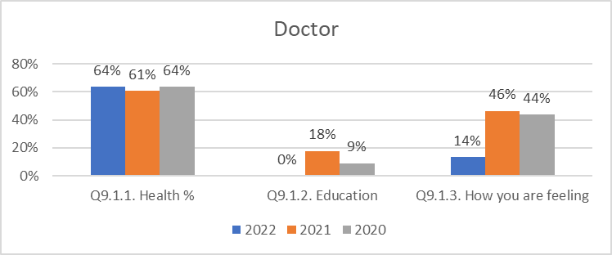
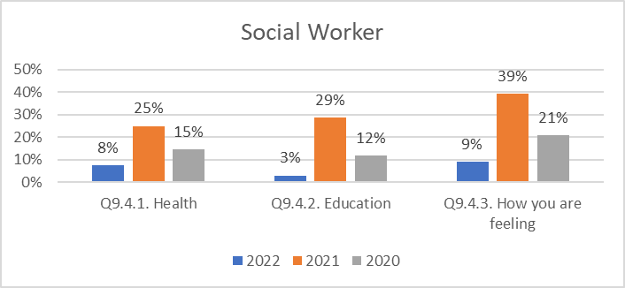
Young People
Q9. If you were worried about something who would you choose to talk to about your health, education and how you are feeling?
Performance, Intelligence & Insight
Notes:
Q9: Total: 66 in 2022; 28 in 2021
Doctor:
Higher % for Health: 42 (17 in 2021)
Lower % for Education: 0 (5 in 2021)
Lower % for How you are feeling 9 (13 in 2021)
Social Worker:
Lower % for Health: 5 (7 in 2021)
Lower % for Education: 2 (8 in 2021)
Lower % for How you are feeling’: 6 (11 in 2021)

Slide 11
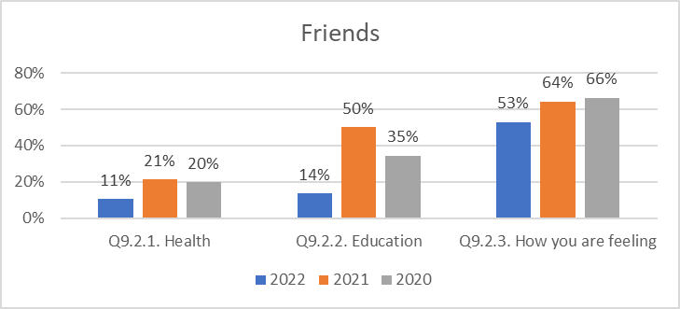
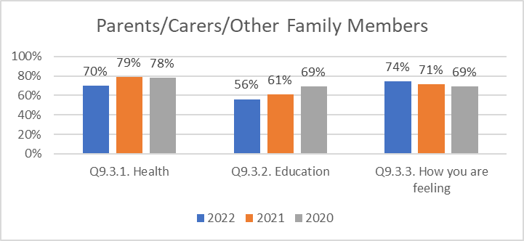
Young People
Q9. If you were worried about something who would you choose to talk to about your health, education and how you are feeling? (you can tick more than one)
Notes:
Total: 66 in 2022; 28 in 2021
Friends:
Lower % for Health: 7 (6 in 2021)
Lower % for Education: 9 (14 in 2021)
Lower % for How you are feeling: 35 (18 in 2021)
Parents/Carers/Family:
Lower % for Health: 46 (22 in 2021)
Lower % for Education: 37 (17 in 2021)
Higher % for How you are feeling: 49 (20 in 2021)

Slide 12
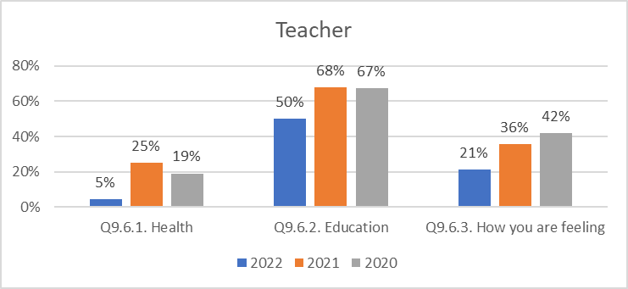
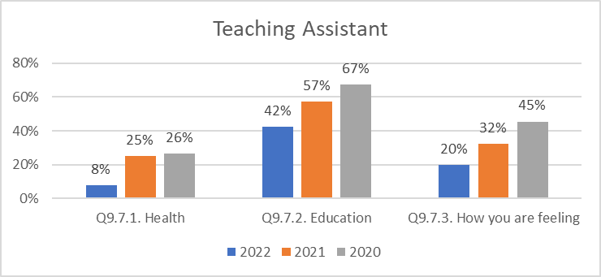
Young People
Q9. If you were worried about something who would you choose to talk to about your health, education and how you are feeling?
Performance, Intelligence & Insight
Notes:
(Total: 66 in 2022; 28 in 2021)
Teacher:
Lower % for Health: 3 (7 in 2021)
Lower % for Education: 33 (19 in 2021)
Lower % for ‘How you are feeling’: 14 (10 in 2021)
Teaching Assistant:
Lower % for Health: 5 (7 in 2021)
Lower % for Education: 28 (16 in 2021)
Lower % for ‘How you are feeling’: 13 (9 in 2021)

Slide 13
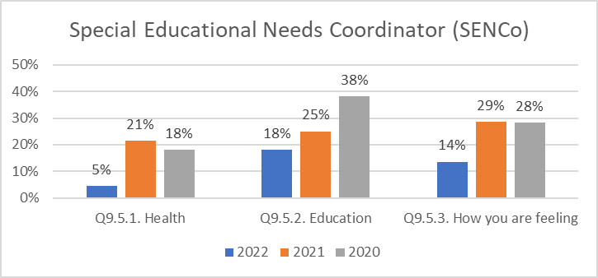
Young People
Q9. If you were worried about something who would you choose to talk to about your health, education and how you are feeling?
Other (New category for 2022):
Health: (4), 6%
Education: (6), 9%
How you are feeling: (13), 20%
Performance, Intelligence & Insight
Notes:
(Total: 66 in 2022; 28 in 2021)
SENCo:
Lower % for Health: 3 (6 in 2021)
Lower % for Education: 12 (7 in 2021)
Lower % for ‘How you are feeling’: 9 (8 in 2021)

Slide 14
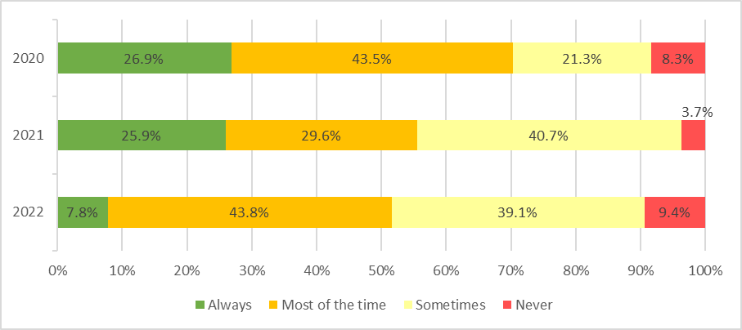
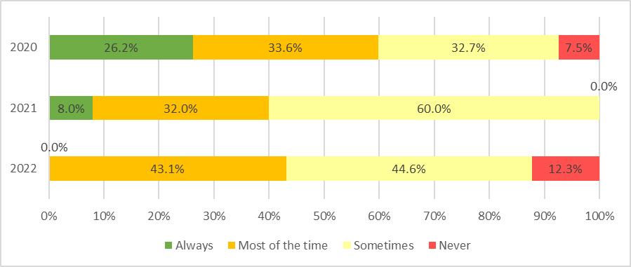
Young People
Q10. Do you feel you are involved in decisions about your life and your future?
Always: -18.1%
Most of the time: +14.1%
Q11. Do you feel that services that support you are interested in what you think about them and use your ideas to help them improve?
Negative changes in the extremes
Most of the time +11.1%
Notes:
Total: 64 responses (27 in 2021)
Q10
Always: 5 (7 in 2021)
Most of the time: 28 (8 in 2021)
Sometimes: 25 (11 in 2021)
Never: 6 (1 in 2021)
Q11
Always: 0 (2 in 2021)
Most of the time: 28 (8 in 2021)
Sometimes: 29 (15 in 2021)
Never: 8 (0 in 2021)

Slide 15
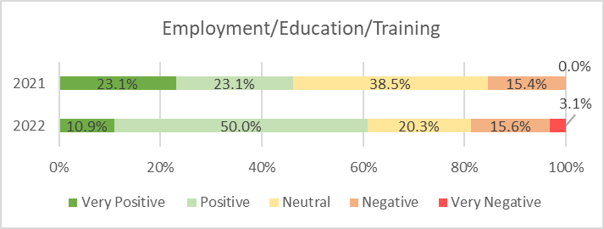
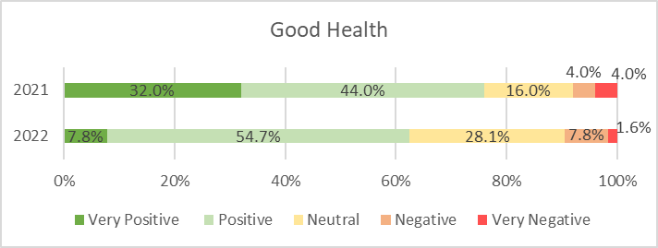
Young People
Q14. How positive do you feel about the future for yourself?
Over 50% Positive for all categories, except Independent Living (45.3%)
‘Very Negative’ selected in each category this year
Notes:
Total respondents 64, 28 in 2021
Totals: Positive + Very Positive, and Negative + Very Negative
Employment/Education/Training:
Positive: 39
Neutral: 13
Negative: 12*
Good Health:
Positive: 40
Neutral: 18
Negative: 6*
*Very Negative: 1 (1 in 2021)

Slide 16
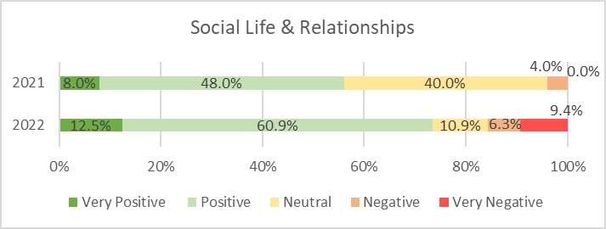
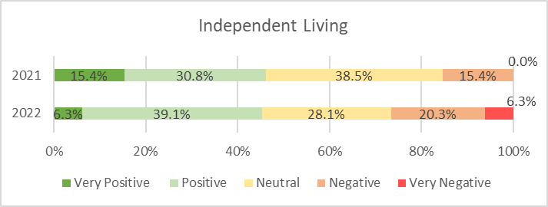
Young People
Q14. How positive do you feel about the future for yourself?
Performance, Intelligence & Insight
Notes:
Total respondents: 64, 28 in 2021
Social Life & Relationships:
Positive: 47
Neutral: 7
Negative: 10*
*Very Negative: 6 (0 in 2021)
Independent Living:
Positive: 29
Neutral: 18
Negative: 17*
*Very Negative: 4 (0 in 2021)

Slide 17
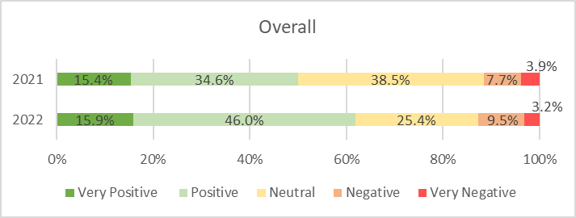
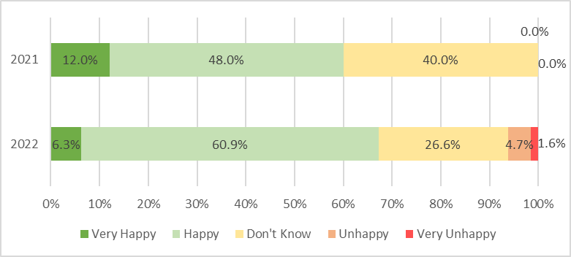
Young People – Overall Opinion
Q14. How positive do you feel about the future for yourself?
Overall:
Positive +11.4%
Q15. Overall, what do you think about Swindon's SEND services that support you?
Happy: +12.9%
Negative changes in extremes
Notes:
Q14 Overall: 63 total respondents
Overall:
Positive: 39
Neutral: 16
Negative: 8*
*Very Negative: 2 (1 in 2021)
Q15 Total: 64 (25 in 2021)
Very Happy: 4 (3 in 2021)
Happy 39: (12 in 2021)
Don’t Know: 17 (10 in 2021)
Unhappy: 3 (0 in 2021)
Very Unhappy: 1 (0 in 2021)

Slide 18
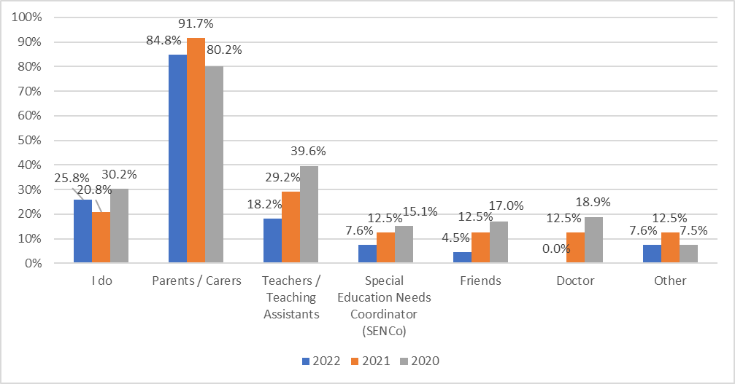
Young People – Staying Informed
Q16. Who normally finds out the information you need about services and support for you?
Q17. If you had to find out the information yourself, where would you look/ find this out?
Online/Internet search (25)
Social Media (Facebook, Twitter, Instagram etc.) (12)
Performance, Intelligence & Insight
Notes:
Q16: 66 responses
‘I do’: 17 (5 in 2021)
Parents/carers: 56 (22 in 2021)
Teachers/TA: 12 (7 in 2021)
SENCo: 5 (3 in 2021)
Friends: 3 (3 in 2021)
Doctor: 0 (3 in 2021)
Q17 Total: 56 responses

Slide 19
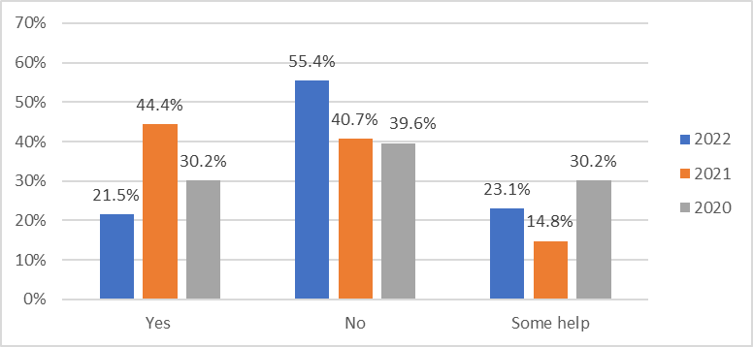
Young People - Communication
Q18. How did you hear about this survey? (New Question)
53 said STEP
Also selected: ‘Parent/Carer/Family’ (6), School/College (5) and Social Media (5)
Q19. Did you get help to complete this survey?
Performance, Intelligence & Insight
Notes:
Q19: Total: 65 responses, 27 in 2021
Lower % said Yes
Higher % said No
Yes: 14 (12 in 2021)
Some help: 15 (4 in 2021)
No: 36 (11 in 2021)

Slide 20
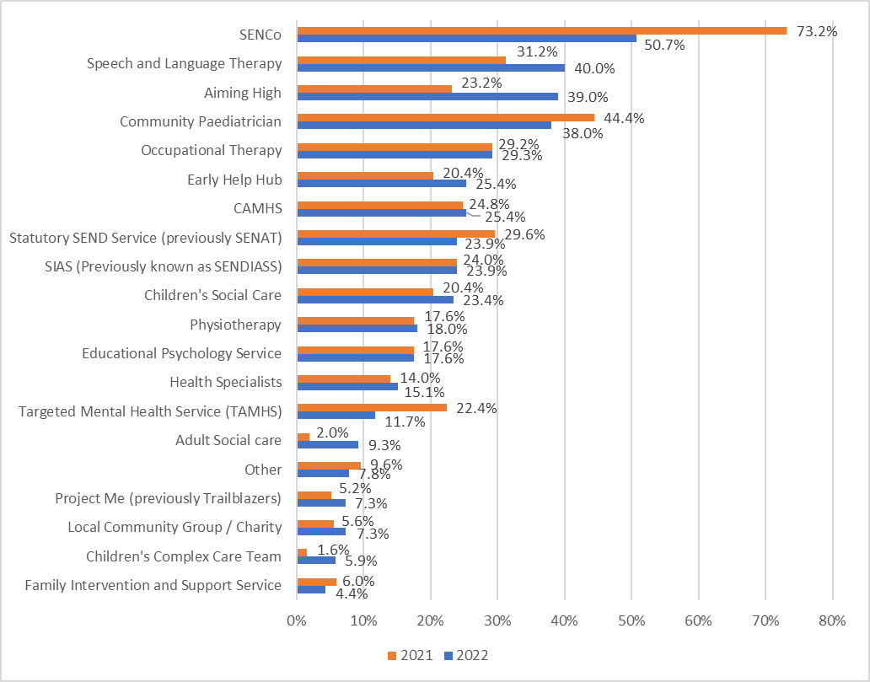
Parents/Carers
Q20. Which SEND Services have you worked with/ accessed in the last 12 months?
Notes:
Total: 205 (250 in 2021)
Most selected services %
SENCo: 104 (183 in 2021)
SALT: 82 (78 in 2021)
Aiming High: 80 (58 in 2021)
Community Paediatrician: 78 (111 in 2021)
Occupational Therapy: 60 (73 in 2021)

Slide 21
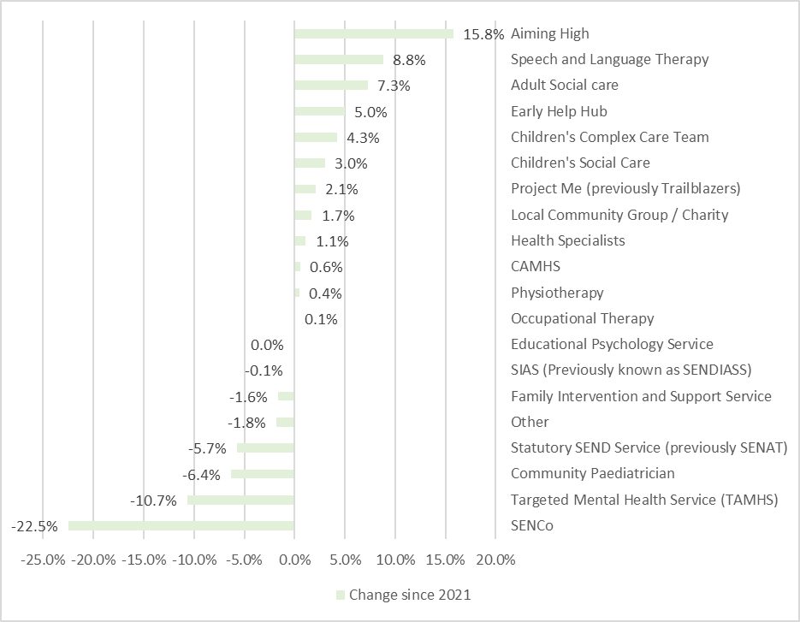
Parents/Carers
Q20. Which SEND Services have you worked with/ accessed in the last 12 months?
Largest increases:
Aiming High: +15.8%
Speech and Language Therapy: +8.8%
Adult Social Care: +7.3%
Largest decreases:
SENCo: -22.5%
TAMHS: -10.7%
Performance, Intelligence & Insight
Notes:
Total: 205 (250 in 2021)
“Project Me” was named Mental Health Trailblazers last year
Greatest % changes since 2021:
SENCo: 104 (183 in 2021)
Aiming High: 80 (58 in 2021)
TAMHS: 24 (56 in 2021)
SALT: 82 (78 in 2021)
Adult Social Care: 19 (5 in 2021)

Slide 22
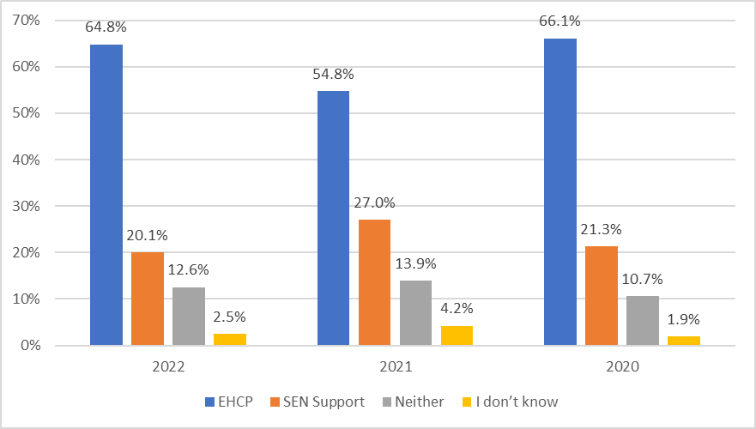
Parents/Carers
Q21. Does your child / young person have an Education Health and Care Plan (EHCP) or is your child / young person on SEND Support (receives additional help in school but does not have an EHCP)?
EHCP: +10.0%
SEN Support: -6.9%
Notes:
Q21 Total 199 (259 in 2021)
EHCP: 129 (142 in 2021)
SEN Support: 40 (70 in 2021)
Neither: -1.3% 25 (36 in 2021)
I don’t know: -1.7% 5 (11 in 2021)

Slide 23
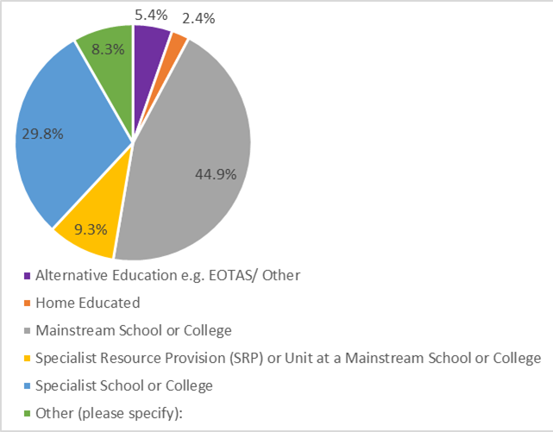
Parents/Carers
New question for 2022
Q22. What is the main educational setting that your child / young person attends?
1. Mainstream School or College: 44.9% (92)
2. Specialist School or College: 29.8% (61)
Other included:
NEET (4)
Preschool/Nursery (4)
Notes:
Q22 Total responses: 205
Mainstream School or College (92, 44.9%)
Specialist School or College (61, 29.8%)
Specialist Resource Provision (SRP) or
Unit at Mainstream School/College (19, 9.3%)
Other (17, 8.3%): NEET (4), Pre-school/ Nursery (4)
Alternative Education EOTAS/Other (11, 5.4%)
Home Educated (5, 2.4%)

Slide 24
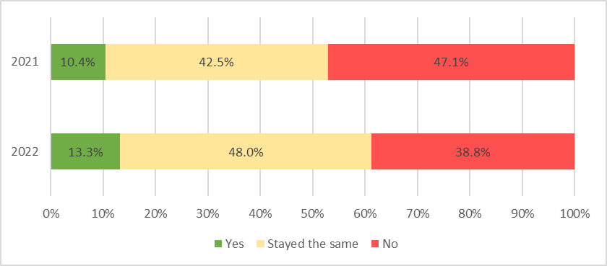
Parents/Carers
New question for 2022
Q23. How confident are you that your child's main education setting meets your child/ young person's needs?
Very satisfied + Satisfied: 55.8%
Dissatisfied + Very dissatisfied: 28.6%
Q24. How much do you agree with the following statement? "I feel that opportunities for children and young people with SEND have improved over the last 12 months"
No % decreased: -8.3%
Notes:
Q23 199 responses
Very satisfied: 40, Satisfied: 71
Neutral: 31
Dissatisfied: 34, Very dissatisfied: 23
Q24: 196 responses
Yes 26 (27 in 2021) +2.8%
Stayed the same 94 (110 in 2021) +5.5%
No 76 (122 in 2021) -8.3%

Slide 25
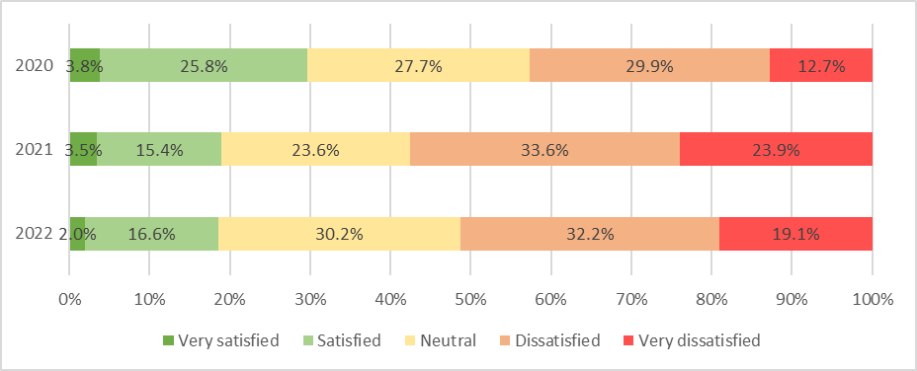
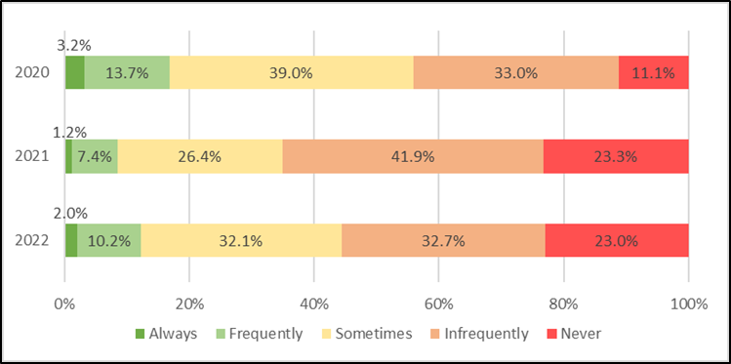
Parents/Carers
Q25. How do you feel about the level of support available for children and young people with SEND in Swindon?
Similar to 2021
Very Negative –4.8%
Q26. Overall do services in Swindon provide the right support at the right time, for the right length of time for children and young people with SEND?
Sometimes +5.8%
Infrequently -9.2%
Notes:
Q25 Total: 199 (259 in 2021)
Very satisfied: 4 (9 in 2021)
Satisfied: 33 (40 in 2021)
Neutral: 60 (61 in 2021)
Dissatisfied: 64 (87 in 2021)
Very dissatisfied: 38 (62 in 2021)
Q26: 196 responses, 258 in 2021
Largest change:
Infrequently: 64 (108 in 2021) -9.2%

Slide 26
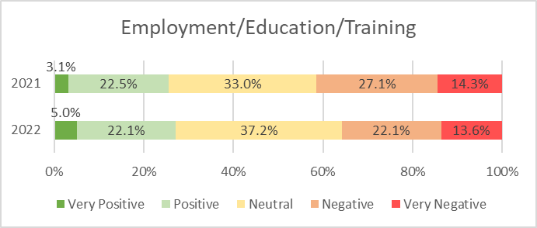
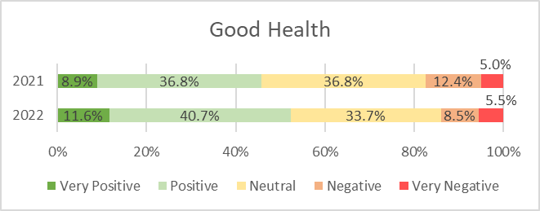
Parents/Carers – Overall Opinion
Q29. How positive do you feel about the future for your child?
Employment
Similar to 2021
Negative -5.0%
Good Health
Over 50% positive for this category
Performance, Intelligence & Insight

Slide 27
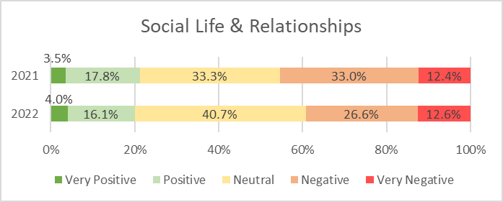
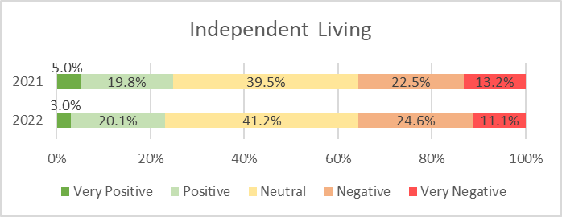
Parents/Carers – Overall Opinion
Q29. How positive do you feel about the future for your child?
Social Life & Relationships
Negative -6.4%
Independent Living
Similar % to 2021
Performance, Intelligence & Insight

Slide 28
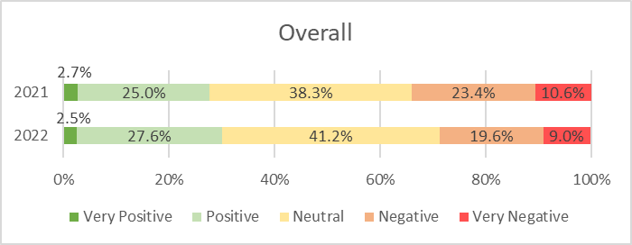
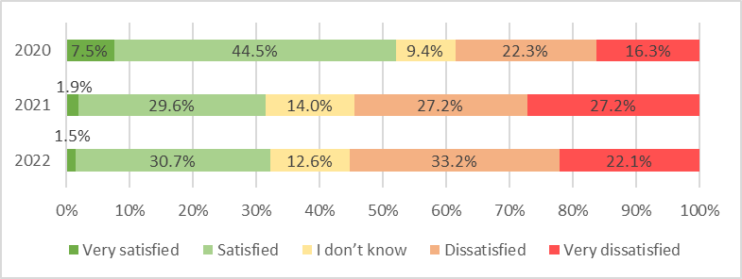
Parents/Carers – Overall Opinion
Q29. How positive do you feel about the future for your child?
Overall
Negative -3.8%
Positive +2.6%
Q30. What is your overall opinion of Swindon's SEND services?
Similar results to 2021 compared with 2020
Very Dissatisfied -5.1%
Dissatisfied +5.9%
Performance, Intelligence & Insight
Notes:
Q29 199 responses
Q30 Total: 199 (257 in 2021)

Slide 29
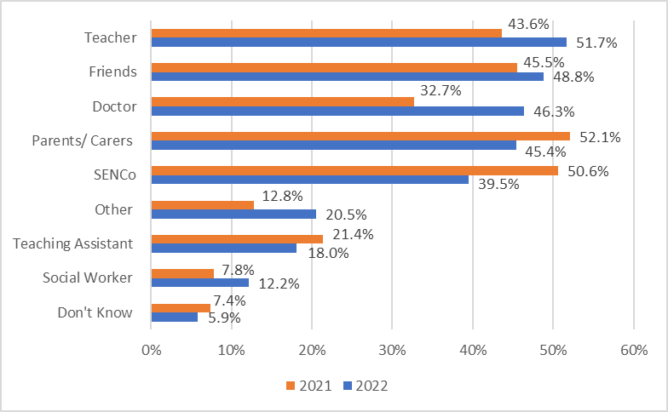
Parents/Carers – Working with you
Q31. If you were worried about something to do with your child, who would you choose to talk to?
Largest % changes:
Teacher +8.1%
Doctor +13.7%
SENCo -11.1%
Performance, Intelligence & Insight
Notes:
Q31: 205 (257 in 2021)
Teacher: 106
Friends: 100
Doctor: 95
Parents/carers: 93
SENCo: 81
Teaching Assistant: 37
Social Worker: 25
Don’t know: 12
Other: 42

Slide 30
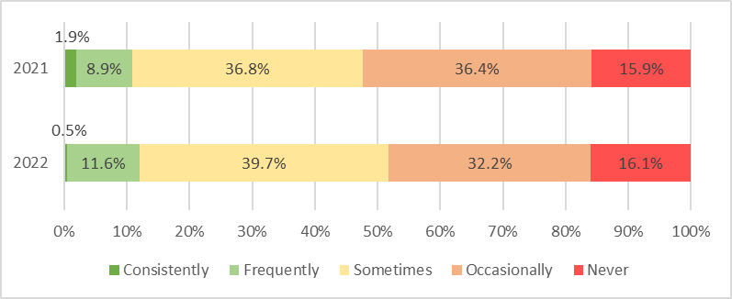
Parents/Carers – Working with you
Q32. Do you feel parent/carers and young people are listened to?
Similar to 2021
More people saying Sometimes +2.9% and Frequently +2.6%
Less people saying Occasionally -4.3%
Performance, Intelligence & Insight
Notes:
Total: 199 (258 in 2021)

Slide 31
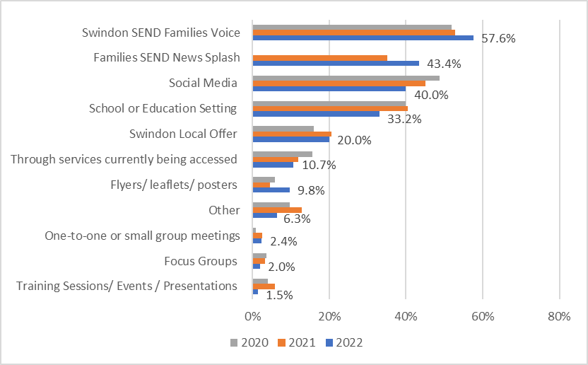
Parents/Carers – Communication
Q42. How do you currently receive information about the services available for SEND?
The same 5 most common categories as 2021
Performance, Intelligence & Insight
Notes:
Total: 205 (242 in 2021)
Same 5 most common as 2021:
SEND Families Voice (52.9%)
Social Media (45.0%)
School or Education Setting (40.5%)
SEND News Splash (35.1%)
Local Offer (20.7%)

Slide 32
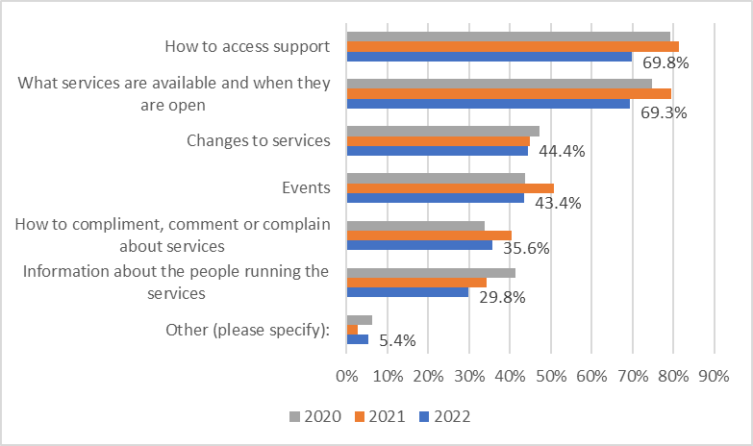
Parents/Carers - Staying Informed
Q43. What would you like to find out more about in terms of services available for children and young people with SEND?
Performance, Intelligence & Insight
Notes:
Q43 Total: 205 responses

Slide 33
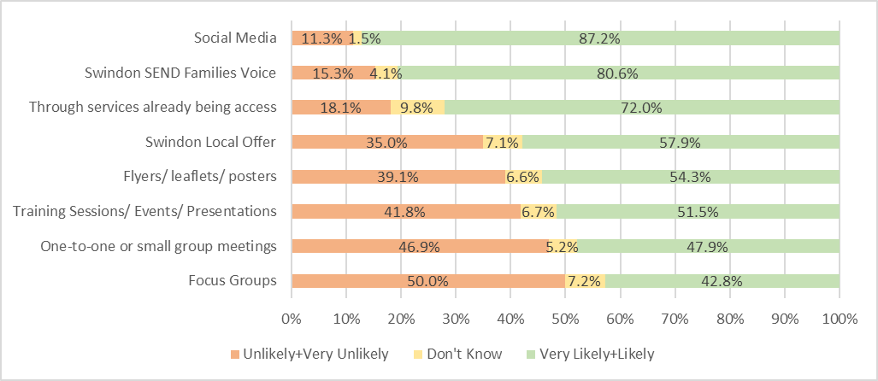
Parents/Carers - Staying Informed
Q44. How likely are you to access the following channels to find out about services for SEND?
Same top 3 rank in 2021
Performance, Intelligence & Insight
Notes:
Q44 197 responses

Slide 34
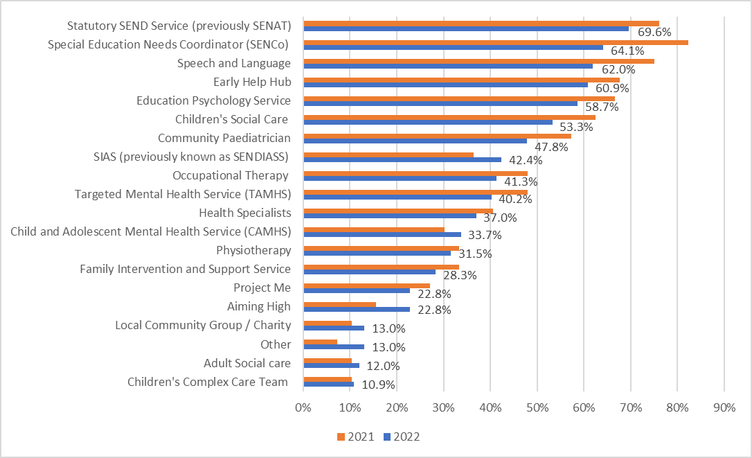
Practitioners/Professionals
Q33. Which SEND Services have you worked with/ accessed in the last 12 months?
SENCo
-18.2%
Speech & Language -13.0%
Aiming High +7.2%
Notes:
92 professionals responded, compared to 96 in 2021
”Project Me” – last year was “Mental Health Trailblazers”
The largest decreases were:
SENCo (59) -20
Speech and Language (57) -15
The largest increase was:
Aiming High (21) +6

Slide 35
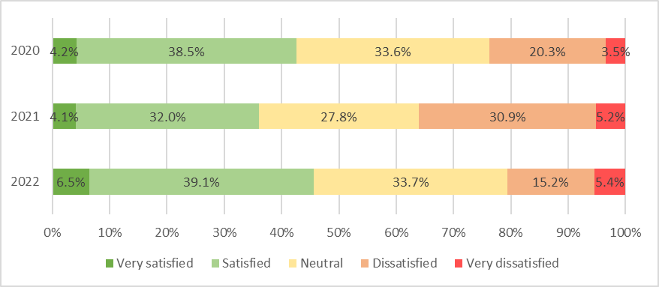
Practitioners/Professionals
Q34. How do you feel about the level of support available for children and young people with SEND in Swindon?
Dissatisfied -15.7%
Neutral +5.9%
Satisfied +7.2%
Performance, Intelligence & Insight
Notes:
Q34: 92 responses, 97 responses in 2021
Very Satisfied: 6 (+2)
Satisfied: 36 (+5)
Neutral: 31 (+4)
Dissatisfied: 14 (-16)
Very Dissatisfied: 5 (no change)

Slide 36
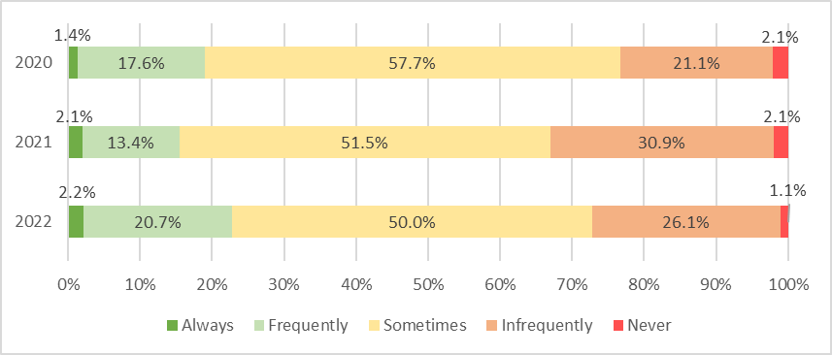
Practitioners/Professionals
Q35. Overall do services in Swindon provide the right support at the right time, for the right length of time for children and young people with SEND?
Frequently +7.3%
Infrequently -4.8%
Performance, Intelligence & Insight
Notes:
Q35: 92 in 2022, 97 in 2021
Always: 2 (no change)
Frequently: 19 (+6)
Sometimes: 46 (-4)
Infrequently: 24 (-6)
Never: 1 (-1)

Slide 37
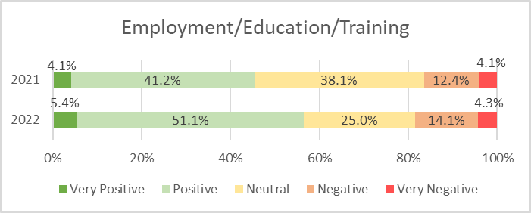
Practitioners/Professionals
Q38. How positive do you feel about the future of the children you support?
Increase in Positive % for every category
Employment/Education/Training
Over 50% Positive
Positive +9.8%
Neutral -13.1%
Performance, Intelligence & Insight

Slide 38
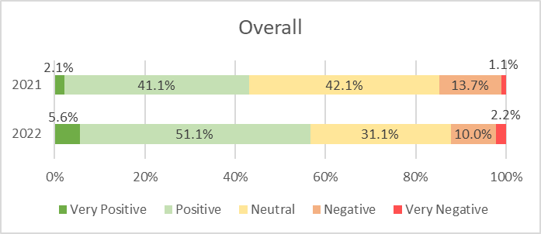
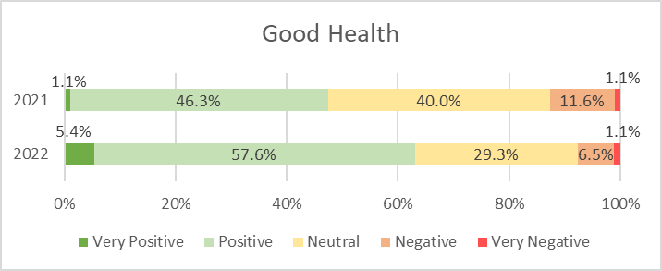
Practitioners/Professionals
Q38. How positive do you feel about the future of the children you support?
Overall
Over 50% Positive
Neutral -11.0%
Positive +10.1%
Good Health
Over 50% Positive
Positive +11.3%
Neutral –10.7%

Slide 39
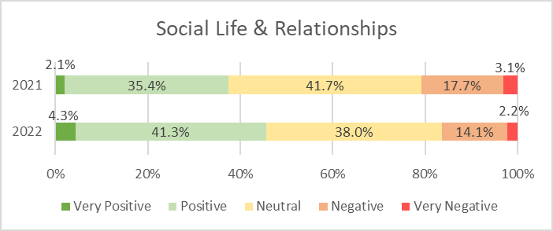
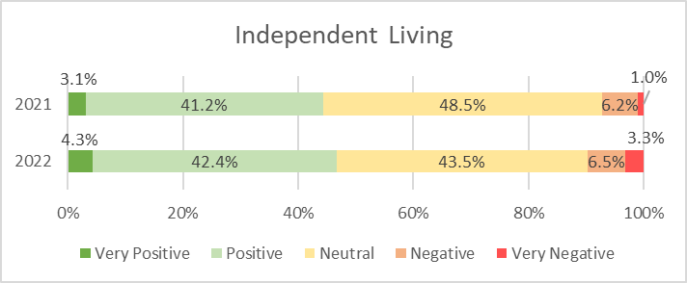
Practitioners/Professionals
Q38. How positive do you feel about the future of the children you support?
Social Life & Relationships
Positive shift
Positive +5.9%
Independent Living
Changes to extremes
Similar to 2021
Neutral -5.0%
Performance, Intelligence & Insight

Slide 40
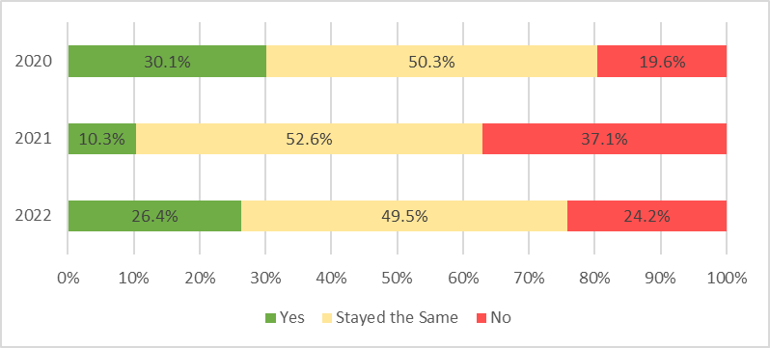
Practitioners/Professionals
Q39. How much do you agree with the following statement? "I feel that opportunities for children and young people with SEND have improved over the last 12 months"
Yes +16.1%
No -12.9%
Performance, Intelligence & Insight
Notes:
Q39 Total: 91 (97 in 2021)
Around half said opportunities have Stayed the Same (45)
Over a quarter said Yes (24)
Less than a quarter said No (22)

Slide 41
Practitioners/Professionals – Opinion of SEND Services
Q40. What is your overall opinion of Swindon's SEND services?
Positive shift
Very Satisfied +3.3%
Satisfied +15.1%
Dissatisfied -8.6%
Very Dissatisfied –7.0%
Performance, Intelligence & Insight
Notes:
Compared to 2021. Total: 92 in 2022, 97 in 2021

Slide 42
Practitioners/Professionals – Communication
Q41. How confident are you in knowing who to contact to discuss concerns you may have about a child/young person with SEND?
Very Confident +7.6%
Quite Confident -8.1%
No change for:
Not very confident
Not at all confident
Performance, Intelligence & Insight
Notes:
Total: 92 (97 in 2021)
Very Confident (43) +5
Quite Confident (40) -10
Not very confident (8) no change
Not at all confident (1) no change

Slide 43
Practitioners/Professionals – Staying Informed
Q45. How do you currently receive information about the services available for SEND?
Largest increases:
Flyers/leaflets/ posters +33.6%
Colleagues/ Team Network +30.5%
SEND Families Voice +21.2%
Performance, Intelligence & Insight
Notes:
Totals 2022: 92; 2021: 97

Slide 44
Practitioners/Professionals – Staying Informed
Q46. What would you like to find out more about in terms of services available for children and young people with SEND?
Performance, Intelligence & Insight

Slide 45
Practitioners/Professionals – Staying Informed
Q47. How likely are you to access the following channels to find out about services for SEND?
Performance, Intelligence & Insight

Slide 46
Thank you
www.swindon.gov.uk
Performance, Intelligence & Insight

